Slide 1
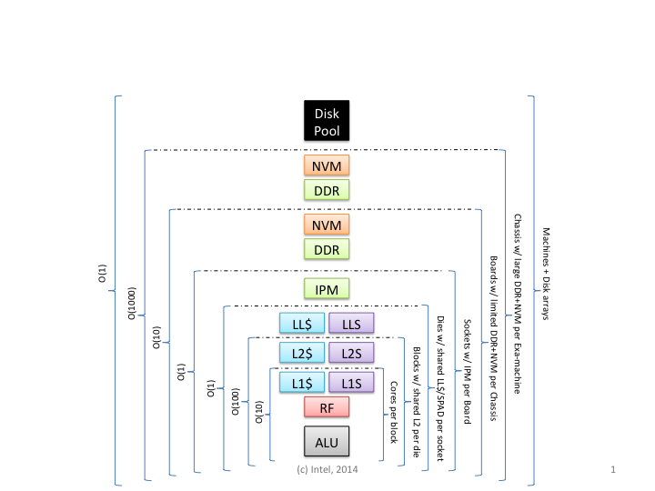
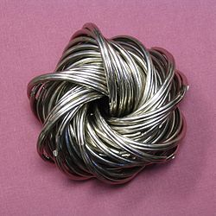
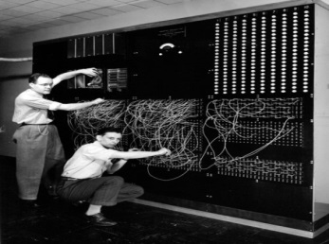
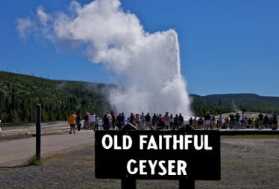
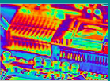
X-Stack PI Meeting, Breakout Group 1 report “Future synergies in programming systems for data-intensive and compute-intensive science” Moderator: Vivek Sarkar, Rice University
Parallelism
Data Movement
Programmability
Resiliency
Energy Efficiency
Deep Memory Hierarchies

Slide 2
Participants
Max Grossman - Rice U
Ron Brightwell - Sandia
Bala Seshasayee - Intel
Milind Kulkarni - Purdue University
Peer-Timo Bremer - LLNL
John Wu - LBNL
Yili Zheng - LBNL
Ray Chen - University of Maryland
Armando Solar-Lezama - MIT
Jayashree Ajay Candadai - Indiana University
Riyadh Baghdadi - MIT
Arun Prakash - Purdue
Aiman Fang - UChicago
Nathan Tallent - Pacific Northwest National Lab
David Bernholdt - ORNL
Brian Van Straalen - LBNL
Roger Golliver - Rice U
Scott Baden – LBNL/UCSD

Slide 3
Breakout Summary (1/2)
There are natural opportunities for synergy among the challenges facing data-intensive and compute-intensive science, and advances in both are necessary for next-generation scientific breakthroughs. Data-intensive science involves the collection, analysis and management of massive volumes of data from experimental/observational facilities as well as large volumes of distributed sensors. Compute-intensive science involves the execution of computational science workflows with large-scale simulations on high-end computing facilities. It is clear that these two classes of scientific endeavors need to work more synergistically, so that (for example) the latest compute-intensive technologies can be employed to enable data analytics on the scales required for data-intensive science, and the latest data science algorithms can be employed to integrate in-situ analyses into compute-intensive workflows. These synergies are already being realized in the commercial world, where high-end computation capabilities are delivered as cloud computing resources to perform machine learning and other forms of predictive analytics on massive volumes of data in a unified ecosystem.

Slide 4
Breakout Summary (2/2)
A major obstacle to realizing this kind of synergy in scientific discovery is the current divergence in the programming systems and software stacks used for data-intensive and compute-intensive science. The software ecosystem for data-intensive science is exemplified by the need for near-real-time analysis to support steering of experiments, as well as analysis technologies built on frameworks using programming languages such as Python, R, Java, and Scala. In contrast, the software ecosystem for compute-intensive science is exemplified by programming languages such as C, C++, and Fortran, combined with numerical libraries and frameworks built on MPI. The importance of bringing these two ecosystems together in the future is widely recognized, as data-intensive science becomes increasingly compute-intensive, and compute-intensive science becomes increasingly data-intensive. How can we overcome the current divergence in programming systems and software stacks to realize these synergies? What are the key software elements that could help bridge between data-intensive and compute-intensive science in the future?

Slide 5
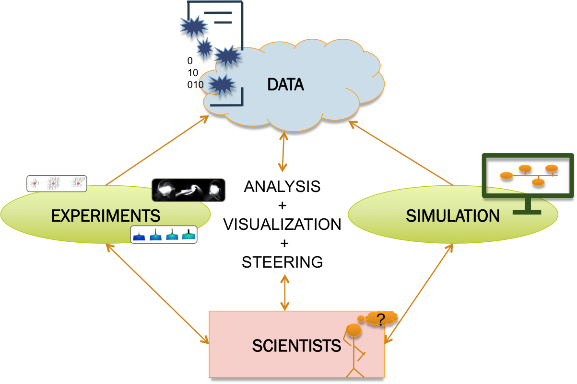
Context: Science Workflows

Slide 6
Challenge & Opportunity #1
HPC data models and implementations
Need to bridge between data structures and data formats used in simulation and analytics applications
Need for different implementations of data model at different levels of system hierarchy and different stages of science workflow
Need to optimize data interchange among different software stacks (e.g., in-situ, without need for data copying or transformation)
➔ Research opportunity: enable consistency in data models with high performance and scalability across different software stacks and different levels of system hierarchy

Slide 7
Challenge & Opportunity #2
Programming system support for tight (in-situ) integration of simulations and analytics
Space-time composition of simulation and analytics models
Analytics developers are accustomed to using declarative programming models with managed runtimes
Need for co-design/collaboration among developers of HPC simulation and analytics applications
➔ Research opportunity: enable HPC programming systems for integrated development of simulations and analytics components of science workflow

Slide 8
Challenge & Opportunity #3
Addressing new scalability and performance bottlenecks in data-intensive + compute-intensive workloads
Coping with new hardware technologies in interconnect, memories, I/O
Need for optimization of high level data abstractions
Need for optimization of locality in workflow
Separation of functional and performance aspects of simulation & analytic applications
Tuning hints should only impact performance not functionality
➔ Research opportunity: address new scalability and performance bottlenecks in simulation & analytics applications

Slide 9
Challenge & Opportunity #4
Customized software stacks and Facility allocation policies for Science workflows
Docker containers are evidence that HPC apps need customized software stacks
Need for scalable data sharing across these software stacks with minimal copying/transformation/movement, but that also depends on facility allocation policies
Need for motifs in data-intensive computing, akin to motifs for compute-intensive computing
➔ Research opportunity: integration of workflow-level customized software stacks with scalable data sharing

Slide 10
Examples of Best Practices in exploiting synergies in data-intensive and compute-intensive applications
Streaming
Data staging
In-situ analytics in simulations
In-situ analytics at experimental facilities
e.g., ADARADA streaming data system provides in-situ reduction of data generated from SNS
Use of declarative languages for analytics applications for high productivity
Tailoring solutions to data-intensive workloads at different levels of system hierarchy

Slide 11
Summary
Exploiting synergies between data-intensive and compute-intensive computations is critical for future HPC applications
Early experiences point to potential benefits
Multiple research opportunities, including:
HPC data models and implementations
Programming systems for integration of simulations and analytics
Addressing new scalability and performance bottlenecks
Scalable integration of customized software stacks for science workflows

