Slide 1
X-Stack, Traleika Glacier (XSTG)
Three-year project results and products, including Intel, Rice, UCSD, PNNL, UIUC, Reservoir Labs, & Eqware
Shekhar Borkar, Josh Fryman
&
The TG Team
This work funded in part by US Government Contracts No.# 7078611, 7216501 and B608115.

Slide 2
Outline
Overview of extreme-scale programs
Architecture & software stack
Results of Tools and Applications
Community Responses
Report Card
Future Work

Slide 3
Top Extreme-scale Challenges
System Power & Energy (Exascale in 20 MW)
New, efficient, memory subsystem (BW, latency, capacity, cost)
Extreme parallelism O(Billion) (productivity, legacy)
New execution model (introspection, event-driven)
Resiliency to provide system reliability (>> 6 days)
$ Cost and affordability by enhancing system-efficiency

Slide 4
Extreme-Scale Programs for Ubiquity
Node architecture, local interconnect,
Complete node design P0
Ready for fabrication
System interconnect technologies
System integration
Research
Basic HW & SW technologies
2010 |  | 2011 |  | 2012 |  | 2013 |  | 2014 |  | 2015 |  | 2016 |  | 2017 |  | 2018 |  | 2019 |  | 2020 |  | 2021 |  | 2022 |  | 2023
 | UHPC
 |  |  |  |  | FF1 |  |  |  | FF2
 |  |  |  |  | X-Stack
 |  |  |  |  |  |  |  | DF1
 |  |  |  |  |  |  |  |  |  |  |  | P0/P1 New ECP Program
 |  |  |  |  |  |  |  |  |  |  |  |  |  |  |  | Product Development
 |  |  |  |  |  |  |  |  |  |  |  |  |  |  |  |  |  |  |  |  |  |  |  | Exascale
SW Stack
PGM system, System SW, Apps
Mature technologies
Prototype HW
Prototype SW stack
Evaluate applications
Influence product direction

Slide 5
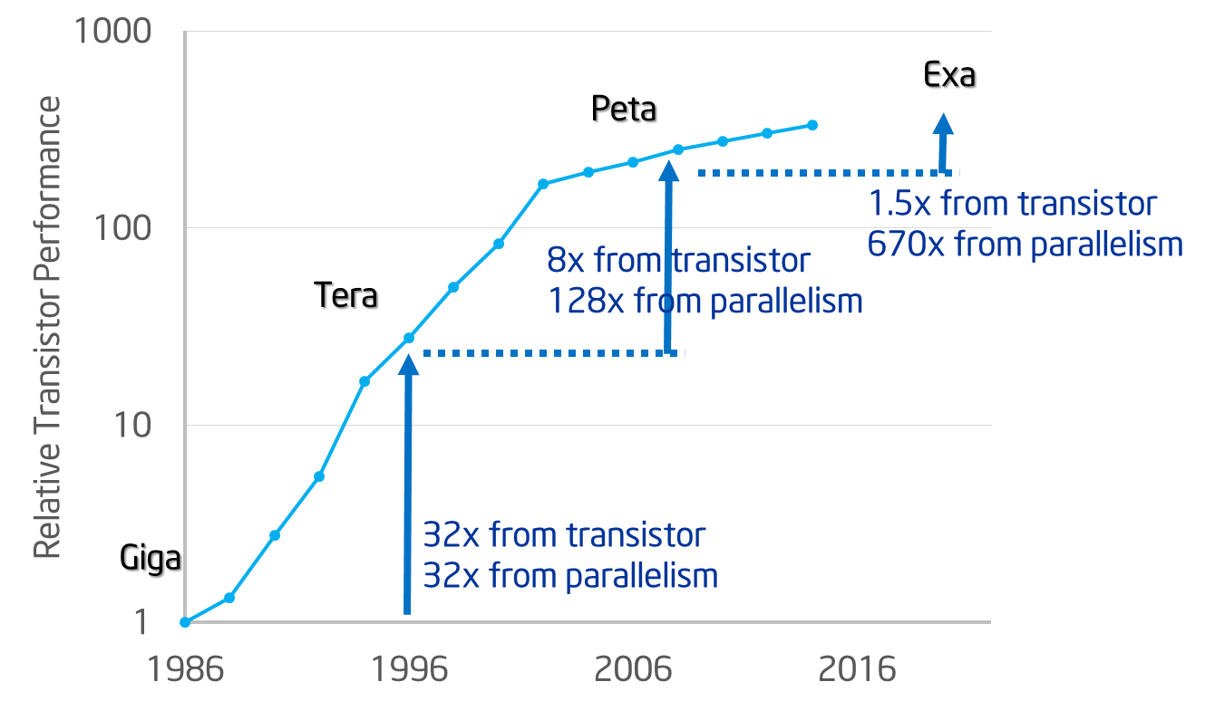
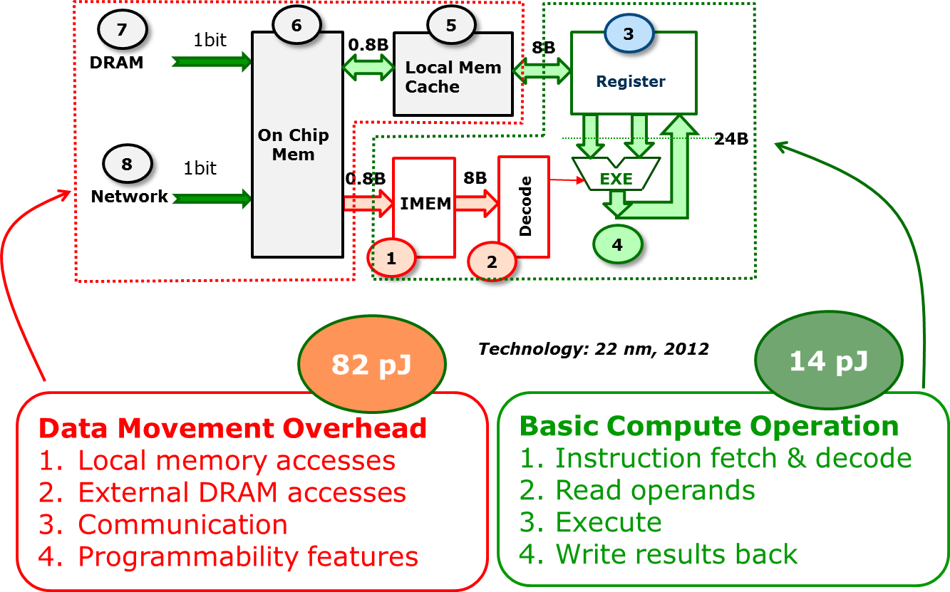
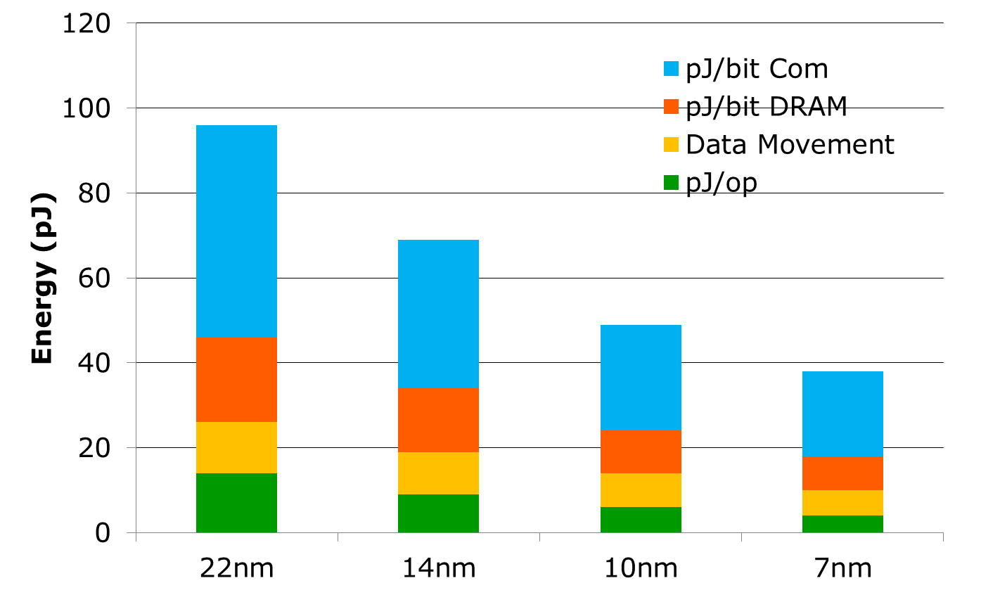
Compute vs Data Movement
60%
6X
Performance from parallelism
Basic compute loop

Slide 6
Memory Hierarchy
Disk
Pool
NVM
DDR
NVM
Hide these details from the programmer….
DDR
O(1)
Machines + Disk arrays
Units / Quantity
IPM
Chassis w/ large DDR+NVM per Exa-machine
O(1000)
LL$
LLS
O(10)
Boards w/ limited DDR+NVM per Chassis
L2$
L2S
O(1)
Sockets w/ IPM per Board
L1$
L1S
O(1)
Dies w/ shared LL$/SPAD per socket
O(100)
Blocks w/ shared L2 per die
O(1)
RF
Cores per block
ALU

Slide 7
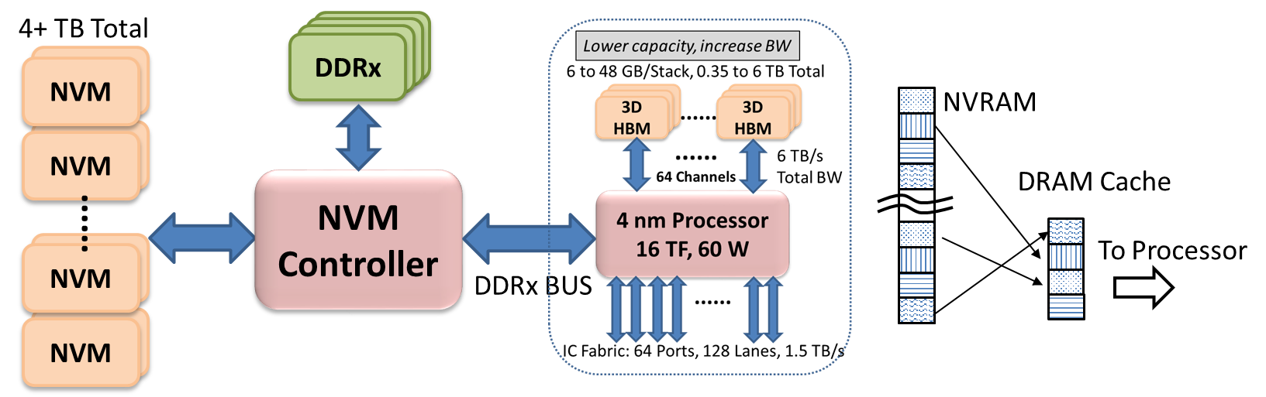
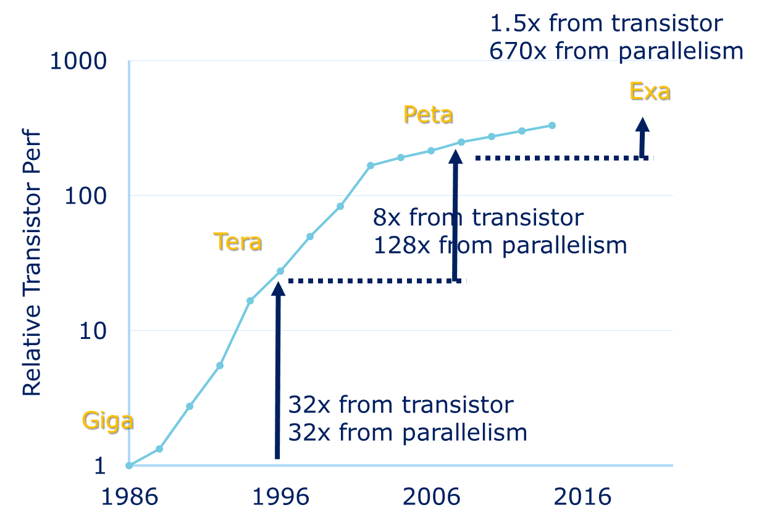
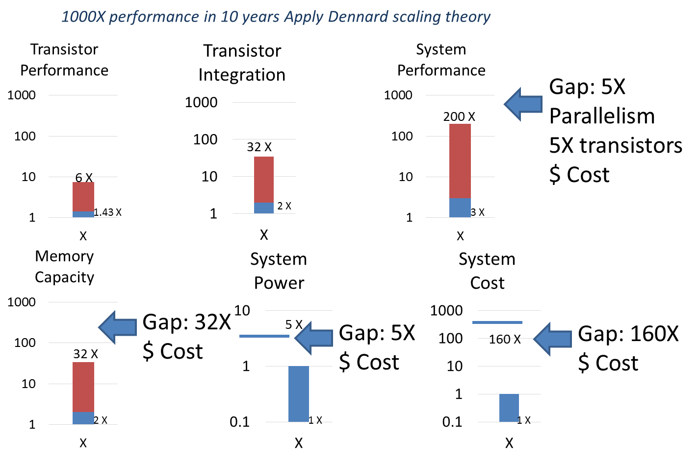
Addressing Challenges
1. Power & Energy
2. Memory subsystem
Vdd scaling
NTV operation
Fine grain power management
Hierarchical, heterogeneous IC fabric
Disproportionately large local memories
Incorporate NVM for cost
Hierarchy, global addressability
3. Programmability
4. Execution model
O(B) threads
Data locality
Separation of concerns
Legacy compatibility
Productivity
Asynchronous
Event-driven tasks (tiny threads)
Dynamic scheduling of threads
Introspective resource management
(Self-aware through observations)
Dynamic system optimization
5. Resiliency
6. Cost & affordability
Improve Perf/Transistor
New, efficient architecture
Data locality
Insert NVM in the hierarchy
First, understand faults
Detection in HW with sensors
Reactive and proactive measures

Slide 8
Software Ecosystem: Support today, find tomorrow
Evolutionary Environment
Revolutionary Environment
D-TEC
DEGAS
Loss of Semantic Information
Domain
Specialist
DSL
DSL, SEJITS
Algorithm
Specialist
CNC
HTA
HabC
C++
Fortran
Python
Python
C
C++
Fortran
RStream
ROSE
ROSE
TBB
MPI*
OMP*
. . .
Tuning Guides
Need for semantic information
(tuning, hints, guides)
(collectives, affinity, stream, ..)
Tuning
Specialist
Low-level compiler
Low-level compiler
Low-level compiler
Runtime
Event driven
Resiliency support
Introspection
Adaptation
Async support
Work with
XPRESS
HPX
SLEEC
For best functionality
Open
Community
Runtime
POSIX,
etc.
Linux
stripped OS
Minimal syscall(),
libC, libFortran, libM, libstdc++
Intel Product
Prototype(s)

Slide 9
Major Points
All work done under XSTG is available publicly, open-source BSD licensed
  http://xstack.exascale-tech.com
  Exceptions:
    PNNL has not yet released their OCR implementation at this time
    R-Stream is closed-source with government use rights
XSTG project has created significant reference implementations
  Formal specification for task-based execution model
  Reference implementation that even in immature form exceeds expectations
  Productivity tools, compilers, profilers, visualizers, re-factored applications, libraries of kernels and examples, simulators, and tutorials
  Application workshops every 6 months with the community
XSTG has transitioned from Research to Technology Maturation

Slide 10
Embargoed Data
The following sections contain results that have not yet been published
Please embargo sharing and distribution of this content until publication efforts have concluded by each team
All results are identified by team – contact each for further details

Slide 11
Task-Execution Runtime (Intel, Rice)
Evolutionary Environment
Revolutionary Environment
D-TEC
DEGAS
Loss of Semantic Information
Domain
Specialist
DSL
DSL, SEJITS
Algorithm
Specialist
CNC
HTA
HabC
C++
Fortran
Python
Python
C
C++
Fortran
RStream
ROSE
ROSE
TBB
MPI*
OMP*
. . .
Tuning Guides
Need for semantic information
(tuning, hints, guides)
(collectives, affinity, stream, ..)
Tuning
Specialist
Low-level compiler
Low-level compiler
Low-level compiler
Runtime
Event driven
Resiliency support
Introspection
Adaptation
Async support
Work with
XPRESS
HPX
SLEEC
For best functionality
Open
Community
Runtime
POSIX,
etc.
Linux
stripped OS
Minimal syscall(),
libC, libFortran, libM, libstdc++
Intel Product
Prototype(s)

Slide 12
Open Community Runtime (OCR)
Multi-party collaboration
        Intel, Rice, UIUC, UCSD, PNNL, Reservoir Labs
Provide effective abstraction for diverse hardware (hetero-ISA ready)
Typify future task-based execution models
Handle large-scale parallelism efficiently and dynamically
Provide user-perspective application-transparent resiliency
Maintain a separation of concerns (application/scheduling/resources)
Open source (encourage collaboration) http://xstack.exascale-tech.com
    OCR is X-Stack Traleika Glacier project’s implementation for this revolutionary run-time prototype
    FFWD-2 is extending OCR with legacy support, re-factored applications, and re-factoring guides, templates, and tools

Slide 13
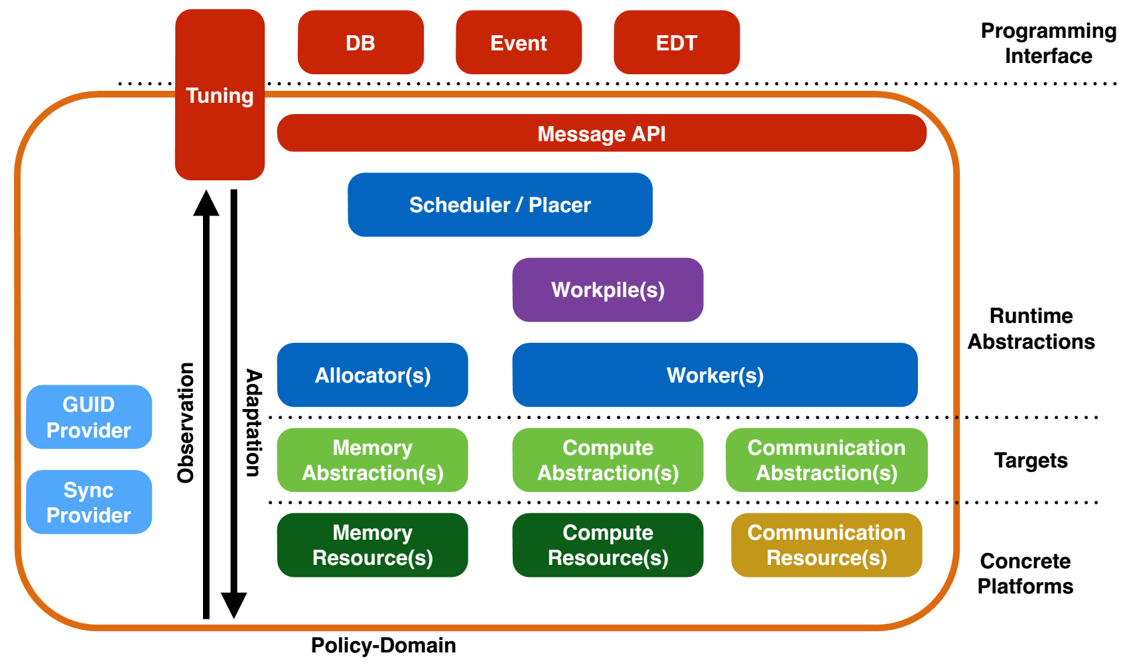
Runtime Design Principles of OCR
Modular
Extensible
Adaptable
Tunable
Generic, Adaptive
Platform Specific

Slide 14
Productivity: Concurrent Collections (Rice, Intel)
Evolutionary Environment
Revolutionary Environment
D-TEC
DEGAS
Loss of Semantic Information
Domain
Specialist
DSL
DSL, SEJITS
Algorithm
Specialist
CNC
HTA
HabC
C++
Fortran
Python
Python
C
C++
Fortran
RStream
ROSE
ROSE
TBB
MPI*
OMP*
. . .
Tuning Guides
Need for semantic information
(tuning, hints, guides)
(collectives, affinity, stream, ..)
Tuning
Specialist
Low-level compiler
Low-level compiler
Low-level compiler
Runtime
Event driven
Resiliency support
Introspection
Adaptation
Async support
Work with
XPRESS
HPX
SLEEC
For best functionality
Open
Community
Runtime
POSIX,
etc.
Linux
stripped OS
Minimal syscall(),
libC, libFortran, libM, libstdc++
Intel Product
Prototype(s)

Slide 15
Productivity: Hierarchically Tiled Arrays (UIUC)
Evolutionary Environment
Revolutionary Environment
D-TEC
DEGAS
Loss of Semantic Information
Domain
Specialist
DSL
DSL, SEJITS
Algorithm
Specialist
CNC
HTA
HabC
C++
Fortran
Python
Python
C
C++
Fortran
RStream
ROSE
ROSE
TBB
MPI*
OMP*
. . .
Tuning Guides
Need for semantic information
(tuning, hints, guides)
(collectives, affinity, stream, ..)
Tuning
Specialist
Low-level compiler
Low-level compiler
Low-level compiler
Runtime
Event driven
Resiliency support
Introspection
Adaptation
Async support
Work with
XPRESS
HPX
SLEEC
For best functionality
Open
Community
Runtime
POSIX,
etc.
Linux
stripped OS
Minimal syscall(),
libC, libFortran, libM, libstdc++
Intel Product
Prototype(s)

Slide 16
Productivity: R-Stream (Reservoir Labs)
Evolutionary Environment
Revolutionary Environment
D-TEC
DEGAS
Loss of Semantic Information
Domain
Specialist
DSL
DSL, SEJITS
Algorithm
Specialist
CNC
HTA
HabC
C++
Fortran
Python
Python
C
C++
Fortran
RStream
ROSE
ROSE
TBB
MPI*
OMP*
. . .
Tuning Guides
Need for semantic information
(tuning, hints, guides)
(collectives, affinity, stream, ..)
Tuning
Specialist
Low-level compiler
Low-level compiler
Low-level compiler
Runtime
Event driven
Resiliency support
Introspection
Adaptation
Async support
Work with
XPRESS
HPX
SLEEC
For best functionality
Open
Community
Runtime
POSIX,
etc.
Linux
stripped OS
Minimal syscall(),
libC, libFortran, libM, libstdc++
Intel Product
Prototype(s)

Slide 17
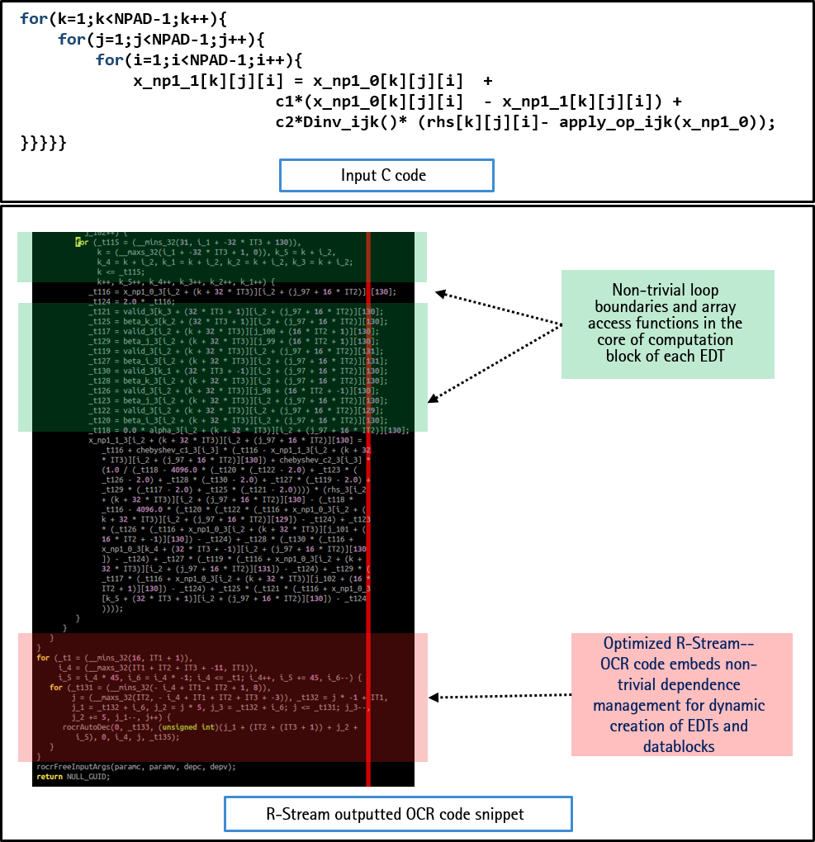
R-Stream: Polymorphic Optimizing Translator
Automatic parallelization and locality optimization
Automatic explicit communications generation and explicit datablock management
Automatic formation of OCR EDT programs (and other runtimes)
Dynamic creation and management of dependences

Slide 18
Task-Execution Runtime (PNNL)
Evolutionary Environment
Revolutionary Environment
D-TEC
DEGAS
Loss of Semantic Information
Domain
Specialist
DSL
DSL, SEJITS
Algorithm
Specialist
CNC
HTA
HabC
C++
Fortran
Python
Python
C
C++
Fortran
RStream
ROSE
ROSE
TBB
MPI*
OMP*
. . .
Tuning Guides
Need for semantic information
(tuning, hints, guides)
(collectives, affinity, stream, ..)
Tuning
Specialist
Low-level compiler
Low-level compiler
Low-level compiler
Runtime
Event driven
Resiliency support
Introspection
Adaptation
Async support
Work with
XPRESS
HPX
SLEEC
For best functionality
Open
Community
Runtime
POSIX,
etc.
Linux
stripped OS
Minimal syscall(),
libC, libFortran, libM, libstdc++
Intel Product
Prototype(s)

Slide 19
Software Ecosystem: Support today, find tomorrow
Evolutionary Environment
Revolutionary Environment
D-TEC
DEGAS
Loss of Semantic Information
Domain
Specialist
DSL
DSL, SEJITS
Algorithm
Specialist
CNC
HTA
HabC
C++
Fortran
Python
Python
C
C++
Fortran
RStream
ROSE
ROSE
TBB
MPI*
OMP*
. . .
Tuning Guides
Need for semantic information
(tuning, hints, guides)
(collectives, affinity, stream, ..)
Tuning
Specialist
Low-level compiler
Low-level compiler
Low-level compiler
Runtime
Event driven
Resiliency support
Introspection
Adaptation
Async support
Work with
XPRESS
HPX
SLEEC
For best functionality
Open
Community
Runtime
POSIX,
etc.
Linux
stripped OS
Minimal syscall(),
libC, libFortran, libM, libstdc++
Intel Product
Prototype(s)

Slide 20
OCR and SoC Methodology: Co-Design
System Processor:
Runtime/OS
“Control Plane”
sL1
iL1
dL1
AU
AU
AU
AU
iL1
iL1
iL1
iL1
On-die I/O Fabric
uDMA
uQMA
dL1
dL1
dL1
dL1
sL1
sL1
sL1
sL1
AO
AO
AO
AO
NLNI
Glue Logic
Bus Gasket
Intra-Accelerator Network
Async Off. Eng.
AU
AU
AU
AU
iL1
iL1
iL1
iL1
dL1
dL1
dL1
dL1
uL2
sL1
sL1
sL1
sL1
AO
AO
AO
AO
sL2

Slide 21
Execution Engine (XE) architecture – tunable to target
Cache manipulation (flush, inv, wbinvl, pf, …) controls
64B
Pipeline
L1 I$
cc + buff
Fetch
[includes FetchBuff]
Decode
[Operand Fetch]
64b
Cacheline Size (64B)
L1 D$
cc + buff
Integer Units
FP Units
PRF
512 entry
64b wide
Load / Store /
Atomic Unit
64b
L1 SPAD
sc
64B
64b
64B
Commit-Retire Buff / RF Update
Command Ctrl Size
Chaining Unit
L2 SPAD
port
MTB + UArb
[Message Transport Buffer &
Unified Arbiter]
DMA
64B
Collectives
QMA
ALUs
Buffer
7x R/W ported;
16 deep,
64B payload wide
ARB
Atomics
Cache Engine
PMU
64B
GAS
Network

Slide 22
DOE Community Responses and Thoughts (1/2)
Member | DOE Lab | Comments
Dave Richards | LLNL | I'm pleased by the progress of the OCR project. MPI-Lite, a full specification, and the expanded feature set including affinity hints are important additions that will expand the set of problems OCR can handle. My biggest concern with OCR is that we have yet to see a believable story regarding how high-level programming models can interface with OCR and capture the full benefits of asynchronous tasks and relocatable data blocks.
Pat McCormick | LANL | The Legion programming model from LANL will be moving on top of OCR to assess performance and viability. If successful, Legion will use OCR as one of the primary back-end runtimes to provide task-based execution model support.
Robert Clay | SNL-L | I’m hugely supportive of the approach — specification-based, open design and development. This is what the community needs to build interchangeable ‘components’ in the task-parallel RTS space. We (Sandia) plan to remain actively engaged with the OCR team(s), and consider OCR an extremely interesting candidate for a core part of our future task-parallel RTS in context of a DHARMA build out. While OCR doesn’t seem ready for prime time use today, I believe with continued community engagement and support it will develop into a highly effective capability which will significantly enhance its adoption w/in the broader community.

Slide 23
DOE Community Responses and Thoughts (2/2)
Member | DOE Lab | Comments
Ian Karlin | LLNL | The OCR research has two advantages over the other mainly university led asynchronous multi-task (AMT) runtimes. OCR development is tied to hardware exploration, which allows for hardware features that are beneficial to AMT runtimes to be co-designed with the programming model. In addition, it is working to become an open community product as opposed to a tool owned by one research group. That said OCR still suffers from the main drawback of most AMT models, as it has yet to be proven that adopting an AMT model is significantly beneficial for enough codes over a well designed non-bulk synchronous MPI application.
Jim Belak | LLNL | I am very pleased by the overall progress and direction of the XSTG project. I am also excited about the direction and vision that this project is exploring. With several application codes now expressed in the model, analysis has revealed the need to introduce concepts, such as hints, to enable performant applications using the model. I look forward to seeing large, at-scale applications running to determine where and when this approach is most appropriate for our problems

Slide 24
Progress Report Card
Technology | Rating | Comments
CnC | Good | CnC specification and reference are open-sourced by Intel; Rice is now driving changes and enhancements
HTA | Stopped | HTA works, but is relatively immature in the ability to express constructs and realize performance on OCR. Further work at UIUC is needed on the basic design.
Habanero | Good | Habanero C support for OCR works well. The lack of a centralized standard or reference implementation for Habanero hampers ability to support OCR with all Habanero features and versions.
R-Stream | Good | R-Stream is very effective at automatically generating high-performance OCR code from high-level C loop nests, that exploit the full feature set of OCR and allow users to get the full benefit of the EDT model vs. classical execution models.
OCR (Intel, Rice) | Good | Functionally complete with a precise open specification and reference implementation. Advanced features on resiliency, hints, and related technologies are in progress.
OCR (PNNL) | Good | A version derived from the open reference implementation with a focus on performance first. Source code is not available.
FSim | Good | Very fast, highly parallel, large-scale architecture simulator works and matches the RTL design model at a functional level. Supports bare-metal as well as OCR applications.
Tools (debug, profile) | Limited | First-pass tools are working, but are not going to scale as-is to the expected size of future machines without significant additional work. Collaboration with DOE groups working on similar tools is just starting, and will remain in progress. Starting this was delayed until the last year of the XSTG project, due to the evolving OCR design and interfaces.

Slide 25
Future Work: 1 of 2
Technology | Comments
Maturation - Xeon | Mature code base on scheduler and allocator to bring up performance and strengthen design corners
Maturation – Xeon Phi | Study KNL-based architecture optimization opportunities for performance and introspection
Maturation – FSim | With RTL design closing on specific performance characteristics and power values, adjust FSim to reflect and optimize the tools targeting FSim and OCR on FSim accordingly

Slide 26
Future Work: 2 of 2
Technology | Comments
Productivity - Legion | Support DOE task-based framework Legion on top of OCR to provide a comparison baseline
Productivity - RAJA | Exploit loop lambda model of RAJA to emit OCR tasks for parallelization evaluation; couple to Rstream and similar tools for “auto-taskification” skeleton for existing codes
Enhancements - Tools | Continue to enhance and extend early debug and profiling tools with DOE teams to facilitate using task-based execution models at scale

