Slide 1
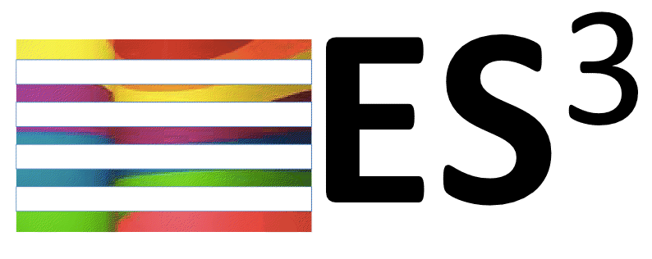
X-Stack Programming Environments
Sonia R. Sachs
August 19, 2014

Slide 2
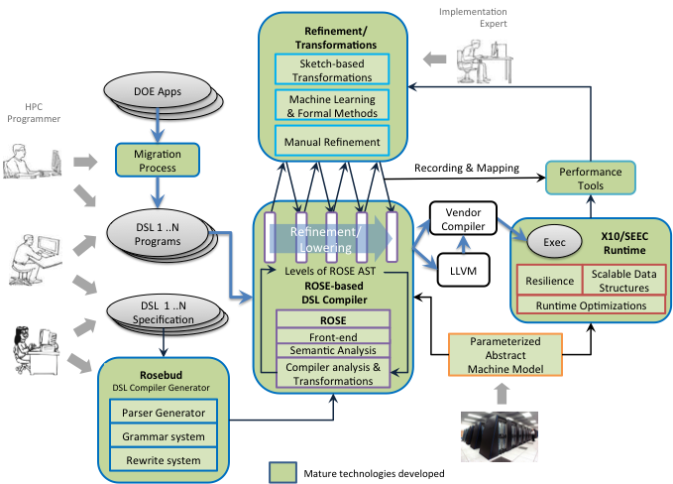
D-TEC Programming Environment
Mature technologies by
September 2015
Notes:
D-TEC focuses on how to support DSLs for Exascale
Two approaches to building DSLs:
1) Rosebud, used to define DSLs (a novel framework for joint optimization of mixed DSLs)
DSL specification is used to generate a "DSL plug-in” for Rosebud's DSL compiler
DSL optimization is done via cost-based search over the space of possible rewritings
Costs are domain-specific, based on shared abstract machine model + ROSE analysis results
Cross-DSL optimization occurs naturally via search of combined rewriting space
Supports both embedded and general DSLs and multiple DSLs in one host-language source file
2) An approach based on sketching, machine learning, and formal methods (a cutting-edge aspect of our proposal)
Series of manual refinements steps (code rewrites) define the transformations
Equivalence checking between steps to verify correctness
The series of transformations define the DSL compiler using ROSE
Machine learning is used to drive optimizations
Supports Embedded DSLs
Builds on top of a single shared compiler infrastructure: the ROSE compiler infrastructure
Uses a single shared runtime system: the SEEC enhanced X10 runtime system
A Parameterized Abstract Machine Model informs the compiler and runtime system about the hardware

Slide 3
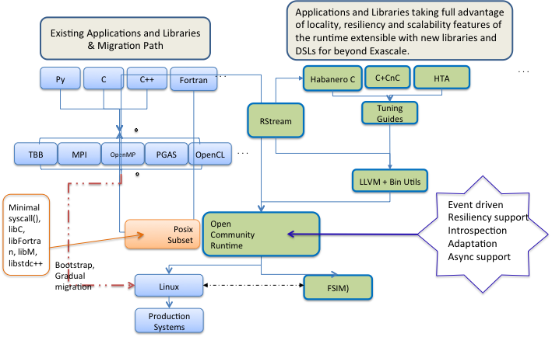
Traleika Programming Environment
. . .
Notes:
Migration path: How do we take care of apps developed using current programming models (e.g. MPI+OpenMP):
Traleika Glacier envisions an incremental migration path from traditional programming models and runtimes to the revolutionary architecture as detailed in the figure:
The migration path starts with existing applications implemented in threading models, message passing and/or in a PGAS language currently running on Linux and traditional hardware architecture with standard resource managers (Left side of the figure).
The exascale goal has refactored applications written in high level languages including DSLs that expresse the task parallelism of the underlying physics. These applications are tuned by tuning guides, translators and low level compilers that emit efficient event driven tasks. The EDTs are managed by the Open Community Runtime, which allows much finer grain resource management, separation of concerns and the introspection and resiliency necessary for fault tolerance in the targeted billion+ threads of computation at exascale. (Right side of figure).
At the top level the migration path has four major steps:
Step 1: Migrate apps programmed in standard models to run on top of the open community runtime (OCR), by providing support for the necessary subset of libraries in OCR running on top of current Linux and x86 clusters
Step 2: Proceeding from extensive experience gained in hand-coding to identify opportunities to re-code parallelism previously implemented in synchronous fashion to asynchronous tasks. This is aided by the choice of high-level languages and notations, such as Concurrent Collections, Hierarchically Tiled Arrays, Habanero-C and transformation by tools such as R Stream. This step targets OCR running on x86.
Step 3: Migration from OCR on x86 to OCR running upon the Traleika Glacier architecture, taking advantage of control over data locality, fine grain resource management of the increased parallelism and the sensor infrastructure allowing introspection.
Step 4: Re-think the implementation of the physics into algorithms that fully exploit the Traleika Glacier architecture.
At Exascale and beyond the programming environment is not finished. Production users will expect high quality development tools, equivalent to or better than current practice. As we arrive at Exascale users and developers will expect debuggers, performance profilers and tuning analyzers that are capable of displaying relevant and useful information for multi-billion-way parallel computations. Identification of this level of parallelism must also be supported by language and compiler development. The programming environment will be further stressed with demands upon resilience taking an increasingly important role. Identification of faults at all software and hardware levels and recovery from them will require tools at all levels of the solution stack and may require us to think in non-deterministic terms.
LLVM + bin utils: We have enhanced LLVM on both front end and back end, It’s a low level compiler that accepts source input from the higher level translators, and therefore needs to understand the keywords and pragmas generated as the higher level translators identify EDTs and data blocks. For example, there are several keywords that allow memory placement identification. On the backend we target a streamlined ISA that actually implements the TG hardware architecture, so LLVM needs to generate this code. Work has been put into the code generator to do this. LLVM then works together with elements of binutils, primarily the assembler and linker, to generate the executables. Binutils has been modified for the same reasons.

Slide 4
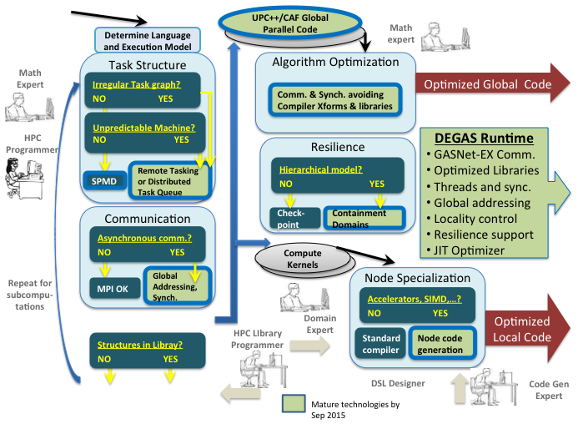

DEGAS Programming Environment
Notes:
DEGAS work focuses on support for irregular computations through a dynamic global address space.
It can interoperate with MPI or OpenMP, used either across nodes, within nodes, or over a small set of nodes that will be treated as a “fat” node. Therefore, parallel program designs can be broken into components and DEGAS used selectively on a subset of the machine or phases of the execution.
The first step is to identify components that may benefit from DEGAS support. This is done by the HPC programmer with some information (about discretizations) from applied mathematicians who in turn are communicating with science domain experts on what scientific phenomena are included. This may be for whole applications or addition of new physical models to an existing application.
The design process can be thought of (oversimplifying) as a serious of high level questions about the type of irregularity, if any. Applications like sparse or dense direct matrix solves have a non-trivial task graph structure that may benefit from global event-driven execution using remote invocation. Applications that have unpredictable running times(not known in advance) in applications may require use of a distributed task queue for load balancing. (Both of these take advantage of the global address space for moving work.)
Unpredictable machine performance may also results in use of dynamic load balancing.
Applications with asynchronous access to large shared data structures may benefit from the global address space. These may be spread over all or a subset of nodes, but designing for locality (data layout) is critical for scalability even if the communication is necessarily fine-grained and asynchronous.
If the machine has high failure rates, the HPC programmer will (preferably) treat this hierarchically to avoid a heavy weight “universal” solution. They will then incorporate containment domains optimized for the application hierarchy and taking advantage of natural redundancy and information about what state can be reconstructed.
These steps can be repeated at various levels: starting with full / global application, within modules, or (very importantly!) within nodes. Thus, dynamic tasking and novel synchronization like phasers may be used within nodes or globally.
Identify data structures. Use of high level arrays (grids or matrices) can greatly aid in productivity and enable automated (runtime) communication optimizations
Out of the first column comes some global parallel code and data structures, plus (see below) local code. There is an opportunity to do further communication optimizations at both levels. Globally this is currently done with math experts possibly using libraries to support “.5D” algorithms, etc. There is also work on automating this in a compiler – an exciting long term goal but not required for the success of the overall programming model.
A strategy for resilience is also considered, probably using the hierarchical nature of the code and application or algorithm-specific resilience strategies using containment domains. Again, a full application checkpoint is still possible in our model, but the long term goal is more hierarchical approaches that will be more efficient.
Also coming from the left programming column is a set of compute kernels to be optimized for a single node/socket/core with data parallel features and possibly accelerators. This is not a major effort in DEGAS, but is building on the SEJITS (Selected Embedded Just-in-Time Specialization) that uses a embedded Python DSL to specify small languages and dynamic optimization framework. This will be used for the UPC++ arrays, stencils, and dense and sparse matrix kernels at least.
A full DEGAS application (which may have mixed MPI or OpenMP code) has optimized global code that communicates with GASNet-EX, lightweight threading and synchronization, and a Just-in-Time optimizer for the DSL specialization for dynamic optimizations.

Slide 5
XPRESS Programming Environment
Legacy OpenMP
Legacy MPI
DSLs
OpenUH Compiler
C, C++ Compiler
PXC
XPI
OpenUH Runtime
Open MPI Runtime
HPX
APEX
HPX-3
HPX-5
RIOS
RCR
LXK
Linux
Hardware
Notes:
XPRESS supports legacy OpenMP and MPI applications by integrating the OpenUH and Open MPI runtime systems with the HPX runtime system. The University of Houston is working on adding support to the OpenUH runtime system to work on top of HPX-3. UH is also working on integrating Open MPI and HPX-3, but that work is still in the design stage.
XPRESS proposed to support DSLs through a ParalleX Compiler (PXC) that would generate the XPI intermediate form, but only the development of the XPI interface was funded through X-Stack. Work on these other parts is supported under other programs.
XPRESS currently has two implementations of the HPX runtime systems, HPX-3 developed primarily at LSU and HPX-5 developed at Indiana University. HPX-3 is designed to integrate well into the C++ ecosystem, while HPX-5 is a C-only implementation focused on streamlined performance.
The Runtime Interface to the Operating System (RIOS) is designed to support resource allocation and management policies specifically for adaptive runtime systems. A key aspect of RIOS is to support more event-driven capability that can support more advanced hardware mechanisms for adaptivity.
The LXK operating system is an evolution of Sandia’s Kitten lightweight kernel that is intended to support RIOS natively. We also expect a Linux implementation of RIOS to be possible, as most of the current prototyping activity is occurring on Linux.
RCR is an interface and module for reflecting priveleged energy-related performance data from the OS through to the runtime system. Implementations for both Linux and LXK are in progress.
The APEX performance infrastructure crosscuts the entire software stack, from the OS through the HPX runtime system. APEX informs HPX about performance information, allowing it make adaptive resource management decisions. APEX also tracks the performance of the HPX runtime system itself so that these decisions can be recorded and evaluated post mortem.

Slide 6
GVR Vision for Resilience at Extreme-scale
D-TEC + DEGAS
Applications
Traleika + XPRESS
Applications
MPI+X
Applications
Global Program Transformation + Optimization
Local
Optimizing Compilers
Petsc
Trilinos
...
Higher-level
Libraries
...
...
GVR
...
HPX, OCR
GVR
...
HPX, OCR
GVR
Rich Runtime Libraries
Rich Runtime Libraries
Rich Runtime Libraries
GVR provides flexible resilience thru versioned, distributed arrays, usable by all the X-stack center projects
  Direct use by application program, exploiting application semantics, via GVR library calls passed through compilation system for Traleika or XPRESS programs
  Compiler generated GVR calls, exploiting DSL or analyzed application semantics, as a runtime resilience service for D-TEC or DEGAS programs
  Indirect use by applications, through high-level libraries that use GVR,, exploiting algorithm semantics, via GVR library calls
GVR also provides cross-layer resilience exposing errors from hardware, runtime, operating system, and application for error recovery by the application/library/compiler-generated software

Slide 7
program with autotuning language extensions
programmer-specified
mappings (recipes)
compiler decision algorithms
search space
code variant with parameter ranges
performance bounds
PBound,
Roofline
code variant with parameter ranges
models
code variant with parameter ranges
power bounds
domain-specific
algorithm
domain-specific
algorithm
starting points
architectural features
search engine
krylov methods
Model-based
Search Algorithm
ca-amr multigrid
code transformation and code generation
tensor computations
Algorithm,
Tuning Expertise
CHiLL,
CUDA-CHiLL
code variant with instantiated parameters
empirical evaluation
domain-specific library
optimized program

Slide 9
Vision: Reduce
Programming to Debugging ratio
Target Domain
Hybrid Parallelism + Floating Point + Modularity
Goals:
Correctness/Performance tools to help programmers with development
efficient
scalable
reproducible
precise
coverage
language agnostic
DEGAS
XPRESS
Traleika
D-TEC
Hobbes
Argo
APPLICATIONS
All this software will have:
non-deterministic bugs
non-reproducible results
redundant syncs
redundant precision
Corvette provides language/runtime independent tools
Thrille: data races
Precimonious: FP precision tuning
ReproBLAS: reproducible num. algorithms
LLVM Shadow Execution: dynamic analysis
Sync reduction: remove redundant syncs
Our Approach:
Dynamic analysis
Symbolic execution
New Algorithms

Slide 10

PIPER X-Stack Vision
Reacting to Application & System Adaptivity
X-Stack
Eco-System
Applications
Extreme Solv.
Co-Design
X-Stack2
ExaOSR
Fast/Design
Forward
Measurement & Attribution
HAIL
Application Info.
TIER
X-Stack Perf. APIs
Stack-wide Data Collection & Semantic Correlation
Online
Data
Analysis
Executed
In a
Scalable
Overlay
Network
Online
Data
Analysis
Techniques
Online
Data
Analysis
Techniques
Interactive
Visualization
Techniques
Dist.
Data
Store
Data Analysis
& Reporting
Tools
Query API
Local
Analysis &
Adaptation
Tuning
Knobs/APIs
Dynamic
Adaptation &
Tuning Tools
Jobs
Enclaves
Whole System
Performance and
Metadata Storage (PAMS)
Adapting Data Collection, Runtimes & Applications
Notes:
Overall goal for PIPER: enabling efficient performance analysis, optimization and auto-tuning for the X-Stack ecosystem, which is expected to be a highly scalable and adaptive environment (and PIPER needs to be able to match these properties)
PIPER ultimately needs interfaces (black vertical bar) to all components in the X-Stack (light orange box, left) from the hardware to the applications. These interfaces need to be co-designed with the other projects where they don’t exist. Particular focus of PIPER are the connections with the X-Stack2 and ExaOSR efforts, since they (in addition to actual application information) can provide the necessary attribution information for the analysis steps. We group the necessary interfaces into two families of APIs: HAIL (High level Annotation Interface Layer) for information exported by applications and TIER (Task-based Instrumentation for Exascale Runtimes) for information from the X-Stack2 and ExaOSR task-based runtimes.
Performance data and attribution information is gathered through the HAIL and TIER interfaces (top white box) and fed into a stack-wide (per node) data collection system (light blue box). Local analysis and direct feedback to local feedback loops can be driven directly from this data (bottom white box), which then uses tuning knobs exposed by the X-Stack2 projects to initiate adaptation.
Data intended for distributed analysis or visualization to the end user is gathered and (where necessary) subjected to online analysis (dark orange box) using a scalable analysis framework, most likely utilizing some kind of overlay network. This can be at the scope of individual jobs, enclaves, or even the whole system. The resulting data is stored in a distributed data store (red box) and from there made available through a query API for visualization (top right), data analysis reporting (middle right) and automatic tuning agents (bottom right).
Decisions from the dynamic tuners or analysis is transmitted through the system (solid green arrow, bottom) and can affect both the data collection (through dynamic and adaptive instrumentation) and the actual application. The latter is initiated through the tuning knobs mentioned above (bottom white box, between X-Stack and Data Collection).
Additionally, PIPER must record and react to system and application adaptivity (solld blue arrow, top) that was not initiated by PIPER (e.g., resilience mitigation, power capping, dynamic load balancing, adaptive simulation refinements, …). This adaptivity must be observable through TIER (topwhite box, between X-Stack and Data Collection) and can affect the analysis of the data, but also how data is handled or stored.

