Slide 1
Keeping Performance Portable In High Performance Kernels
Saman Amarasinghe
Una-May O’Reilly
Jason Ansel
Phitchaya Mangpo Phothilimthana
Jonathan Ragan-Kelley
Computer Science and Artificial Intelligence Laboratory
Massachusetts Institute of Technology
Notes:
Heterogeneity is here. If you care about performance and energy efficiency, you will need to work with system with different specialized accelerators such as gpu. Programing on heterogeneous system is hard, but making the program portable across different systmes is even harder.

Slide 2
Example: Convolution
2D Convolution
k1
k₂
k₃
k₁k₁ | k₁k₂ | k₁k₃
k₂k₁ | k₂k₂ | k₂k₃
k₃k₁ | k₃k₁ | k₃k₁
2D kernel
k₁k₁ | k₁k₂ | k₁k₃
k₂k₁ | k₂k₂ | k₂k₃
k₃k₁ | k₃k₁ | k₃k₁
k₁k₁ | k₁k₂ | k₁k₃
k₂k₁ | k₂k₂ | k₂k₃
k₃k₁ | k₃k₁ | k₃k₁
k₁k₁ | k₁k₂ | k₁k₃
k₂k₁ | k₂k₂ | k₂k₃
k₃k₁ | k₃k₁ | k₃k₁
k₁k₁ | k₁k₂ | k₁k₃
k₂k₁ | k₂k₂ | k₂k₃
k₃k₁ | k₃k₁ | k₃k₁
output
input
Notes:
We have seen that there 2 common ways to do convolution.

Slide 3
Example: Convolution Algorithmic Choices
2D Convolution
Separable Convolution
Convolve Row
k₁ | k₂ | k₃
k₁ | k₂ | k₃
k1
k₂
k₃
k₁k₁ | k₁k₂ | k₁k₃
k₂k₁ | k₂k₂ | k₂k₃
k₃k₁ | k₃k₁ | k₃k₁
k₁ | k₂ | k₃
2D kernel
input
intermediate
Convolve Column
k1
k₂
k₃
k1
k₂
k₃
k1
k₂
k₃
output
input
output
intermediate
Notes:
Transition: we can represent this algorithmic choices in the existing ZettaBricks language like this.

Slide 4
ZettaBricks Language [PLDI’09]
transform SeparableConvolution
from In[w, h], Kernel[KWIDTH]
to Out[w - KWIDTH+1, h - KWIDTH+1]
{
// Choice 1: single pass 2D convolution
to(Out out) from(In in, Kernel kernel) {
Convolve2D(out, in, kernel);
}
// Choice 2: two pass separable convolution
to(Out out) from(In in, Kernel kernel)
using(buffer[w - KWIDTH+1, h]) {
ConvolveRows(buffer, in, kernel);
ConvolveColumns(out, buffer, kernel);
}
}
Notes:
Convolution transform can convolves by using one of these 2 choices.
first rule maps from In to Out in a single pass, by directly applying the another transform Convolve2D.
Choice 2 maps in two passes, by first calling ConvolveRows, and then ConvolveColumns transform.
transition: In order to generate opencl code automatically.

Slide 5
ZettaBricks for Heterogeneous Systems
ZettaBricks
ZettaBricks
Program
- algorithmic choices
- parellelization techniques
- data distributions - transformations - CPU/GPU choices - global/local memory - CPU-GPU workload ratio
- GPU local work size - etc.
- dependency analysis - data movement analysis
- CPU/GPU task creations - task scheduler - C++ code gen - OpenCL code gen
- etc.
- dependency analysis
- task creations
- task scheduler - C++ code gen
- etc.
Compiler
Training Information
- algorithmic choices
- parellelization techniques
- data distributions - transformations - etc.
Autotuner
C++ output
Program
Choice
Configuration
Runtime System
- CPU work-stealing model
- CPU work-stealing model
- GPU work-pushing model
- memory management
[ASPLOS13]
Notes:
Compiler for algorithmic choices. It can autotune for both algorithmic choices and more fine-grained parameters.

Slide 6
Automatic OpenCL Code Generation
STEP 1: dependency analysis
Allow sequential dependency and data parallel dependency patterns, and reject complex data dependency
STEP 2: syntactic conversion
Rewrite data accesses to GPU global memory
STEP 3: GPU local memory utilization
When there is stencil computation pattern, GPU local memory version kernel is generated.
Phase 1: work-items cooperate to load data into local memory that will be accessed by the work-group they belong to
Phase 2: actual computation derived from the basic version by replacing global memory accesses with local memory accesses
Notes:
We perform data dependency analysis and syntactic conversion to OpenCL using just GPU global mem
Step 3: we generate another version OpenCL code with GPU local memory if it has stencil computation pattern.

Slide 7
Scheduling Choices: Convolution
Schedule 1:
Convolve2D();
Schedule 2:
Convolve2D_opencl();
Schedule 3:
ConvolveRows();
ConvolveColumns();
Schedule 4:
ConvolveRows ();
ConvolveColumns_opencl();
Schedule 5:
ConvolveRows_opencl();
ConvolveColumns();
Schedule 6:
ConvolveRows_opencl();
ConvolveColumns_opencl();
Schedule 1:
Convolve2D();
Schedule 2:
ConvolveRows();
ConvolveColumns();
Before adding OpenCL
After adding OpenCL

Slide 8
Scheduling Choices: Convolution
Schedule 1:
Convolve2D();
Schedule 2:
Convolve2D_opencl();
Schedule 3:
Convolve2D_opencl_local();
Schedule 4:
ConvolveRows();
ConvolveColumns();
Schedule 5:
ConvolveRows ();
ConvolveColumns_opencl();
Schedule 6:
ConvolveRows ();
ConvolveColumns_opencl_local();
Schedule 7:
ConvolveRows_opencl();
ConvolveColumns();
Schedule 8:
ConvolveRows_opencl_local();
ConvolveColumns();
Schedule 9:
ConvolveRows_opencl();
ConvolveColumns_opencl();
Schedule 10:
ConvolveRows_opencl();
ConvolveColumns_opencl_local();
Schedule 11:
ConvolveRows_opencl_local();
ConvolveColumns_opencl();
Schedule 12:
ConvolveRows_opencl_local();
ConvolveColumns_opencl_local();
Local memory = scratchpad memory shared by all work-items (gpu threads)
in the block
Schedule 1:
Convolve2D();
Schedule 2:
Convolve2D_opencl();
Schedule 3:
ConvolveRows();
ConvolveColumns();
Schedule 4:
ConvolveRows ();
ConvolveColumns_opencl();
Schedule 5:
ConvolveRows_opencl();
ConvolveColumns();
Schedule 6:
ConvolveRows_opencl();
ConvolveColumns_opencl();
Schedule 1:
Convolve2D();
Schedule 2:
ConvolveRows();
ConvolveColumns();
Original Choices
After adding OpenCL
After adding local mem version

Slide 9
CPU-GPU Workload Balancing
CPU/GPU ratio parameter statically defines how much of the data should be computed on each device.
Program
Program

Slide 10
GPU Choice Representation
Schedule 1:
Convolve2D();
Schedule 2:
Convolve2D_opencl();
Schedule 3:
Convolve2D_opencl_local();
Schedule 4:
ConvolveRows();
ConvolveColumns();
Schedule 5:
ConvolveRows ();
ConvolveColumns_opencl();
Schedule 6:
ConvolveRows ();
ConvolveColumns_opencl_local();
Schedule 7:
ConvolveRows_opencl();
ConvolveColumns();
Schedule 8:
ConvolveRows_opencl_local();
ConvolveColumns();
Schedule 9:
ConvolveRows_opencl();
ConvolveColumns_opencl();
Schedule 10:
ConvolveRows_opencl();
ConvolveColumns_opencl_local();
Schedule 11:
ConvolveRows_opencl_local();
ConvolveColumns_opencl();
Schedule 12:
ConvolveRows_opencl_local();
ConvolveColumns_opencl_local();
Local Work Size
GPU-CPU Ratio
1/8
2/8
4
3/8
9
…
16
8/8
25

Slide 11
GPU Choice Representation
Schedule 1:
Convolve2D();
Schedule 2:
Convolve2D_opencl();
Schedule 3:
Convolve2D_opencl_local();
Schedule 4:
ConvolveRows();
ConvolveColumns();
Schedule 5:
ConvolveRows ();
ConvolveColumns_opencl();
Schedule 6:
ConvolveRows ();
ConvolveColumns_opencl_local();
Schedule 7:
ConvolveRows_opencl();
ConvolveColumns();
Schedule 8:
ConvolveRows_opencl_local();
ConvolveColumns();
Schedule 9:
ConvolveRows_opencl();
ConvolveColumns_opencl();
Schedule 10:
ConvolveRows_opencl();
ConvolveColumns_opencl_local();
Schedule 11:
ConvolveRows_opencl_local();
ConvolveColumns_opencl();
Schedule 12:
ConvolveRows_opencl_local();
ConvolveColumns_opencl_local();
Local Work Size
GPU-CPU Ratio
Other Parameters …
…
1/8
2/8
4
3/8
…
9
…
…
16
8/8
25
…
Big Search Space!
up to 10¹⁰⁴⁰ choices
…
Bottem-up evolutionary algorithm [GECCO’11]
Notes:
Emphasize that autotuner

Slide 12
Runtime System
Non Runnable
Tasks
CPU Worker
CPU Worker
CPU Worker
GPU Manager
Local Task Creation
Runnable Task
Deques
Randomized Work-stealing
GPU Task Pushing
Notes:
The existing runtime system is based on work-stealing model. …
Unfortunately, this model doesn’t work with gpu because gpu requires different tasks and it has segregated mem.
Therefore, we introduce a dedicated thread for GPU management that has FIFO queue where CPU workers can push GPU tasks to the end of the queue.
Non-runnable tasks can also depend on GPU tasks.

Slide 13
Experimental Results
Convolution Black-Sholes
Poisson2D SOR Sort
Strassen Tridiagonal Solver
Single Value Decomposition
Notes:
Use OpenCL and GPU interchangably

Slide 14
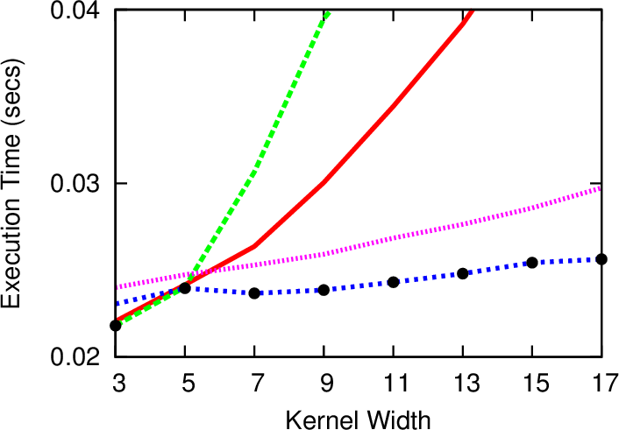
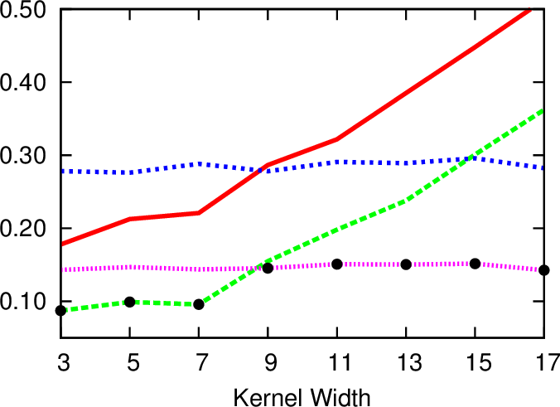
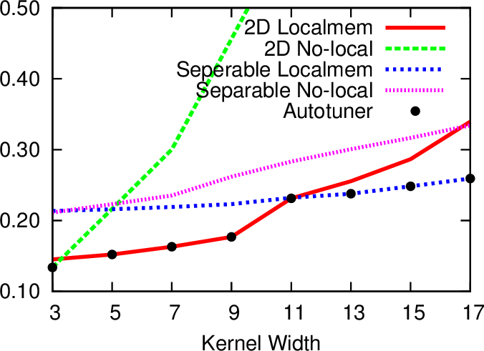
Experiment: Convolution
All choices are in OpenCL
Desktop
Server
Laptop
Notes:
Intro: here is a real program on real machines.
Points:
4 lines on each figure represent 4 different implementation of convolution in opencl.
There are 2 different algorithmic choices: 1-pass 2D convolution and 2-pass separable convolution.
Each algorithm has 2 version: using global and local memory.
These graphs show the runtime vs kernel with (or think of it as a blur size of the image you do convolution on).
Transition: in practice, there are a lot more choices than what we show here.

Slide 15
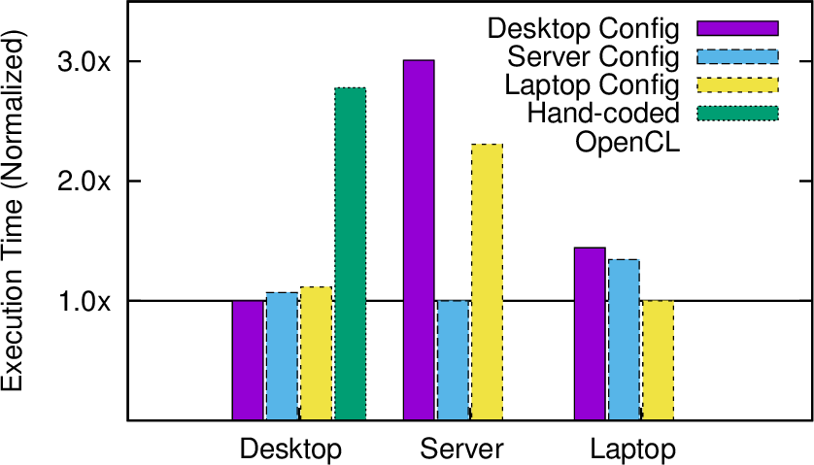
Experiment: Convolution
Autotune on each machine
Test cross-run
Normalize execution time by the best config
Desktop config
Separable convolution w/
local memory on GPU
Lower is better.
Server config
Separable convolution
on OpenCL
Laptop config
2D convolution w/
local memory on GPU
Hand-coded OpenCL

Slide 16
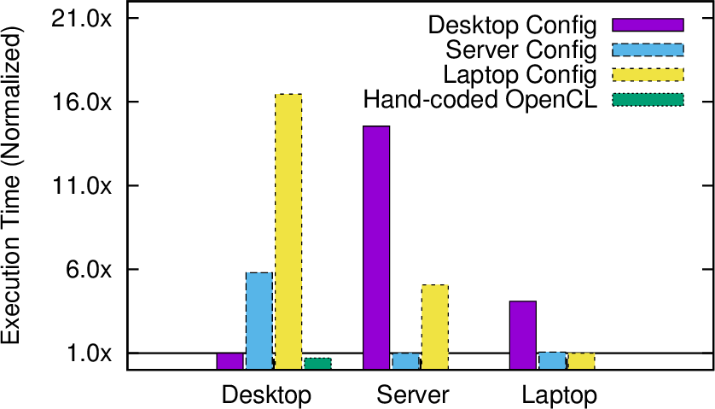
Experiment: Stressen (Matrix Multiply)
Right configuration can provide huge performance improvement.
Desktop config
16.5x
Data parallel on GPU
Server config
Recursive decomposition
-> LAPACK on CPU
Laptop config
LAPACK on CPU
Hand-coded OpenCL
Notes:
Right configuration can provide huge performance improvement.

Slide 17
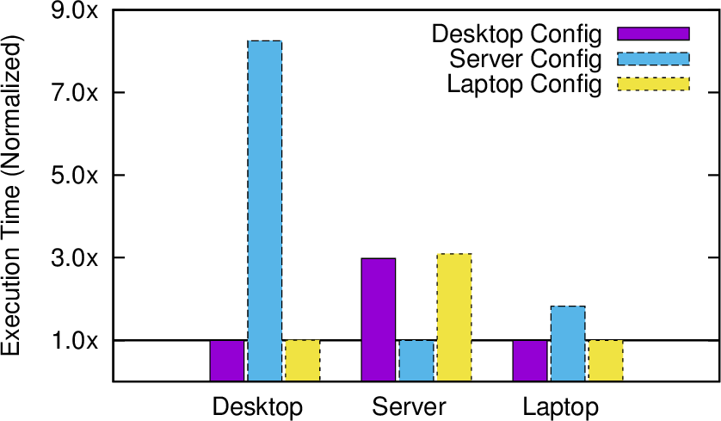
Experiment: Poisson 2D SOR
Optimal placement is almost the opposite of another across machines.
Desktop config
Split on CPU
Compute on GPU
Server config
Split on OpenCL
Compute on CPU
Laptop config
Split on CPU
Compute on GPU
Notes:
Right configuration can provide huge performance improvement.

Slide 18
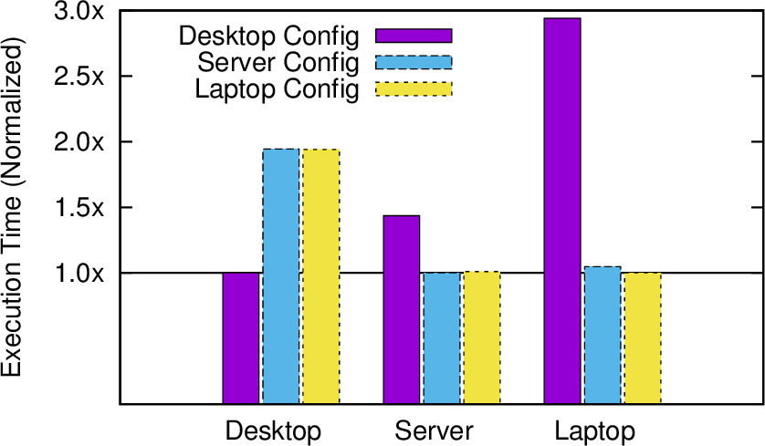
Experiment: Tridiagonal Solver
Algorithmic choice dramatically affects performance.
Desktop config
Cyclic reduction on GPU
Server config
Direct solve on CPU
Laptop config
Direct solve on CPU
Notes:
Right configuration can provide huge performance improvement.

Slide 19
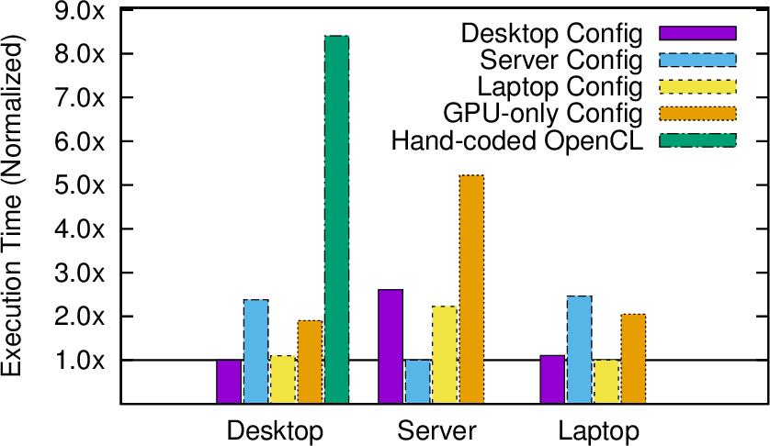
Experiment: Sort
It is always best to use accelerators.
Desktop config
2MS -> QS -> 4MS -> IS
on CPU
Server config
4MS -> 2MS -> IS
on CPU
Laptop config
4MS -> 2MS -> 4MS -> IS
on CPU
GPU-only config
Bitonic sort
Hand-coded OpenCL
Radix sort
Notes:
Right configuration can provide huge performance improvement.

Slide 20
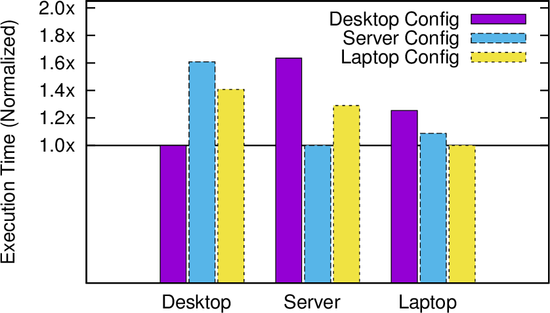
Experiment: SVD
GPU-CPU task parallel division on some machines
Desktop config
Task parallelism between
CPU/GPU
Server config
All on CPU
Laptop config
All on CPU
Notes:
Right configuration can provide huge performance improvement.

Slide 21
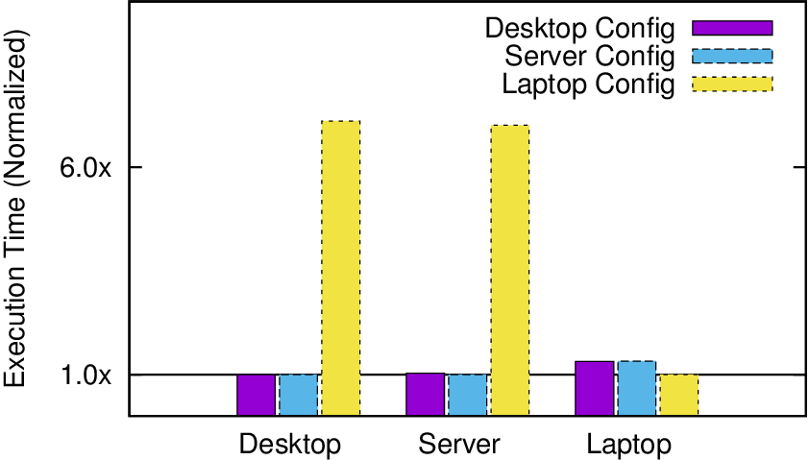
Experiment: Black-sholes
GPU-CPU task workload division on some machines
Desktop config
All on GPU
Server config
All on OpenCL
Laptop config
25% on CPU, 75% on GPU
Notes:
Right configuration can provide huge performance improvement.

Slide 22
Choice Differences Across Machines
GPU/CPU task parallelism
Global/local memory
Devices (C++/OpenCL)
Algorithms
GPU-CPU ratio
Convolution
Stressen
SOR
Tridiagonal Solver
Sort
SVD
Black-sholes
Notes:
In this slides, I’ll show the override theme of the benchmarks. I look at the 3 configurations obtained from tuning on the 3 machines and compare them.
In these 5 benchmarks, the best configurations show different mapping of program portions to different devices.
The blue ones show that best algorithmic choices are changed across the machines.
Different GPU-Cpu ratio affects performance in Black-sholes, while GPU/CPU task parallelism affects SVD benchmark.
And global/local mem decision affects convolution.

Slide 23
OpenTuner: Make Autotuning Available Beyond ZettaBricks
Every high performance programmer can, and should, use autotuners
But autotuning is sparsely used
Most still do exhaustive search!
Taking advantage of what we have learned in the 5+ ZettaBricks autotuners
We use sophisticated machine learning techniques
A general framework for building autotuners
A toolbox, not a one-size-fits-all autotuner
Making it available to the community
Domain experts can put together a sophisticated autotuner

Slide 24
Lessons from ZettaBricks #1
Configuration representation is critical
Cartesian coordinates often natural/useful
Represents things like trees poorly
OpenTuner:
Custom format with dual interfaces:
Cartesian view
Point in high dimensional space
Maze view
Dynamic number "moves" can be taken from any current position

Slide 25
Lessons from ZettaBricks #2
There is no perfect search technique
Techniques have differing strengths
Experience with many novel techniques
Exploitation/exploration tradeoff
OpenTuner:
Library of competing techniques:
Ensembles of techniques run in parallel
Credit assignment gives larger testing budgets to successful techniques
Long term (cross-run) performance informs which techniques are best for each problem

Slide 26
Lessons from ZettaBricks #3
Usage, aggregation, and interpretation of results data varies widely
Often accessed in different ways at different times
OpenTuner:
Fully featured database of results (SQL):
Cross cutting access and mining of results data
Supports transactional parallelism
Long term knowledge sharing between runs

Slide 27
OpenTuner Modules/Processes

Slide 28
OpenTuner Status
V1 is ready, ZettaBricks is now ported to the OpenTuner
Looking for users
Come find us at the Technology Marketplace

