Slide 1
Performance and Power Modeling
Adolfy Hoisie
Performance and Architecture Lab (PAL)
Pacific Northwest National Laboratory
X-stack Meeting
March 19, 2013
Berkeley, CA
Notes:
1

Slide 2
Outline
The vision
Beyond the Standard Model (BSM)
Modeling Execution Models (MEMS)
Summary

Slide 3
Challenges Exascale Poses on Modeling
Multiple constraints
  Achieve performance
  Power constraints
  Fault tolerance
Adaptivity: vast numbers of “knobs” to deal with
Complexity of the system software stack – dynamic behavior
  models in runtime
  actionable models
  guiding runtime optimizations and operation
Complexity of the architecture and associated technologies
  need to leverage marketplace
  the exascale system will emerge as a synthesis of technologies
  leverage commoditization but adds specific smarts for exascale
Modeling is called to capture multiple boundaries of the HW-SW stack
Applications need to cope with and help mitigate the increased complexity
This triggers the need for Modeling now, wide-spread exploration of future apps and future technologies

Slide 4
The vision: ubiquitous modeling
Performance & Power & Reliability
  together
Bag-of-tools approach –
  not one for all but all for one.
  modeling, simulation, and emulation.
Lifecycle coverage –
  software and hardware,
  from design space exploration, to analysis of early implementation, to deployment, and to run-time optimizations.
Co-design –
  modeling need be applied to negotiate tradeoffs at all the boundaries of the Hardware/Software stack
Dynamic Modeling –
  intelligent and informed decision within runtime software
Introspective runtime –
  dynamic hardware and software, rapid optimizations.
  the runtime system is model driven, and the model is actionable

Slide 5
The Model as a first class citizen
Performance/Power/Reliability Model

Slide 6
Beyond the Standard Model (BSM)
Collaborative project between the PNNL (PAL), LLNL, and UC San Diego/SDSC (PMaC)
Adolfy Hoisie (PI), PNNL
Kevin J. Barker (PNNL)
Greg Bronevetsky (LLNL)
Laura Carrington (SDSC)
Marc Casas (LLNL)
Daniel Chavarria (PNNL)
Roberto Gioiosa (PNNL)
Darren J. Kerbyson (PNNL)
Gokcen Kestor (PNNL)
Nathan R. Tallent (PNNL)
Ananta Tiwari (SDSC)

Slide 7
Main areas of emphasis in BSM
Modeling of Performance and Power – Establishing the modeling of performance and
power in concert as the ultimate goal, beyond the current state-of-the-art in which (except for limited instances) performance only is the modeling target
Modeling at different scales – From definition of metrics, to application models, to detailed
architectural descriptions, models capture the performance and power characteristics at the various boundaries of the hardware/software stack with the desired accuracy and predictive capability needed to make the decision at hand.
Dynamic Modeling of Performance, Power and Data Movement – At the heart of modeling performance and power together. Aims at going beyond the current practice that regardless of the methodology employed is static (off-line) in nature. We envision models operating in the entire spectrum from static to dynamic, the latter models serving as the engine of intelligent runtime systems, among others
Techniques for Model Generation – Simplifying static model generation, including through compiler based approaches, and at coming up with methodologies for generating models dynamically based on monitoring of systems and application behavior at runtime.

Slide 8
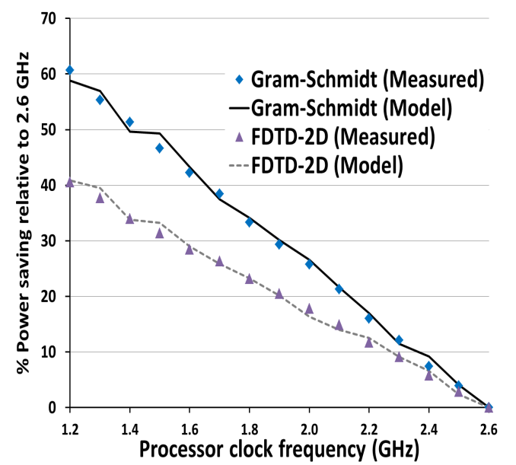
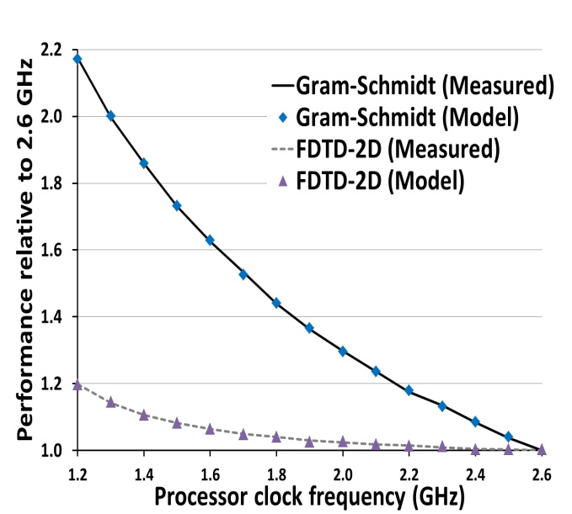
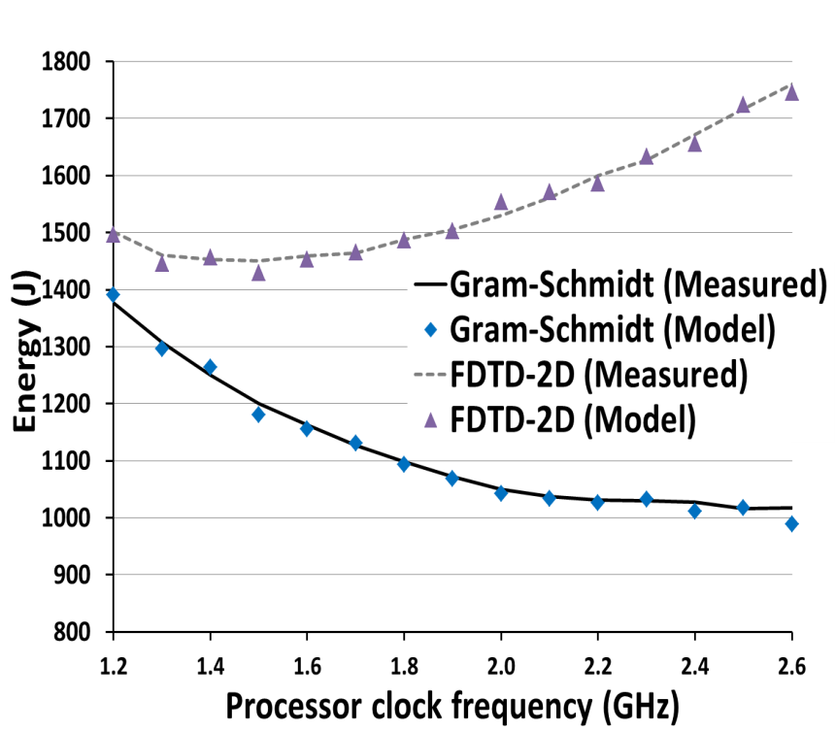
Power & Performance Modeling
Goal: Automate model generation for power and performance for large-scale HPC applications. Utilize the models to make application-aware runtime energy optimizations
Model of performance impact
Model of power impact
Energy usage = power * time
Minimal Energy Usage
Carrington et al, PMaC
Notes:
The goal at PMaC is to take our power and performance modeling techniques and combine them into a single framework, that will enable power, performance, and energy usage predictions for the computational phases of a large scale HPC application. These models enable optimizations for energy-efficiency as well as optimal computing within a power limit within the BSM runtime system.
The 2 outer plots show the power draw and performance behavior of two computational kernels that have different response to changes in the processor frequency in order to reduce power draw. The middle plot combines the power and performance models to plot energy usage. The curves show that for the gram-schmidt kernel (a dense linear algebra) the most energy efficient frequency is 2.4 GHz or the highest frequency, while the FDTD-2D kernel (a stencil kernel) shows that one can lower the frequency to ~1.5GHz and reduce the energy usage considerably.

Slide 9
Dynamic modeling & modeling at different scales
Goal: predict execution time of complex workloads
Given multiple tasks or application modules that may execute on common resources
  (e.g. Same node, same network, same file system)
Measure each task’s execution independently
Predict execution time when multiple tasks run concurrently on common resources
Bronevesky et al, LLNL

Slide 10
Execution time determined by dependencies, resource availability
Represent execution as partial order of operations
Cost of operations
determines length
of critical path and
execution time
If some resources
become congested, new critical paths emerge
Critical Path
Control points
in code
Operations
that utilize
resources
Bronevesky et al, LLNL

Slide 11
Execution time determined by dependencies, resource availability
Represent execution as partial order of operations
Cost of operations
determines length
of critical path and
execution time
If some resources
become congested, new critical paths emerge
New Critical Path
Control points
in code
Operations
that utilize
resources
Bronevesky et al, LLNL

Slide 12
Active measurement of critical paths, resource impact
Measure application Compressibility
  Run an interference
  workload to utilize a
  specific resource
  Observe impact on
  application execution
  time
Produce resource vs
time curve
Application
Resources
Resources
Resources
Resources
Utilization
Utilization
Utilization
Utilization
Time
Resources

Slide 13
Active measurement of critical paths, resource impact
Measure application Impact
  Run small workloads
  that utilize same
  resources as
  application
  Infer the amount
  available from
  workload
  execution time
Application
Measurement
Workload
Resources
Bronevesky et al, LLNL

Slide 14
Current Status
Developed compressibility measurements
  Shared cache storage, bandwidth
  Network bandwidth and latency
Lulesh
MCB
Input Size
Input Size

Slide 15




Simplifying Model Generation With Tools
Use source code annotations as primary modeling interface
Analytical (predictive) models require human input (annotations)
Tool generates model based on static & dynamic analysis
  modeler refines annotations using diagnostic feedback
Explore model as ‘first-class’ citizen
  annotations coordinate w/ source code
Explore annotation language (vs. library)
  analogy: parallelism through language instead of library
  annotation semantics may eclipse host-language semantics
    formal semantics w.r.t. static & dynamic aspects of app
    e.g.: placement not restricted to executable-statement contexts
  static analysis minimizes dynamic impact of an annotation instance
    may entirely eliminate runtime effects

Slide 16
“PALM”: PAL Model generation tool
Annotations: primary input to PAL modeling tools
Compile with PAL compiler
Execute with PAL monitor
  collect accurate & detailed measurements
Generate model based on dynamic code structure
  model expressions become model functions
Models are programs
Refine annotations using model diagnostics

Slide 17
Modeling Execution Models (MEMS)
Collaborative project between the PNNL (PAL), Indiana University, and LSU
Adolfy Hoisie (PI), PNNL
Matt Anderson (IU)
Kevin J. Barker (PNNL)
Daniel Chavarria (PNNL)
Hartmut Kaiser (LSU)
Sriram Krishnamoorthy (PNNL)
Joseph Manzano (PNNL)
Thomas Sterling (IU)
Abhinav Vishnu (PNNL)
Project coordinated with 2 other projects related to characterizing EMs from Sandia (Clay) and LBL/USC (Shalf/Lucas)

Slide 18
Modeling Execution Models
Goal: model execution models…quantitatively and predictively
What is an execution model?
  “… a paradigm of computing establishing the principles of computation that govern the interrelationships of the abstract and physical components and their functions comprising the computational process” [Thomas Sterling]
  Describes the orchestration of computation on hardware and software resources.
  Connects the application and algorithms with the underlying architecture through its semantics.
The Need for New Execution Models
  Extreme scale systems exhibit a high level of complexity
  Adaptivity is the main keyword
  The multi-objective optimization problem of achieving maximum performance within stringent power and reliability constraints at Exascale requires new system software stacks

Slide 19
Modeling Execution Models
Examples of execution models
  Sequential, SIMD, CSP, Global Memory, ParalleX, etc.
However
  Design & implementation of applications highly dependent on execution models features.
  Hardware features determine the efficiency of execution model support
  When a new execution model is introduced …
    Algorithms must be remapped to the new model
    Architecture features should be updated to support the new paradigm
How to characterize and quantify execution models?
  Simple answer: By their attributes
  SCaLeM → Hierarchical methodology to characterize, quantify and map execution models impact on hardware and applications.

Slide 20
Modeling Execution Models: SCaLeM / AntiCiPate
Execution Model Attributes
Can characterize execution models
A sufficient set of characteristics
Execution Models reason about …
S: Coordination between concurrency units
Synch
Conc
Locality
Mem
Not linearly independent
Need to be “composed” & “parameterized”
Execution Models
Execution Models
L: Differentiation between local and remote regions or units
Represent universes of all execution model’s features and primitives
C: Creating, management and destruction of concurrency units
Execution Models
M: Availability of address ranges and operations on such ranges

Slide 21
Modeling Execution Models: SCaLeM / AntiCiPate
P
A
R
A
M
E
T
E
R
S
Execution Model Compositions
  Compositions of execution model attributes
    Based on the four initial attributes
    May not be defined for a given execution model
Execution Model Parameters
  Costs of the compositions in a given architecture
  Might be a vector of values per composition entry.
Applicable to different level of abstraction
  Core → Node → System
  Hardware → Runtime → Programming Model
Mapping
  The process of mapping SCaLeM compositions between two level of abstractions: i.e. “realizing” the execution model costs
The methodology of defining the Attributes, Compositions, Parameters and Mappings is called AntiCiPate
A n t i C i P a t e
A
T
T
R
I
B
U
T
E
S
C
O
M
P
O
S
I
T
I
O
N
S
Solely architectural / system software dependent variables, not application dependent
Shared by all Execution Models
Quantifications of attributes
Relevant combination of Attributes
Modeling Methodology

Slide 22
Modeling Execution Models: SCaLeM / AntiCiPate
Extracted from Execution Model Primitives
Extracted from Architecture & System Software
SCaL’eM Attributes
Parameter List
e.g. On-node versus Off-node communications
P_{w} = {p₀, p₁, p₂, …}
S
C
F_{s}
F_{c}
F_{L}
Full System Level Parameter Space
F_{M}
F_{CL}
F_{ml}
Mapping
P_{n} = {p₀, p₁, p₂, …}
Node Level Parameter Space
L
M
…
F_{SL}
F_{MSL}
F_{CSL}
Core Level Parameter Space
P_{c} = {p₀, p₁, p₂, …}
e.g. Access to different Memory Hierarchies & NUMA domains
Execution Model Compositions
Relevant costs at each abstraction level (i.e. from a full system perspective to a per core one) can be described in terms of AntiCiPate
Performance
Prediction
Model
Workload Characterization
Application

Slide 23
Compositions in SCaLeM / AntiCiPate
Comp | Semantic Meaning
F() | Not applicable
F(S) | Synchronization operations in an execution model.
F(C) | Concurrency Style of the execution model
F(L) | Accessibility of different memory ranges
F(M) | Memory consistency characteristics of memory ranges
F(C,S) | Synchronization operations between concurrency units
F(S,M) | Classical Data centric synchronization
F(S,L) | Data centric synchronization that enforces ordering
F(C,M) | Concurrency units and their consistency interactions
F(C,L) | Concurrency units access properties
F(M,L) | Alignment between consistency and locality ranges
Comp | Semantic Meaning
F(S,C,M) | Data centric synchronization on different consistency ranges affected by the ordering of concurrency units
F(S,C,L) | Control and termination centric synchronization with respect to locality ranges
F(S,M,L) | No application found
F(C,L,M) | No application found
F(S,C,L,M) | No application found

Slide 24
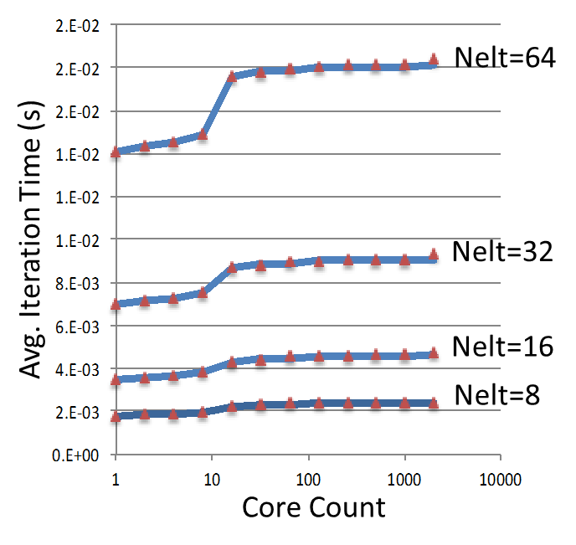
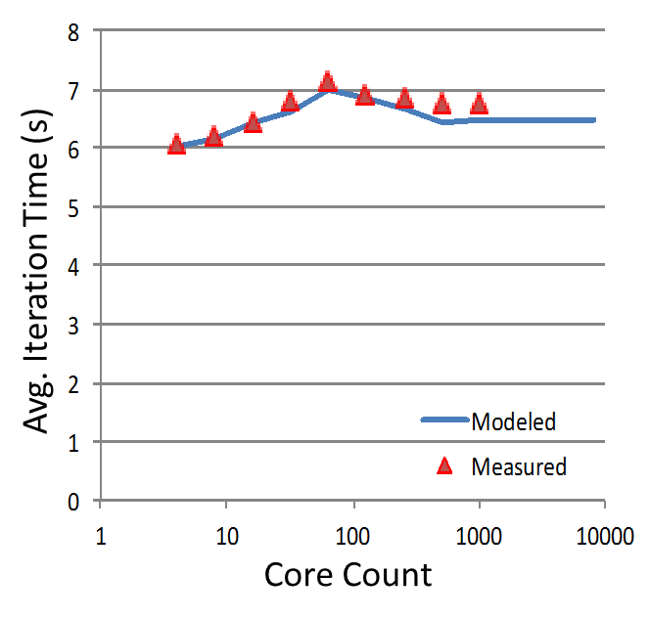
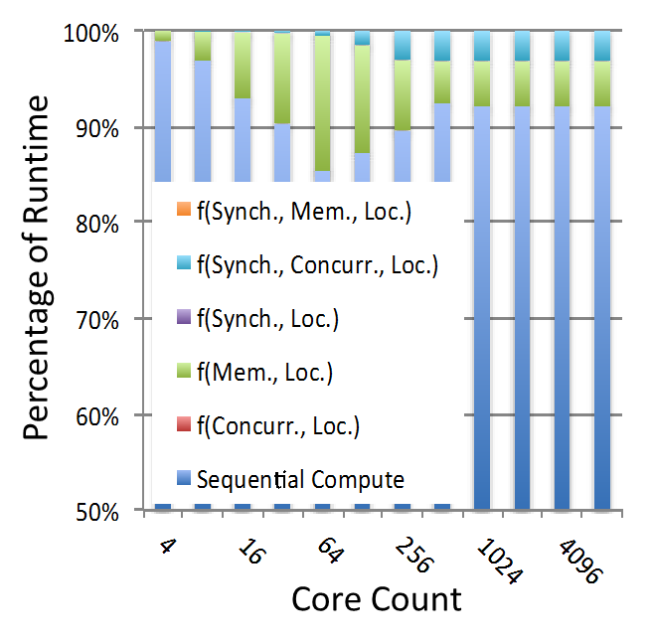
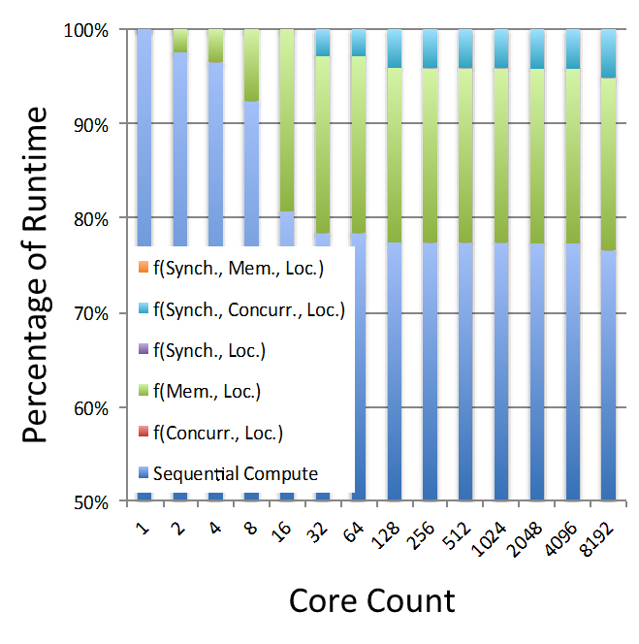
Performance Model (CSP)
GTC Model
NekBone Model
Modeled vs. Measured performance
Maximum Error < 5%
Highly Accurate Model
Composition of Memory and locality (the performance of local stores and loads) dominate the execution runtime
TLB Miss Rate
Intra-node contention resulting from congestion in the memory system

Slide 25
Modeling Execution Models: Sensitivity Analysis
Fundamental attributes of EMs, and representative modeling parameters
EM Memory and Locality Attributes
EM Synchronization, Concurrency, and Locality Attributes
Relative Performance
Core Count
Core Count
20% Improvement
80% Improvement
40% Improvement
100% Improvement
60% Improvement
Sensitivity Analysis of GTC based on ranges for EM attributes. Model-based quantitative analysis will be used for the co-design of Exascale EMs, architectures and applications.

Slide 26
Summary
We are making significant inroads towards the vision of ubiquitous modeling, including dynamic modeling, in related projects such as BSM & MEMS
The X-stack is a rich ecosystem, with significant opportunities, needs, and requirements for modeling
Coordinated, synergistic efforts at project level are key for integration (e.g., modeling in X-stack projects, modeling the execution models featured in X-stack for the workload of the co-design centers)
Work funded by DOE/ASCR, Sonia Sachs PM

