Slide 1
XPRESS Project Update
Ron Brightwell, Technical Manager
Scalable System Software Department

Slide 2
Project Goal
R&D of OpenX software architecture for exascale computing
Four thrust areas
HPX runtime system based on the ParalleX execution model that supports dynamic resource management and task scheduling
LXK lightweight operating system based on the Kitten OS that exposes critical resources to HPX runtime system
Runtime Interface to OS (RIOS) definition and description of the interaction between HPX and LXK
Support for legacy MPI and OpenMP codes within OpenX

Slide 3
OpenX Software Architecture

Slide 4
Schedule and Milestones – Year 1
Component | Year 1 Task | Lead Institution(s) | Status
OpenX Software Architecture | Define architecture components, including LXK operating system, HPX-4 runtime system, interface protocol, compilation methods, debugging tools, instrumentation, fault tolerance, and power management | Sandia, Indiana
ParalleX Execution Model | Refine specification, extend to incorporate semantics of locality and priority policies | Indiana
HPX-3 Runtime System | Implement processes, object migration, policies, system introspection | LSU
 | Develop, maintain, document, and support HPX-3 as a bootstrapping platform for XPI
HPX-4 Runtime System | Development of software architecture for each component subsystem | Indiana
LXK Operating System | Port HPX-3 on Kitten | Sandia, LSU
RIOS | Develop first draft of interface | Sandia, Indiana
XPI | Develop first specification | Indiana
On Track
Delayed
Complete
Not Started

Slide 5
Schedule and Milestones – Year 1
Component | Year 1 Task | Lead Institution(s) | Status
Introspection | Design and prototype HPX/LXK interface for performance information | RENCI
 | Design methodology and development approach for performance introspection in HPX
 | Help design XPI interface to allow for maximal system performance and parallelization information transfer
Performance Measurement | Design methodology and development approach for APEX performance instrumentation and measurement integration with OS and runtime layers | Oregon
 | Develop initial version of measurement wrapper libraries for XPI
 | Implement performance observation support in HPX-3 and evaluate
 | Identify HPX-4 performance requirements based on HPX-3 observations
Legacy Migration | Baseline runtime on HPX-3 on Kitten | Houston
 | Explore baseline support to port OpenMP/OpenACC codes to XPI
 | Evaluate modifications required to support Open MPI to OpenX
On Track
Delayed
Complete
Not Started

Slide 6
ParalleX Execution Model - Locality Extensions
Locality Intrinsics
Adaptive Locality Semantics
Processes
Encapsulation of logically local data and tasks
Very coarse to coarse granularity
Complexes
Executes on a single “synchronous domain”
Local variables in same synchronous domain
Medium granularity with intra-thread dataflow fine granularity
Multi-threading of Complexes
Asynchrony management
Non-blocking of physical resources by blocked logical threads
Limited by overhead of context switching
Parcels move work to data to minimize distance of access
Establish relative associations
Semantics of affinity
Data to data
Data to actions
Actions to actions
Establish disassociations
Uncorrelated for distribution
Task composition
Aggregation
Coarse granularity

Slide 7
XPI Goals & Objectives
A programming interface for extreme scale computing
A syntactical representation of the ParalleX execution model
Stable interface to underlying runtime system
Target for source-to-source compilation from high-level parallel programming languages
Low-level user readable parallel programming syntax
Schema for early experimentation
Implemented through libraries
Look and feel of familiar MPI
Enables dynamic adaptive execution and asynchrony management

Slide 8
Classes of XPI Operations
Miscellaneous
XPI_Error XPI_init(int *arc, char ***argv, char ***envp);
Parcels
XPI_Error XPI_Parcel_send(XPI_Parcel *parcel, XPI_Address *future);
Data types
XPI_INT, XPI_DOUBLE
Threads for local operation sequences
XPI_Error XPI_Thread_waitAll(size_t count, XPI_Address *lcos);
Local Control Objects for synchronization and continuations
XPI_Error XPI_LCO_new(XPI_LCO_SubtypeDescriptor *type, XPI_Address *lco);
Active Global Address Space
int XPI_Address_cmp(XPI_Address lhs, XPI_Address rhs);
PX Processes
Hierarchical contexts and name spaces

Slide 9
HPX-3 Runtime System
Released HPX V0.9.5 (Boost License, Github)
Main goal: API consolidation, performance, overall usability improvements
APIs aligned with C++11 Standard
Greatly improved performance of threading and parcel transport subsystem
API is now asynchronous throughout
Improved and refined performance counter framework
Based on feedback from APEX, RCB discussions
Port to Android and Mac OSX
Much improved documentation
User manual, reference documentation, examples
Updated often: http://stellar.cct.lsu.edu/files/hpx_master/docs/html/index.html
HPXC V0.2: pthreads (compilation) compatibility layer

Slide 10
Not this HPX-3….

Slide 11
HPX-3 Parcel Subsystem
Performance of existing TCP transport has been improved
Added shared memory transport
IB verbs transport is currently being developed
Added possibility to compress byte stream
Beneficial for larger messages
Support for special message handling is currently being added
Message coalescing
Removal of duplicate messages

Slide 12
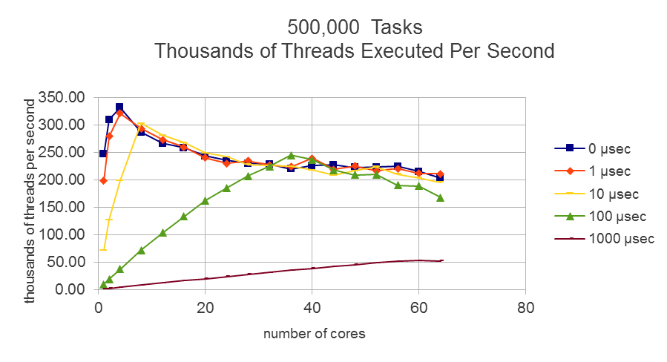
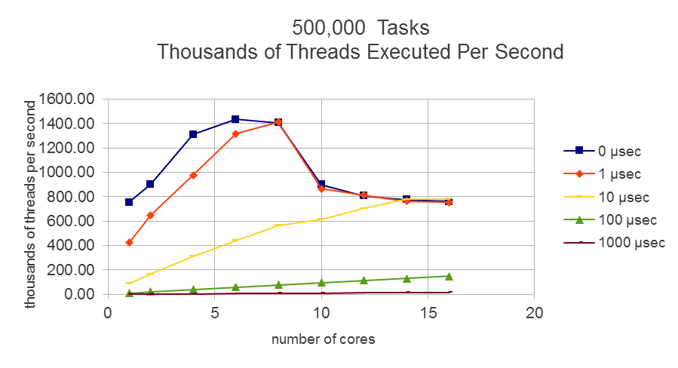
HPX-3 Threading Subsystem
Average amortized overhead for full life cycle of null thread: 700ns
More work needed: NUMA awareness!
AMD Opteron 6272 (2.1 GHz)
Intel Sandybridge E5 2690 (2.9 GHz)
Notes:
We were able to reduce the (amortized) overheads for creating, scheduling, executing, and deleting one HPX thread (with no workload) to 700ns, which is equivalent to executing ~1.4 million HPX threads per seconds.

Slide 13
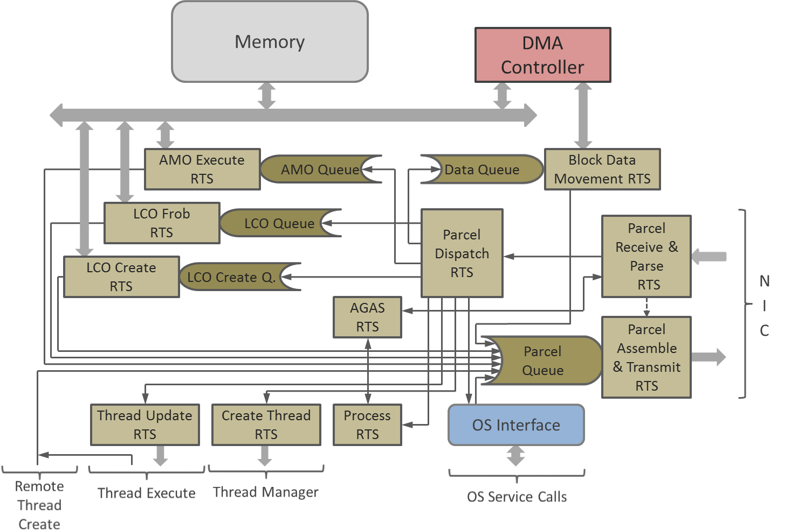
Runtime Software Architecture: Parcel Handler
Preparation for HPX-4 runtime software development
Defines runtime software services
Establishes dispatch tree
Specifies interfaces to:
Memory & DMA controller
Network interface controller
Operating System
Thread manager
Incorporates LCO operation
Logical queuing
Not necessarily implemented

Slide 14
RIOS – Runtime Interface to OS
Key logical element to OpenX system software architecture
Establishes mutual relationships and protocol requirements between new runtime systems and lightweight kernel OS
Initial boundaries being established bottom up: from internal OS and runtime system designs
IU specifying interface from HPX-4 runtime side
Processor cores – dedicated, shared, or unavailable
Physical memory blocks – allocated/de-allocated
Virtual address space assignments
Channel access to network for parcel transfer
Error detection
Sandia working on identifying OS/hardware mechanisms

Slide 15
LXK Lightweight Operating System
Completed initial analysis of HPX-3 requirements
Dynamic memory management
Non-physically contiguous allocation
Allow runtime to manage virtual-to-physical binding
Dynamic library support (dlopen)
I/O forwarding
Intra-node IPC via Portals 4
XPMEM over SMARTMAP for Portals 4 progress engine
InfiniBand support
Mellanox NICs working again
Added support for Qlogic
Integrating Hydra PMI daemon into persistent runtime
Support for multi-node process creation

Slide 16
Performance Infrastructure Unification
Gathering performance information
Dynamic hardware resource utilization information
RCRdaemon (RENCI)
Dynamic application parallelization/performance information (LSU)
Information on current location of application
TAU libraries (Oregon)
Distributing performance information
General information repository
RCRblackboard (RENCI)
Unified performance counter/event interface
HPX-3 (LSU)
Applying performance information
First and third person performance tool GUI
TAU (Oregon)
Thread scheduling adaption
HPX-3 (LSU/RENCI)

Slide 17
Progress on APEX Prototype
Built on existing TAU measurement technology
Provides initial infrastructure for data collection, performance measurement output
TAU configured with pthread support
Integrate seamlessly with HPX-3 build process
Easy integration with HPX-3 configuration
C++ library, configured with Cmake
Define APEX_ROOT, TAU_ROOT, pass to HPX-3 configuration, build HPX-3 as usual
If APEX variables are not defined, normal HPX-3 build
Execute HPX-3 application with tau_exec
Needed to preload pthread wrapper library
Eventually get rid of with link parameters
Notes:
The UO team has made solid progress with respect to design of the APEX performance measurement infrastructure, performance measurement of the HPX-3 runtime system, and beginning the transition from first-person performance reporting to third-person performance observation. The XPRESS team has implemented an APEX prototype using TAU as the core measurement infrastructure. The APEX instrumentation interface provides access to TAU performance timers and counters.
The APEX prototype has been developed with the HPX-3 build process in mind, and is designed to integrate seamlessly into the HPX-3 build. If the APEX variables are not defined, HPX-3 is configured and compiled as normal. If the APEX variables are defined with a reference to the local APEX installation, the HPX-3 build system will enable APEX support.
Tau_exec is required in order to preload the pthread wrapper library. I am currently working on making that unnecessary, by defining the wrappers in the link parameters for hpx, but I might need some help from the hpx team.

Slide 18
HPX-3 Performance Counters
HPX-3 has support for performance counters
--hpx:print-counter <counter name>
--hpx:print-counter-interval <period>
Counter Examples:
Thread queue length, thread counts, thread idle rate
Periodically sampled and/or reported at termination
Need to make available to APEX
HPX-3 modified to record counters to APEX
Counter values captured at interval and exit
Required a new TAU counter type: context user event
Conventional process/OS thread dimensions
No ParalleX model specific measurements yet
Notes:
HPX-3 previously provided support for various performance counters that could be periodically sampled and/or reported at program termination. Some examples of these counters include the runtime thread queue length, various thread counts, and the thread idle rate. As these counters were only output to the user terminal, the counters were not easily machine readable, nor in a form that could leverage existing analysis tools. HPX-3 was modified so that when the counters were reported they were also recorded by the APEX prototype, and subsequently stored in performance profiles at program termination. This initial implementation will be improved, so that whenever these monitored counters are modified, they will be automatically reported to the APEX measurement library, rather than only when requested. Supporting the HPX-3 counters required a modification to TAU to create a new type of counter, a context user event.

Slide 19
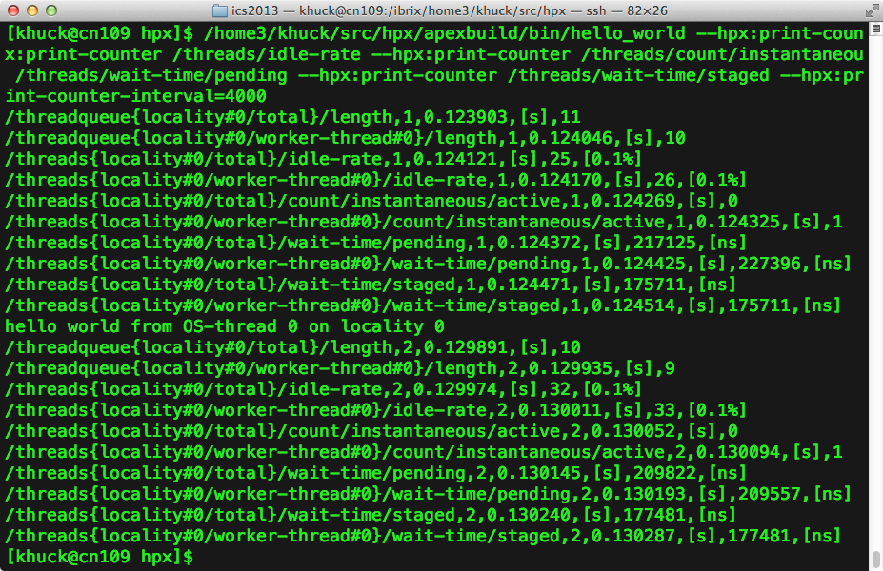
HPX-3 Performance Counters
HPX previously output to screen
or text file
TAU profile from APEX integration
Notes:
HPX performance counters were previously output to screen or a text file. By integrating them with APEX, we capture them to put in a profile, with timer data. Statistics are generated by APEX/TAU automatically.

Slide 20
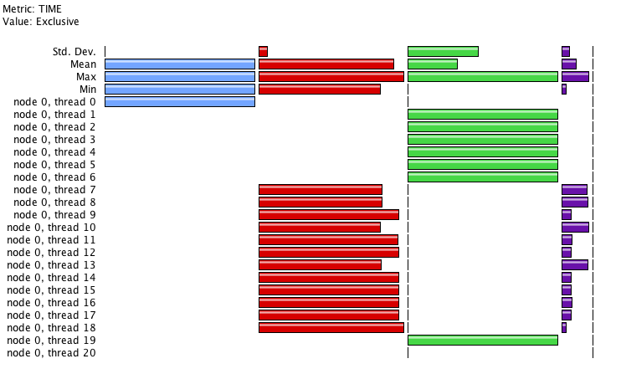
HPX-3 Timers
HPX thread scheduler loop
HPX “main”
HPX “helper” OS threads
HPX user level
GTCX on 1 node of ACISS cluster at UO
* 20 / 80 OS threads * 12 cores (user)
Instrumented the thread scheduler
Separates scheduler time from executing user-level threads
Notes:
Showing 20 of 80 total OS (pthread) threads. The blue bar is “main” from the primary thread of each process. The green bars are .TAU application (the top level timer) for the helper threads. The red bars are the thread scheduler loop. The purple bars are the user level code. Notice that far more time is spent in the thread scheduler than the user level code. We need to understand this better, to see if that is truly the case.
The GTCX application is a significant code example distributed with HPX. It has better scaling behavior and performance than the conventional MPI version of GTC.
The “main” OS thread and the “helper” OS threads are mostly idle during execution.

Slide 21
Integration with RCRToolkit
Currently only observing daemon data
Energy, power
APEX will broadcast performance data to the blackboard
Current HPX runtime performance state
Timer statistics
APEX will also consume data from the blackboard
Runtime layer will know about problems in the OS
Contention, latency, deadlock…
DSL layer will know about problems in the runtime
Starvation, latency, overhead, contention…
Notes:
The current prototype integration with RCR is unavailable, as the daemon isn’t running on the RENCI machine, and Allan and Rob have started re-writing the whole thing. I would capture some sample output for you, but because of those problems, I can’t…

Slide 22
RCRBlackboard
Initial Purpose: Provide Dynamic User Access to Shared Hardware Performance Counter
Prototype: Implemented using Google Protobuf
Each region has a single writer/multiple readers
Publisher / Reader (readers don’t register – so don’t know who is reading)
Provides information to APEX
Uses shared memory region to pass information
RCRdaemon Overhead 16-17% of a single core
Overhead of compaction/expansion of Protobuf ~8-10%
Overhead of using pread to access MSR performance registers
Reimplementation: Use hierarchical include file to define data
One writer per page
Simple load/store to access data in blackboard (overhead down to 6-7%)
Direct access to MSR register (in progress)

Slide 23
Dynamic Thread Scheduling Adaption
Continuing work from previous projects
Concurrency Throttling
Poor scaling happens for many reasons
Memory contention – too many accesses for memory to handle – additional concurrency does not decrease execution time – memory is already saturated
RCRDaemon/blackboard can detect periods of memory saturation
For Intel SandyBridge/IvyBridge RCRdaemon/blackboard can detect periods with high power requirements
Integrate thread scheduling with RCRblackboard and limit active concurrency when power and memory contention are both high
Start of prototype implementation predates project
RENCI is exploring an HPX implementation – requires locality based thread scheduler

Slide 24
Concurrency Throttling for Power
Simple model within runtime reads RCRblabckboard
If Power combined over both sockets during the last time period (~0.001sec) exceeds 150 W mark power as high if below 100 set power as low
If outstanding memory references (combined over all memory controllers) exceeds 75% of achievable set high if below 25% set low
If both high – limit concurrency
At next schedule point idle first 4 threads (and set duty-cycle to 1/32 clock)
On parallel loop completion/program termination/ or no-longer both high – release thread (and reset duty cycle)
Configuration | Time | Total Joules | Ave. Watts
16 Threads – dyn | 48.4 | 6860 | 141.7
16 Threads – fixed | 45.5 | 7089 | 155.9
12 Threads – fixed | 48.2 | 6341 | 131.5

Slide 25
Legacy Application Migration Path
Step 1: A POSIX/MPI wrapper for HPX/XPI
Only requires relinking, seamless migration
No code/compiler/runtime change required
Very easy to retarget most scientific OpenMP codes to HPX
Step 2: Add XPI subset to the MPI/OpenMP runtime
Requires OpenMP runtime and compiler changes
Possible language changes at this point
Changes to application source codes may be required
Step 3: Introduce other HPX/XPI to the MPI/OpenMP runtime
Requires OpenMP runtime and compiler changes
Will require language extensions
Leverage OpenMP 4.0 or proposal for new extensions
Application changes will be needed, but goal is to minimize the developer effort
May need to restructure application parallelism pattern
Notes:
Overview, migrate, picture, migration path

Slide 26
Progress on Legacy Application Migration
Migration of MPI/OpenMP apps
A pthread layer on top of HPX-3
OpenUH OpenMP runtime integration with HPX-3
Retargeting OpenMPI on top of HPX-3
OpenACC work -- to leverage current OpenACC apps
Working on the OpenACC compiler in the OpenUH runtime → integrate accelerator execution model in the XPRESS runtime
Goals: help DoE GPGPU code
Extensions of OpenMP to support ParalleX features
Completed OpenMP data-driven computation ←→ HPX future
Leverage OpenMP 4.x standard
Notes:
OpenX, HPX-3, HPX-4 and XPI

Slide 27
http://xstack.sandia.gov/xpress

