Slide 1
Enabling Refinement with Synthesis
Armando Solar-Lezama with work by
Zhilei Xu and many others*

Slide 2
The Programming Model Conundrum
Contradictory Requirements
High-level enough to enhance productivity
High-level enough to enable performance portability
Low-level enough to give the programmer control
Low-level enough to ensure predictable performance

Slide 3
Traditional Compiler Approach
space of all programs
High-level code
low-level code Explicitly committed to a set of implementation details
more explicit about implementation details

Slide 4
Traditional Compiler Approach
Can program at a high-level or at a low-level
You can write clean high-level code
You can write very efficient code
But they are usually not the same code!
Solution
Take control over the lowering process

Slide 5
Interactive Refinement 1
Provide sequence of lower-level implementations
space of all programs
High-level code
low-level code Explicitly committed to a set of implementation details
more explicit about implementation details

Slide 6
Interactive Refinement 1
Provide sequence of lower-level implementations
Stop once the implementation is “low enough”
Record of lowering steps serves as documentation
System checks equivalence between versions
Can be a big help in avoiding bugs
We can do even better

Slide 7
Sketch Based Refinement
Infer the details of refined versions
space of all programs
High-level code
low-level code Explicitly committed to a set of implementation details
more explicit about implementation details

Slide 8
Enabling abstractions with Synthesis
Writing the Kernel:
void seqKernel(Grid g){
sten(|Cell| c){
double v1 = getValue(getNeighbor(c, -1, -1));
double v2 = getValue(getNeighbor(c, -1, 1));
setValue(c, (v1 + v2)/2);
}
time_iterator(g, cell)
}

Slide 9
Grid and Cell library
void time_iterator(Grid g, fun f){
int N = g.n;
int T = g.t;
int ofst = ??;
minimize(ofst);
for(int i=ofst; i<T-ofst; ++i){
for(int j=ofst; j<N-ofst; ++j){
f( getCell(g, i, j) );
}
}
}
Offset is left for the synthesizer to discover
This simplifies the interface making library easier to use
Eliminates one common source of errors

Slide 10
Distribution
Simple distributed implementation

Slide 11
Distributed Refinement
Code is more or less the same
void spmdKernel(DGrid g){
sten(|Cell| c){
double v1 = getValue(getNeighbor(c, -1, -1));
double v2 = getValue(getNeighbor(c, -1, 1));
setValue(c, (v1 + v2)/2);
}
dtime_iterator(g, cell)
}

Slide 12
Distributed Refinement
void dtime_iterator(DGrid g, fun f){
int N = g.ln;
int T = g.t;
int ofst = ??;
minimize(ofst);
for(int i=ofst; i<T-ofst; ++i){
for(int j=ofst; j<N-ofst; ++j){
f( getCell(g, i, j) );
}
exchange(g);
}
}
Iterator is now scanning over the local portion of the distributed grid.
after every timestep, an exchange step updates ghost regions
Distributed iterator is very general and works for many kernels
Details of exchange will be different depending on kernel

Slide 13
Distributed Refinement
Communicating refinement
We need to tell the system about the equivalence of the two kernels
We need to tell the system about the relatiohsip between the sequential and distributed DS

Slide 14
Describing equivalence
void SPMDcompute(Grid g) implements seqKernel{
SMPD_fork{
Dgrid dg;
dg = distribute(g);
spmdKernel(dg);
collect(g, dg);
}
}
Distribute and Collect describe how to map back and forth from distributed to global state.

Slide 15
Example Continued
Improving locality
Trading communication for computation

Slide 16
Example Continued

Slide 17
Distributed Refinement
Different implementation strategies encapsulated in different iterators
Rest of the code remains unchanged

Slide 18
Further refinement
void dtimeblocked_iterator(DGrid g, fun f){
int N = g.ln;
int T = g.t;
int ofst = ??;
minimize(ofst);
for(int i=ofst; i<T-ofst; i += BLOCK){
midTriangle(i, g);
steadyState(i,g);
exchange(g);
leftLeftover(i, g);
rightLeftover(i,j);
}
}

Slide 19
Generators + Synthesis
Generator1
Generator2
Generator3
Spec1
Generators define an exploration space for autotuning
Spec2
Spec3

Slide 20
Synthesis for a DSL
Synthesis technology is limited in the amount of code it can handle at once
This limits our scope to simple kernels
DSLs can help us work on larger codes by abstracting low-level details

Slide 21
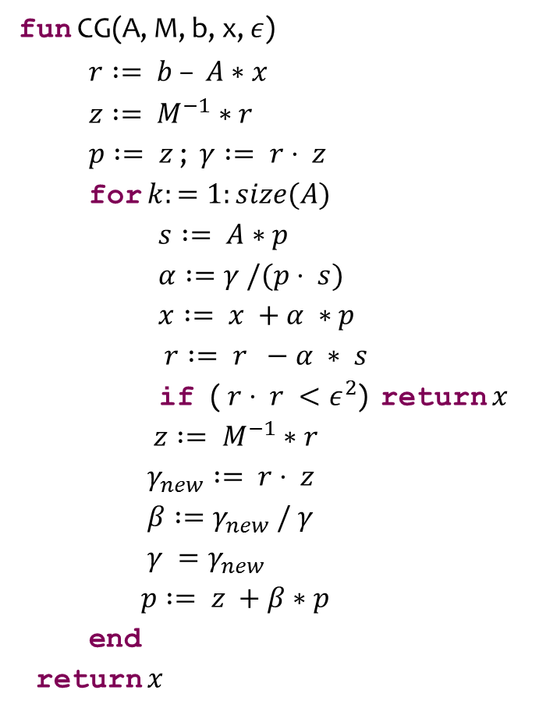
Example
fun CG(A, M, b, x, $ε$)
$r := b – A∗x$
$z := M^{−1}∗r$
$p := z$ ; $γ := r⋅ z$
for $k:=1:size(A)$
$s := A∗p$
$α :=γ /(p⋅ s)$
$x := x +α ∗p$
$r := r −α ∗ s$
if ( $r⋅ r <ε^{2}$) return $x$
$z := M^{−1}∗r$
$γ_{new} := r⋅ z$
$β :=γ_{new} / γ$
$γ =γ_{new}$
$p := z +β∗p$
end
return $x$
Very high-level transformation
Performance bottleneck
Operation is expensive
The result is used right away

Slide 22
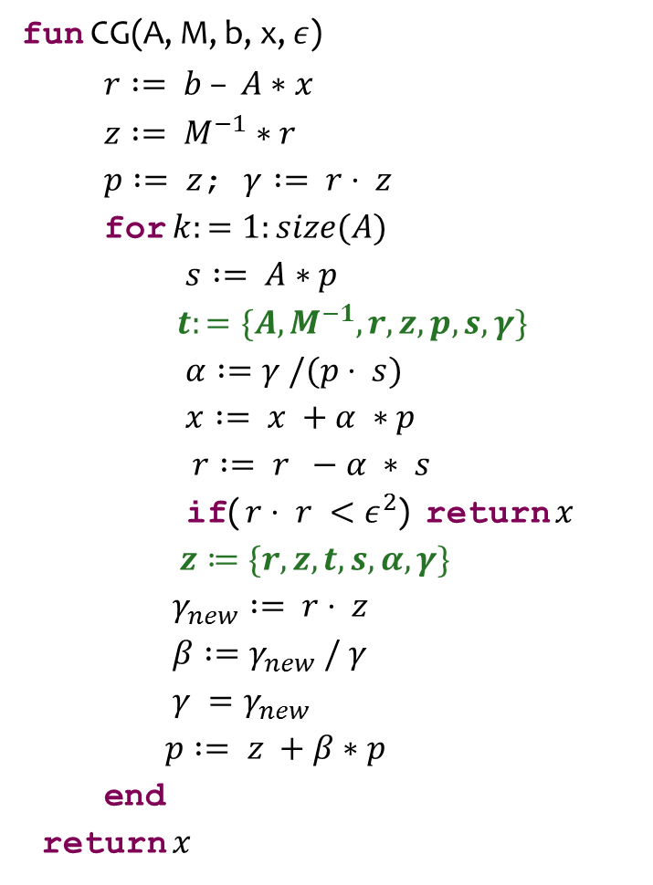
Example
fun CG(A, M, b, x, $ε$)
$r := b – A∗x$
$z := M^{−1}∗r$
$p := z$; $γ := r⋅ z$
for $k:=1:size(A)$
$s := A∗p$
$t:=\{A, M^{−1}, r, z, p, s, γ\}$
$α :=γ /(p⋅ s)$
$x := x +α ∗p$
$r := r −α ∗ s$
if( $r⋅ r <ε^{2}$) return $x$
$z≔\{r, z, t, s, α,γ\}$
$γ_{new} := r⋅ z$
$β :=γ_{new} / γ$
$γ =γ_{new}$
$p := z +β∗p$
end
return $x$
Idea:
Move the expensive computation out of the critical path
Computation of z no longer involves matrix multiplication
The idea is simple, but we need to figure out the details

Slide 23
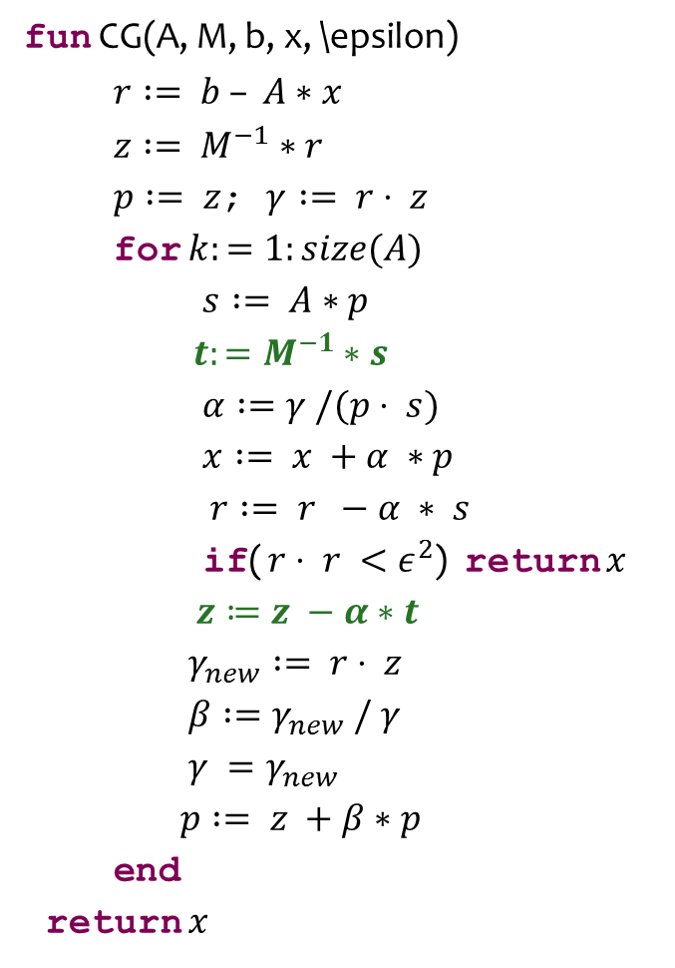
Example
fun CG(A, M, b, x, \epsilon)
$r := b – A∗x$
$z := M^{−1}∗r$
$p := z$; $γ := r⋅ z$
for $k:=1:size(A)$
$s := A∗p$
$t:=M^{−1}∗s$
$α :=γ /(p⋅ s)$
$x := x +α ∗p$
$r := r −α ∗ s$
if( $r⋅ r <ε^{2}$) return $x$
$z≔z −α∗t$
$γ_{new} := r⋅ z$
$β :=γ_{new} / γ$
$γ =γ_{new}$
$p := z +β∗p$
end
return $x$
Synthesizer can figure this out in < 3 min.

Slide 24
Open Challenges
Scalability, scalability, scalability
Modeling and abstraction are crucial
Learning from experience
Can you learn from a similar refinement?
Can you generalize from a one-off to a rewrite rule
Feedback and debugging
Correctness Guarantees

