Slide 1
DynAX
Innovations in Programming Models, Compilers and Runtime Systems for Dynamic Adaptive Event-Driven Execution Models
X-Stack: Programming Challenges, Runtime Systems, and Tools
Brandywine Team
March 2013

Slide 2
Objectives
Scalability | Expose, express, and exploit O(10¹⁰) concurrency
Locality | Locality aware data types, algorithms, and optimizations
Programmability | Easy expression of asynchrony, concurrency, locality
Portability | Stack portability across heterogeneous architectures
Energy Efficiency | Maximize static and dynamic energy savings while managing the tradeoff between energy efficiency, resilience, and performance
Resilience | Gradual degradation in the face of many faults
Interoperability | Leverage legacy code through a gradual transformation towards exascale performance
Applications | Support NWChem

Slide 3




Brandywine Xstack Software Stack
NWChem + Co-Design Applications
Rescinded Primitive Data Types .
HTA
(Library)
R-Stream
(Compiler)
SCALE
(Compiler)
E.T. International, Inc.
SWARM
(Runtime System)
E.T. International, Inc.

Slide 4
SWARM
MPI, OpenMP, OpenCL
SWARM
VS.
Time
Time
Active threads
Waiting
Communicating Sequential Processes
Bulk Synchronous
Message Passing
Asynchronous Event-Driven Tasks
Dependencies
Resources
Active Messages
Control Migration

Slide 5
SCALE
SCALE: SWARM Codelet Association LangaugE
  Extends C99
  Human readable parallel intermediate representation for concurrency, synchronization, and locality
  Object model interface
  Language constructs for expressing concurrency (codelets)
  Language constructs to association codelets (procedures and initiators)
  Object constructs for expressing synchronization (dependencies, barriers, network registration)
  Language constructs for expressing locality (planned)
SCALECC: SCALE-to-C translator

Slide 6
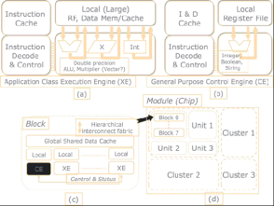
Rstream Compiler
R-Stream
Loop + data optimizations,
locality, parallelism, communication
and synchronization generation
Different APIs
and execution
models (AFL, OpenMP,
DMA, pthreads,
CUDA…)
Polyhedral
Mapper
Machine Model
Low-Level Compilers
ISO C Front End
API
Lowering
Code Gen/Back End
Raising
Compiler Infrastructure
…

Slide 7
Hierarchical Tiled Arrays
Abstractions for parallelism and locality
Recursive data structure
Tree structured representation of memory
Distributed
across nodes
Across cores
Tiling for locality

Slide 8
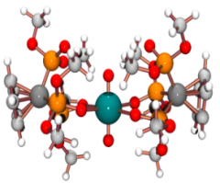
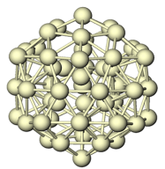
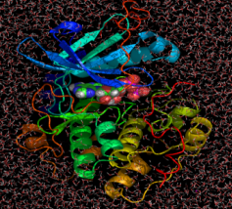
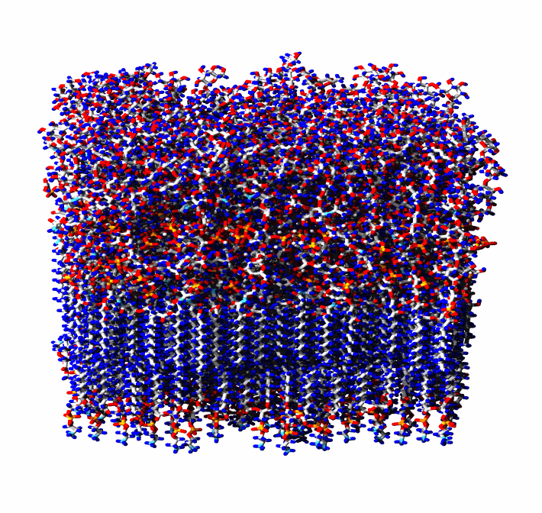
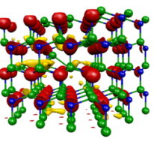
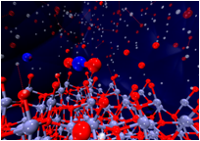
NWChem
QM-CC QM-DFT AIMD QM/MM MM
DOE’s Premier computational chemistry software
One-of-a-kind solution scalable with respect to scientific challenge and compute platforms
From molecules and nanoparticles to solid state and biomolecular systems
Distributed under Educational Community License
Open-source has greatly expanded user and developer base
Worldwide distribution (70% is academia)

Slide 9
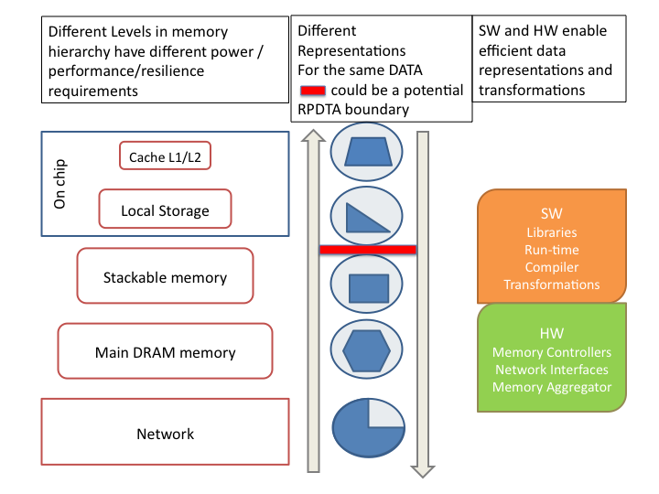
Rescinded Primitive Data Type Access
Prevents actors (processors, accelerators, DMA) from accessing data structures as built-in data types, making these data structures opaque to the actors
Redundancy removal to improve performance/energy
Communication
Storage
Redundancy addition to improve fault tolerance
High Level fault tolerant error correction codes and their distributed placement
Placeholder representation for aggregated data elements
Memory allocation/deallocation/copying
Memory consistency models

Slide 10
Approach
Study codesign application
Map application (by hand) to asynchronous dynamic event-driven runtime system [codelets]
Determine how to improve runtime based on application learnings.
Define key optimizations for compiler and library team members.
Rinse, wash, repeat.

Slide 11
Progress
Applications
  Cholesky Decomposition
  NWChem: Self Consistent Field Module
Compilers
  HTA: Initial design draft of PIL (Parallel Intermediate Language)
  HTA: PIL -> SCALE compiler
  R-Stream: Codelet generation, redundant dependence
Runtime
  Priority Scheduling
  Memory Management
  Data Placement

Slide 12
Cholesky DAG
POTRF → TRSM
TRSM → GEMM, SYRK
SYRK → POTRF
Implementations:
  MKL/ACML (trivial)
  OpenMP
  SWARM
POTRF
TRSM
SYRK
GEMM
1:
2:
3:

Slide 13
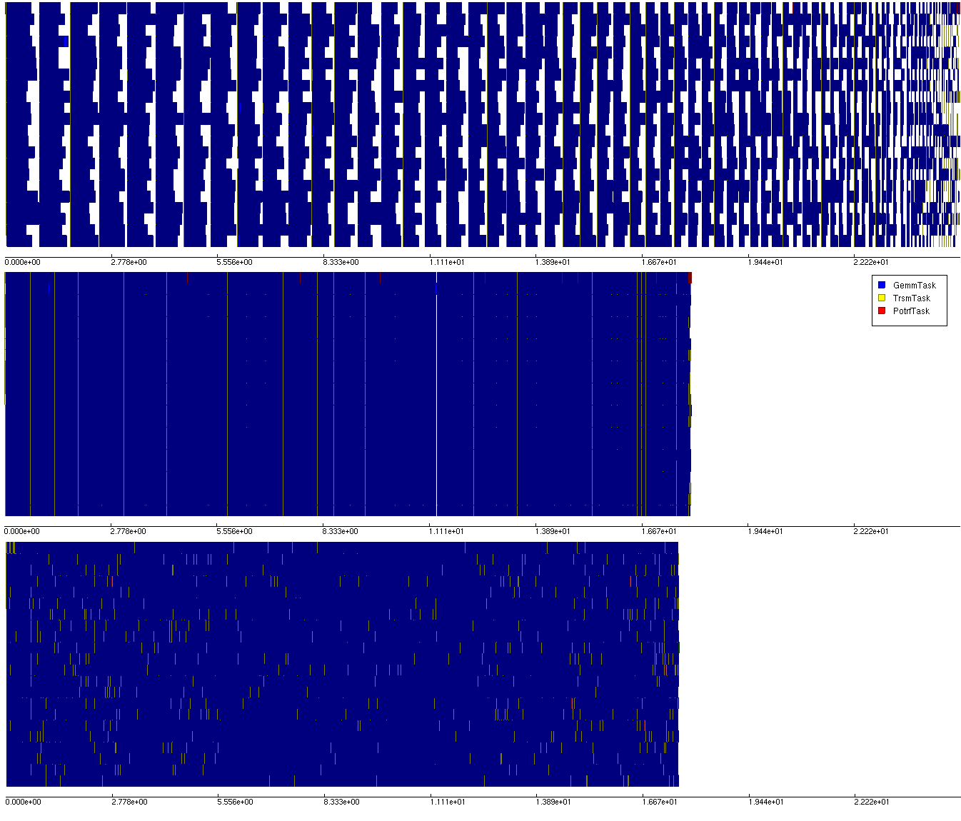
Cholesky Decomposition: Xeon
Naïve OpenMP
Tuned OpenMP
SWARM

Slide 14
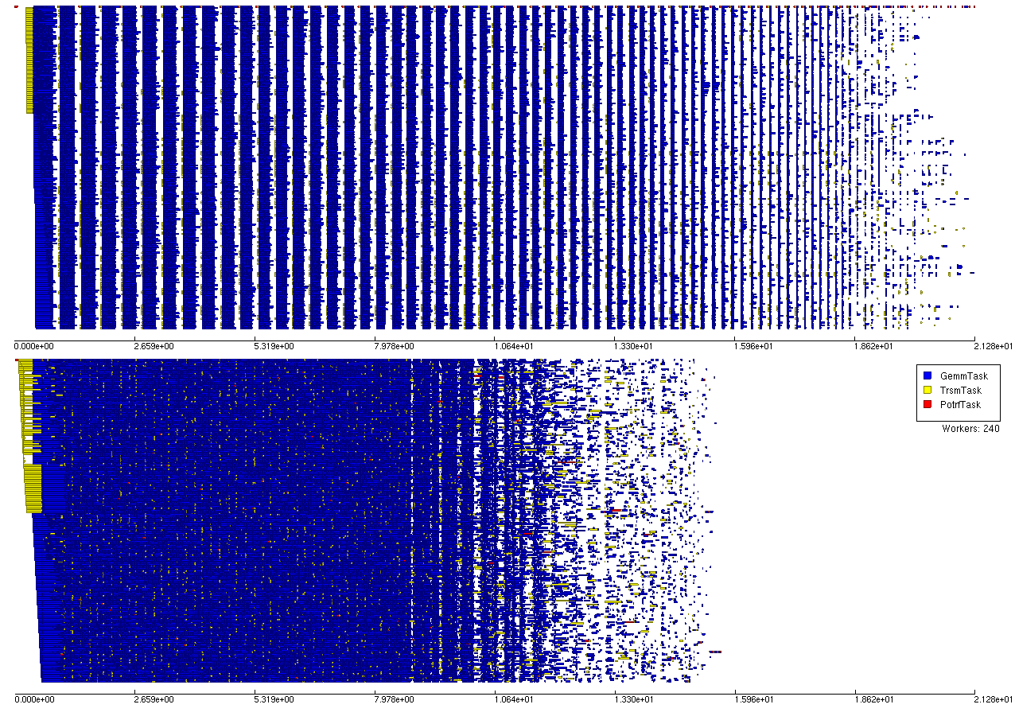
Cholesky Decomposition: Xeon Phi
OpenMP
SWARM
Xeon Phi: 240 Threads
OpenMP fork-join programming suffers on many-core chips (e.g. Xeon Phi).
SWARM removes these synchronizations.

Slide 15
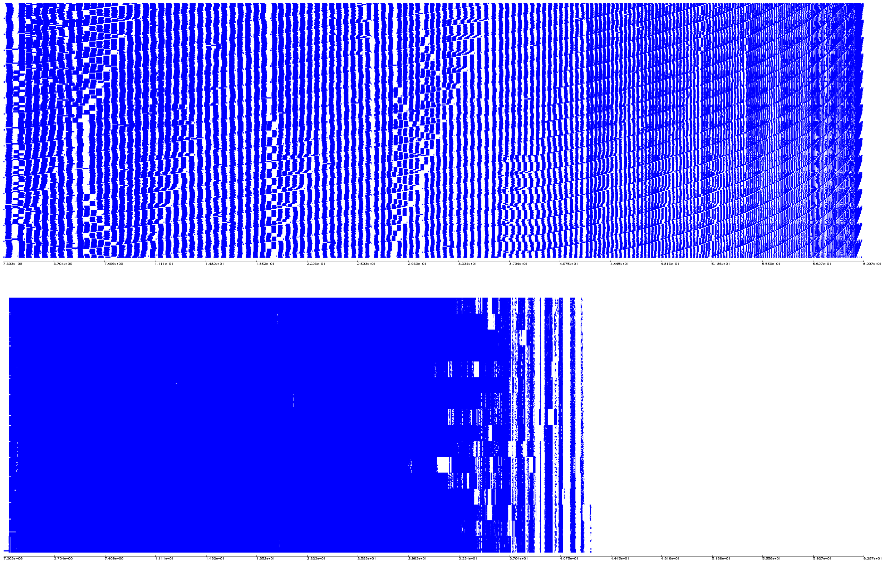
Cholesky: SWARM vs ScaLapack/MKL
ScaLapack
SWARM
16 node cluster: Intel Xeon E5-2670 16-core 2.6GHz
Asynchrony is key in large dense linear algebra

Slide 16
Memory and Scheduling: no prefetch
Net – # outstanding buffers that are needed for computation but not yet consumed
Sched – # outstanding tasks that are ready to execute but have not yet been executed
Miss - # times a scheduler went to the task queue and found no work (since last timepoint)
Notice that at 500s, one node runs out of memory and starves everyone else.

Slide 17
Memory and Scheduling: static prefetch
Because the receiver prefetches, he can obtain work as it is needed.
However, there is a tradeoff between prefetching too early and risking out of memory and prefetching too late and starving.
It turns out that at the beginning of the program we need to prefetch aggressively to keep the system busy, but prefectch less when memory is scarce.
A prefetch scheme that is not aware of memory usage cannot balance this tradeoff.

Slide 18
Memory and Scheduling: dynamic prefetch
Because the receiver prefetches, he can obtain work as it is needed.
The receiver determines the most buffers it can handle (i.e. 40,000)
It immediately requests the max and whenever a buffer is consumed, it requests more.
Note the much higher rate of schedulable events at the beginning (5000 vs 1500) and no memory overcommital

Slide 19
Key Learnings
Fork-Join model does not scale for Cholesky
  Asynchronous data dependent execution needed
Scheduling is by priority is key
  Not based on operation, but phase and position
Memory Management
  ‘pushing’ data to actor does not allow actor to control it’s memory management
  Static prefetch works better but limits parallelism
  Prefetch based on how much memory (resource) you have provides best balance

Slide 20
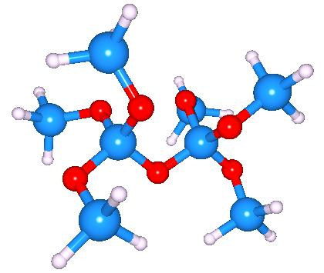




Self-Consistent Field Method
Obtain variational solutions to the electronic Schrödinger Equation
Wavefront
Energy
By expressing the system’s one electron orbitals as the dot product of the system’s eigenvectors and some set of Gaussian basis functions
eigenvector
Gaussian basis function

Slide 21
… reduces to
The solution to the electronic Schrödinger Equation reduces to the self-consistent eigenvalue problem
Eigenvalues
Overlap matrix
Eigenvectors
Two-electron Exchange forces
Density matrix
Two-electron Coulomb forces
Fock matrix
One-electron forces

Slide 22
Logical flow
Initial Density Matrix
Initial Orbital Matrix
Construct Fock Matrix
a) One electron
b) Two electron
Compute Orbitals
Schwarz Matrix
no convergence
Damp Density Matrix
Compute Density Matrix
convergence
Output

Slide 23
The BIG loop
twoel
for (i = 0; i < nbfn; i++) {
for (j = 0; j < nbfn; j++) {
for (k = 0; k < nbfn; k++) {
for (l = 0; l < nbfn; l++) {
if (g_schwarz[i][j] * g_schwarz[k][l]) < tol2e) continue;
double gg = g(i, j, k, l);
g_fock[i][j] += ( gg + g_dens[k][l]);
g_fock[i][k] -= (0.5 * gg * g_dens[j][l]);
}
}
}
}

Slide 24
Serial Optimizations
Added additional sparsity tests.
Reduced calls to g by taking advantage of its 8-way symmetry.
Replaced matrix multiplication and eigenvector solving routines with BLAS and LAPACK.
Pre-compute lookup tables for use in g to reduce calculations and total memory accesses.
Reduced memory accesses in inner loops of twoel by taking advantage of input and output matrices being symmetric
Parallelized twoel function using SWARM.

Slide 25
Serial Optimizations

Slide 26
Single Node Parallelization
SWARM
  Create temp arrays and do a parallel array reduction
OpenMP:
  Version 1: Atomic operations
  Version 2: Critical Section
  Version 3: SWARM method [not really OpenMP style]

Slide 27
Single Node Parallelization

Slide 28
Multi-Node Parallelization

Slide 29
Key Learnings
Better loop scheduling/tiling needed to balance parallelism
Better tiling needed to balance cache usage [not yet done]
SWARM Asynchronous runtime natively supports better scheduling/tiling than current MPI/OpenMP
  Rstream will be used to automate the current hand-coded decomposition
Static workload balance across nodes is not possible [highly data dependent]
  Future work: Dynamic internode scheduling

Slide 30
R-Stream
Automatic parallelization of loop codes
  Takes sequential, “mappable” C (writing rules)
Has both scalar and loop + array optimizers
Parallelization capabilities
  Dense: core of the DoE app codes (SCF, stencils)
  Sparse/irregular (planned): outer mesh computations
Decrease programming effort to SWARM
  Goal: “push button” and “guided by user”
  User writes C, gets parallel SWARM
Loops
R-Stream
Parallel Distributed SWARM

Slide 31
The Parallel Intermediate Language (PIL)
Goals
  An intermediate language for parallel computation
  Any-to-any parallel compilation
    PIL can be the target of any parallel computation
    Once parallel computation is represented in PIL abstraction, it can be retargeted to any supported runtime backend
Retargetable
  Possible Backends
    SWARM/SCALE, OCR, OpenMP, C, CnC, MPI, CUDA, Pthreads, StarPU
  Possible Frontends
    SPIL, HTAs, Chapel, Hydra, OpenMP, CnC

Slide 32
PIL Recent Work
Cholesky decomposition in PIL case study
  Shows SCALE and OpenMP backend perform very similarly
  PIL adds about 15% overhead to pure OpenMP implementation from ETI
Completed and documented the PIL API design
  Extended PIL to allow creation of libraries
    We can provide or users can write reusable library routines
  Added built in tiled Array data structure
    Provide automatic data movement of built in data structures
  Designed new higher level language Structured PIL (SPIL)
    Improves programmability of PIL

Slide 33
Information Repository
All of this information is available in more detail at the Xstack wiki:
  http://www.xstackwiki.com

Slide 34
Acknowledgements
Co-PIs:
  Benoit Meister (Reservoir)
  David Padua (Univ. Illinois)
  John Feo (PNNL)
Other team members:
  ETI: Mark Glines, Kelly Livingston, Adam Markey
  Reservoir: Rich Lethin
  Univ. Illinois: Adam Smith
  PNNL: Andres Marquez
DOE
  Sonia Sachs, Bill Harrod

