Slide 1
Climate Science:
The Most Important DOE App for X Stack
Phil Jones (LANL)
Project Lead: Climate, Ocean and Sea Ice Modeling (COSIM)
Two-time Co-design Loser

Slide 2
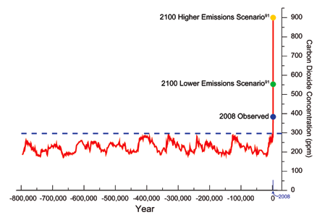
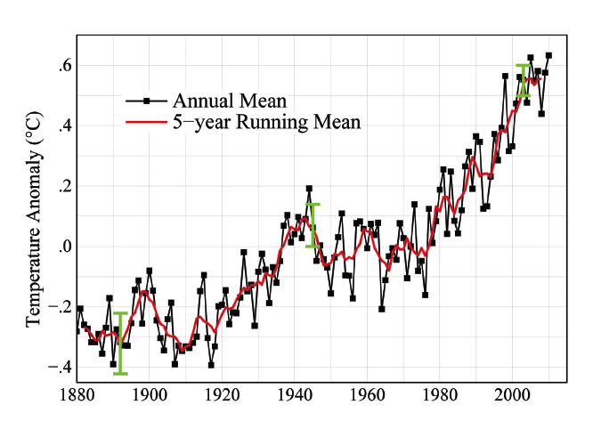
Temperature is Rising due to Anthropogenic Greenhouse Gases
0.8 degrees C
Basic relationship:
Fourier (1824)
Pouillet(1827)
Tyndall (1859)
Arrhenius (1896)
Isotopes and inventories: human emissions and land use change
But Tavg is not the only (or even the most important) metric – this ain’t QCD

Slide 3
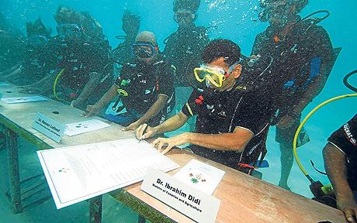
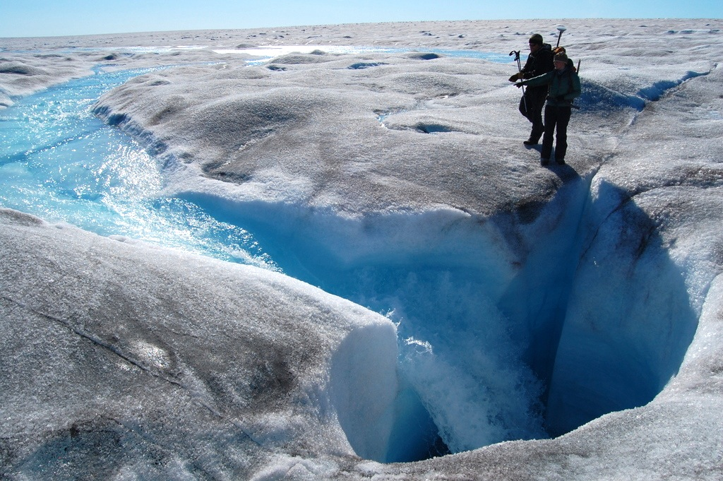

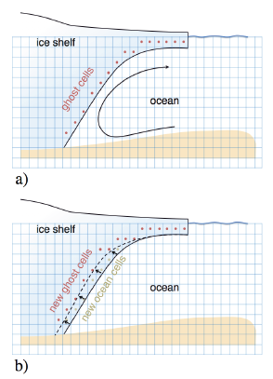
Ice Sheets and Sea Level Rise
Stephen Leatherman
Recent addition to models
Needed for sea level rise prediction
6m of sea level rise if Greenland melts, 6m if W. Antarctic ice sheet melts
Slow melt over 1000 years or more rapid?
Threshold of no return?
Small-scale ice sheet dynamics, ocean/ice interaction, disparate timescales
Gravitation/geodetic
Gregory et al. 2004

Slide 4
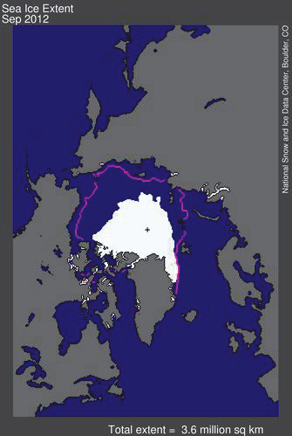
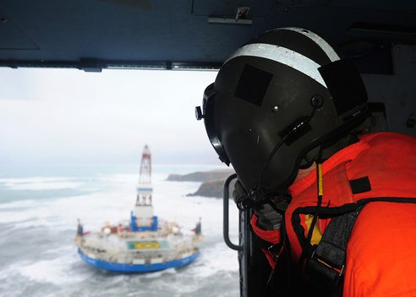
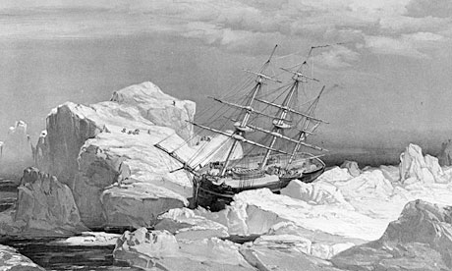
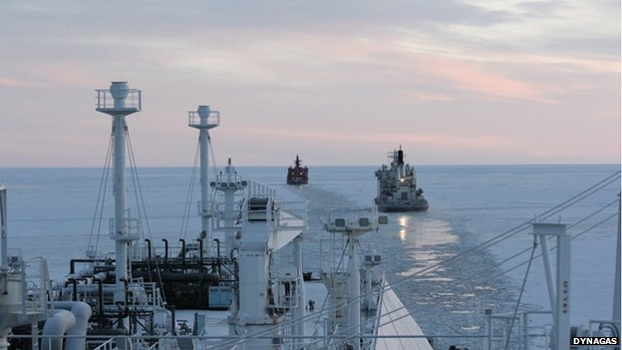
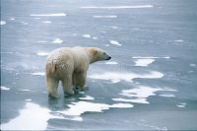

Arctic Prediction
Polar amplification
  Rapid ice loss, feedbacks
  Impacts on global weather
Human activities/energy
  Infrastructure, coastal erosion, permafrost melt
  Resource extraction
  Shipping
  Security/safety, staging
Ecosystem impacts/mgmt
  Arctic, marine mammals
  Marine ecosystems
Regime change
  Thin ice leads to more variability
Shell Kulluck Arctic oil rig runs aground in Gulf of Alaska
(USCG photo)
LNG carrier Ob River in winter crossing (with icebreakers)

Slide 5
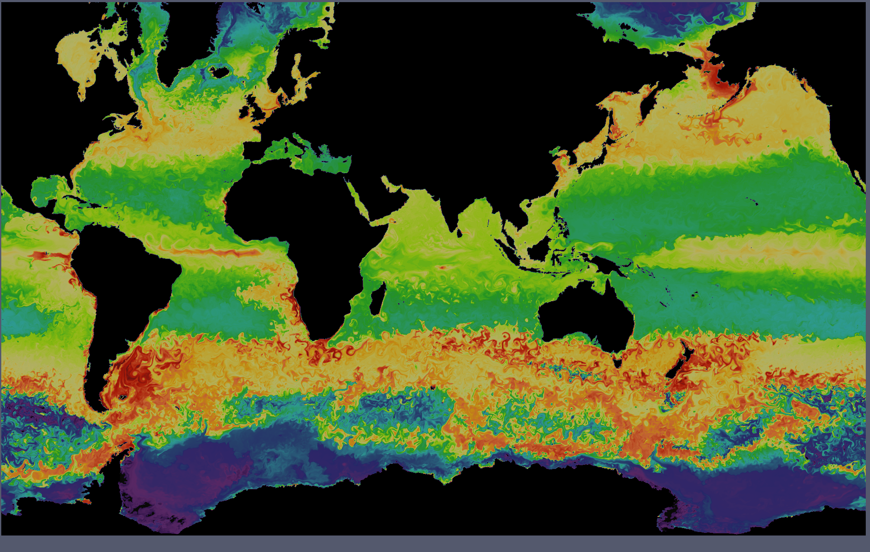
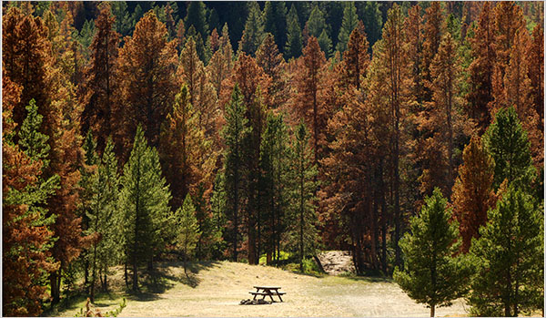
Sequestration
Biogeochemical feedbacks
  Carbon/sulfur cycles
  Methane
  Nutrient limitation
  Dynamic vegetation
  Ocean/ice ecosystems

Slide 6
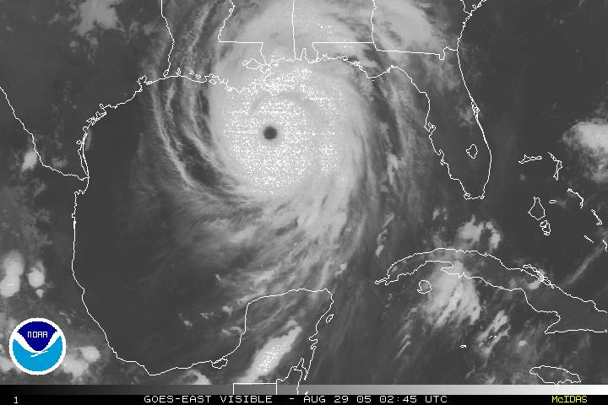
Others
Cloud/aerosol/radiation feebacks
  Enhance or counter GHGs
Extreme events
  Droughts
  Heat waves
  Severe storms
Interactions with economy, human behavior

Slide 7
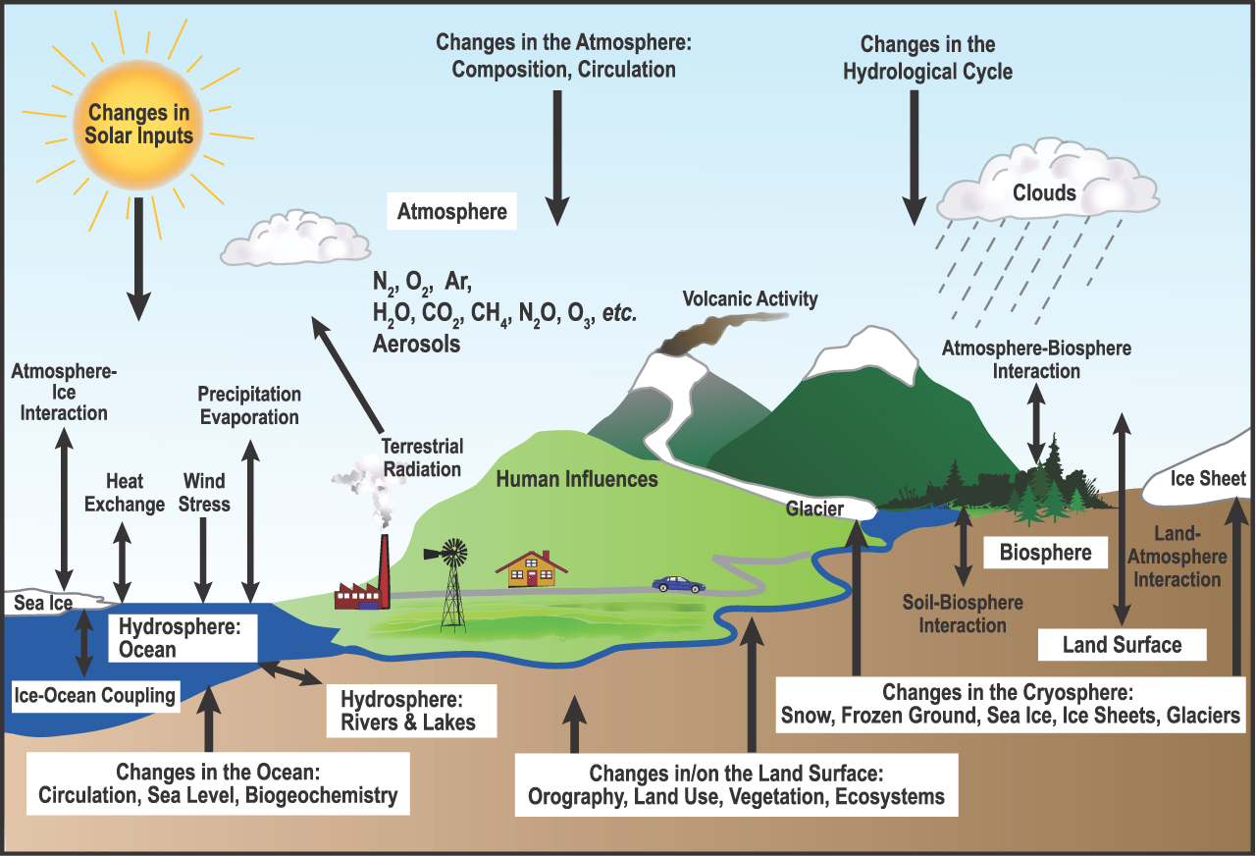
Climate is Complex
Dynamics
Biogeochemistry
Physics
Human Interactions

Slide 8
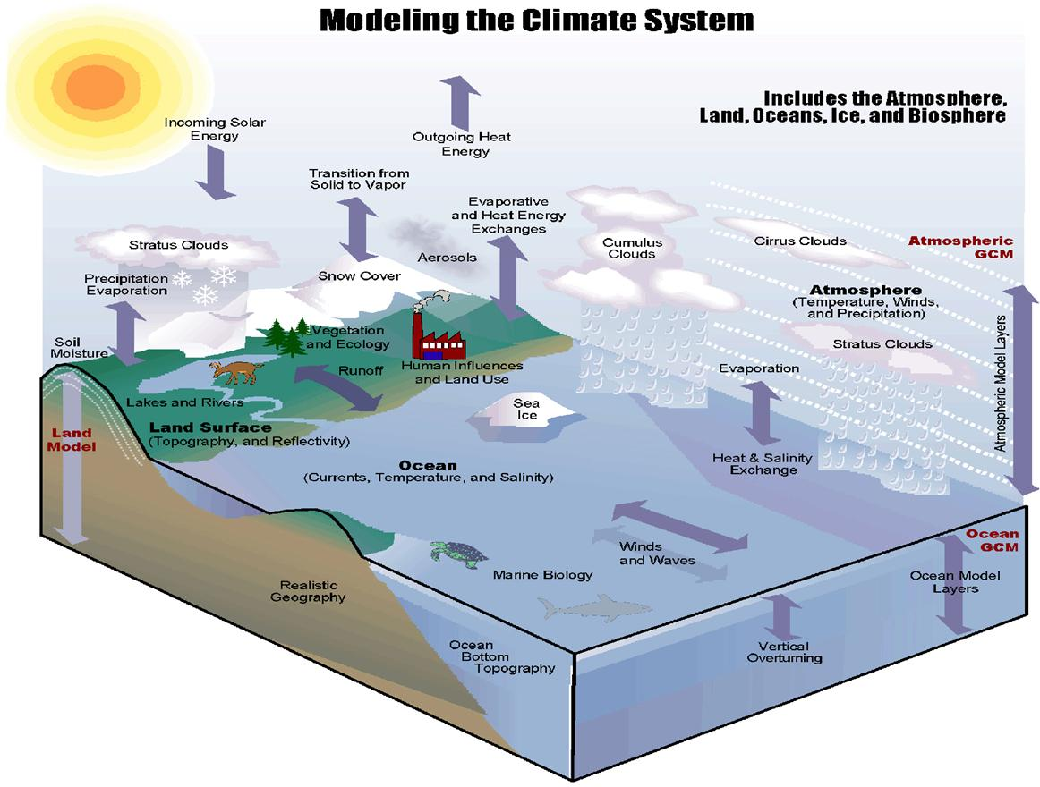
Climate Models are Tools for:
Integrating knowledge of climate system
Understanding and quantifying feedbacks
Attributing causes
Projecting future change
Mitigation and adaptation

Slide 9

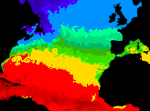

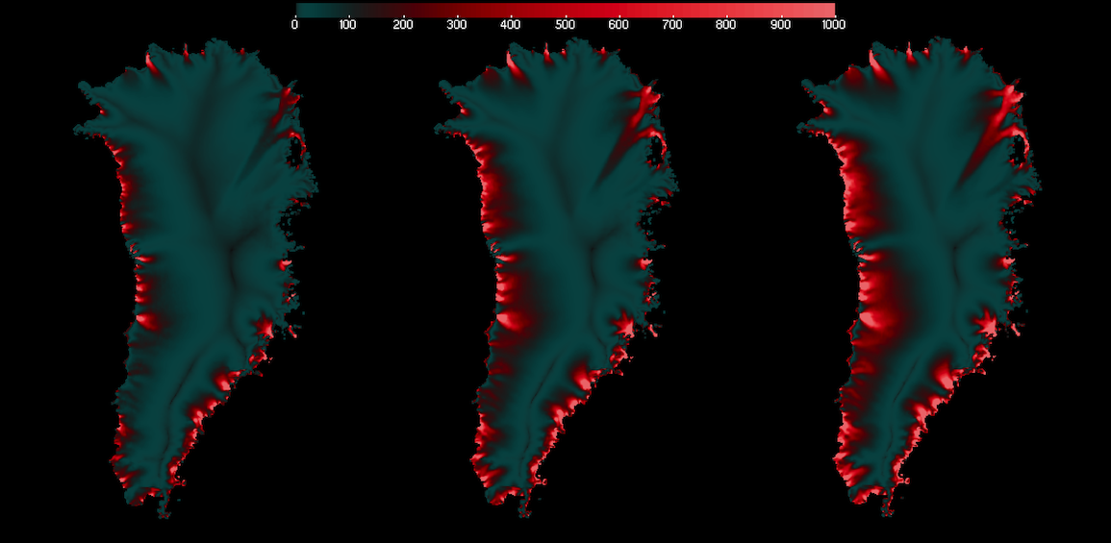
Community Earth System Model
NSF/DOE
300+ Participants
Million lines code
Atmosphere
CAM
Land
CLM
Once
hour
per
per
hour
Flux Coupler
Once
day
per
Once
Once
Once
per
per
Year?
hour
Ice Sheet
CISM
Ocean
POP
Sea Ice
CICE

Slide 10
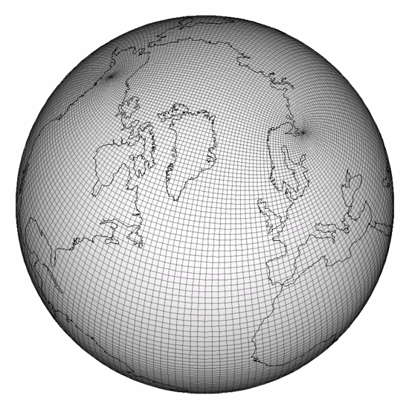
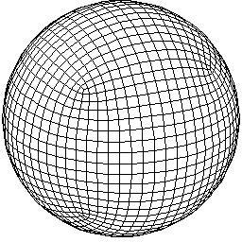
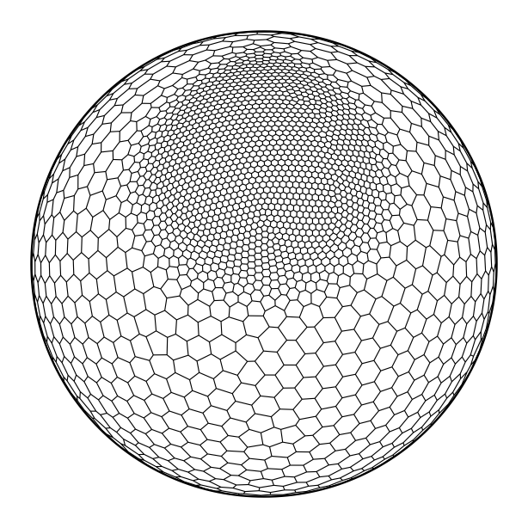
Global Climate Models
Atmosphere (CAM)
  3-d Fluid equations (N-S, hydro)
  Spectral-element, finite-volume, spectral
  Column physics (radiation, clouds, convection)
  Mixed time
Ocean (POP is dead, long live POP; MPAS)
  3-d Fluid equations (N-S, hydro, incomp)
  Finite diff., EOS, mixing
  Explicit, semi-implicit or subcycled barotropic
Sea Ice (CICE)
  Viscous-plastic (EVP), subcycled E
  Thermodynamics
Land Surface (CLM)
  Plant functional types
  Surface water, energy
Ice sheets (CISM)
  Stokes (or approximations), JFNK/elliptic
  Surf mass balance, hydrology
BGC: coupled ODEs, many tracers
All Components: MPI + OpenMP + ?

Slide 11
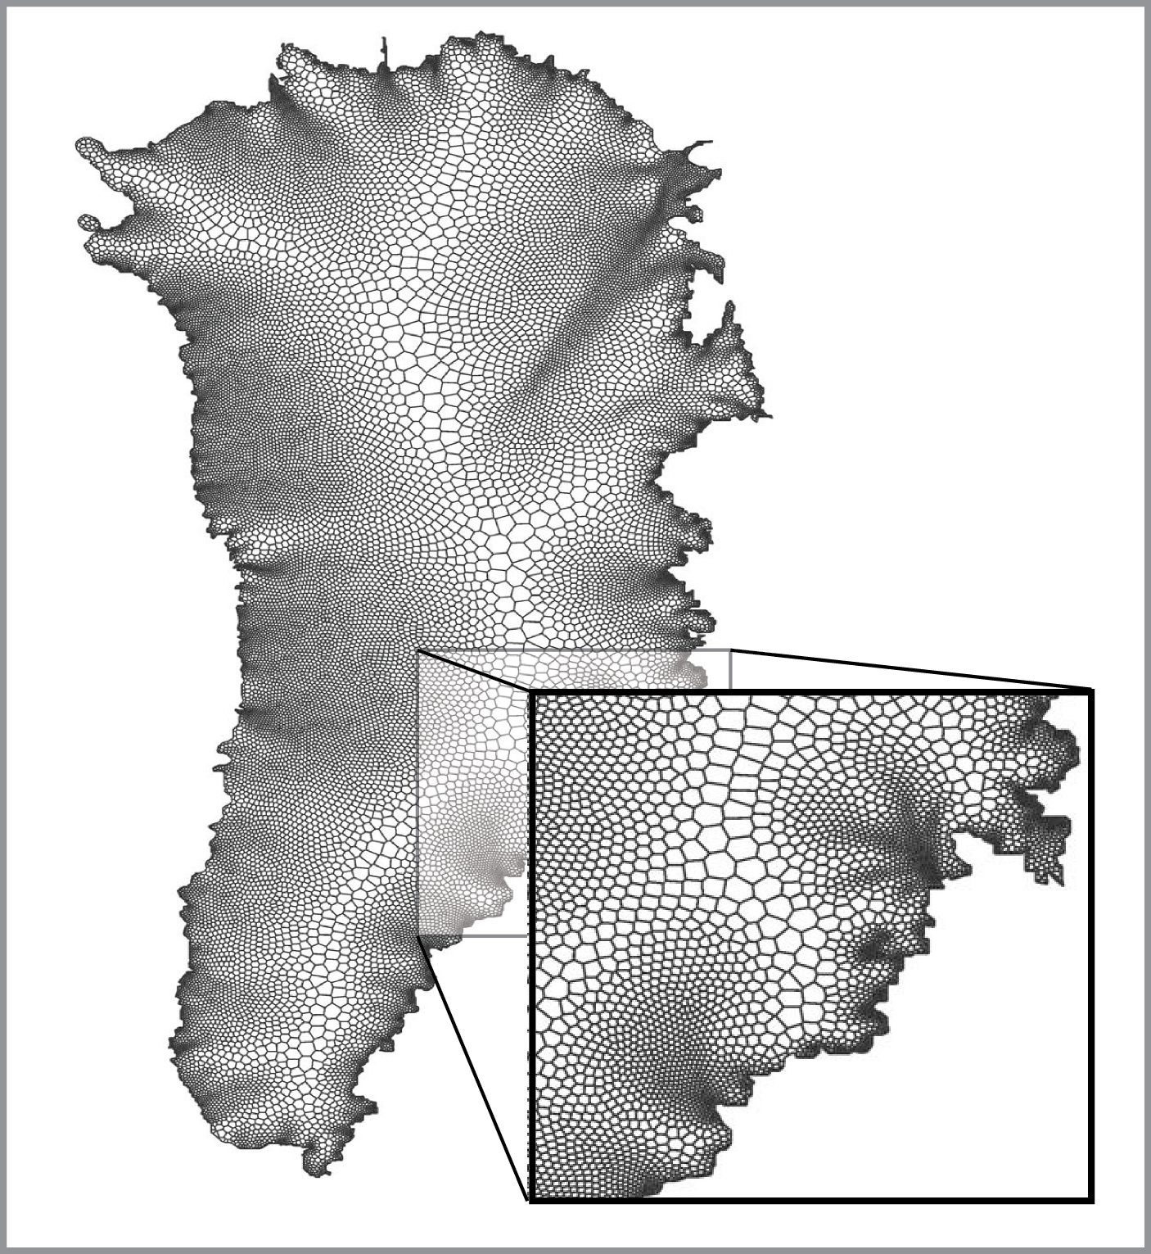
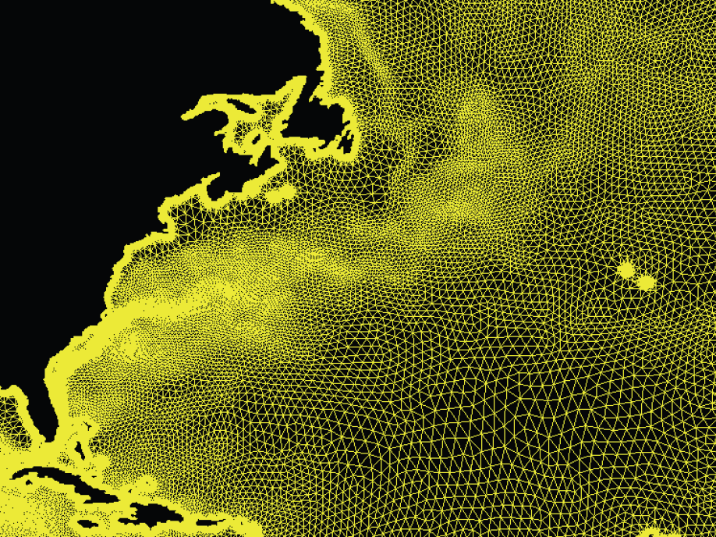
Climate Model Characteristics
Multiscale in space
  Must resolve some scales (ideal < 1km)
  Parameterize unresolved scales
  Mix of two in same model
Multiscale in time
  Seconds to centuries/millenia
  Scale space, but not time
  Implicitness and performance
Multiphysics? Multiscience
  Physics, chemistry, biology, ecology, astronomy
  Disparate components
  Model coupling (conserv, data motion)
Large algorithm diversity
  Domain specific = not specific

Slide 12
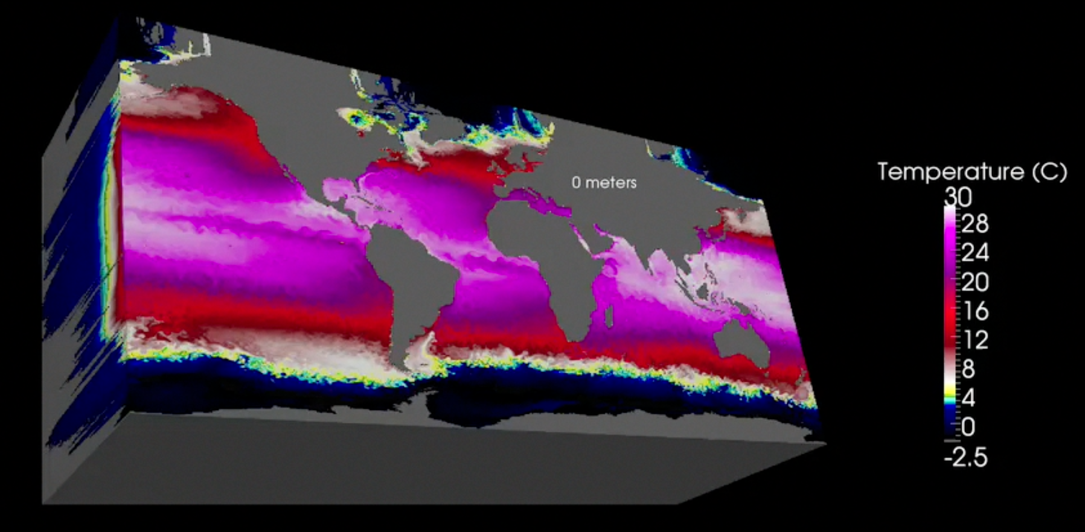
Policy-relevant
Testing and Validation
  Emphasize validation
  Testing needs work, missing data
Conservative
  Stuffy old white guys, do no harm
Uncertainty Quantification
Ensembles
  UQ
  Decadal prediction, data assimilation
Diverse stakeholders
  Implications for in situ analysis
  Data distribution, provenance
  High-perf analysis tools

Slide 13
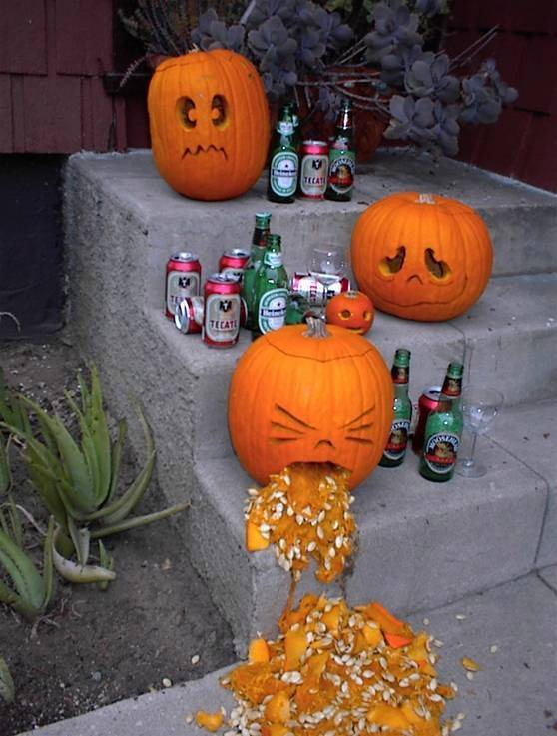
Validation of Ocean Models using Integrated Testbed
(VOMIT)

Slide 14
Community Model
Large number of users/developers (100s), million LOC
Large inertia
Project management, change management
Configuration management
  Common and/or distributed repositories
  Different build, config, language approaches: dev friendly vs user
  Input datasets, config files, support infrastructure for creating
Coding, data standards
  Clean interfaces, encapsulation, naming/namespace conflicts
  Can degrade over time, educate new developers
Performance portability
  Support high-end and desktop/departmental
Need broad buy-in, training, clear programming models or abstractions

Slide 15
Exascale Challenges
Exposing more parallelism
  May not be enough in domain decomp
  Tasks?, stochastic parameterizations, ensembles
Acceleration
  Enough work to amortize data motion, esp. quasi-2d models, submodels
  Algorithm diversity, no kernels
  Unstructured grids, irregular access
Optimize Data motion
  Low flop/memory ratio, though vectorizable
  Transfer to accelerators
  Solvers
I/O
  In-situ can’t be only solution
  Diverse stakeholders require lots of output

Slide 16
Priorities
Short term
  Performance on accelerated architectures
  Define SE framework/process
  Begin developing hierarchy of tests, unit tests
  Training/staffing for above
  Flexible/configurable analysis, UQ framework
Next priorities
  Agility/portability/abstractions
  Comprehensive test frameworks
  Long-term support for code refactoring
  End-to-end system for config-run-analysis workflow
Final priorities
  Co-design effort to revisit/iterate on approaches
  Compact apps
  Comprehensive tools and processes in place as a model for others
  Full-featured integrated system tools for rapid science investigations

Slide 17
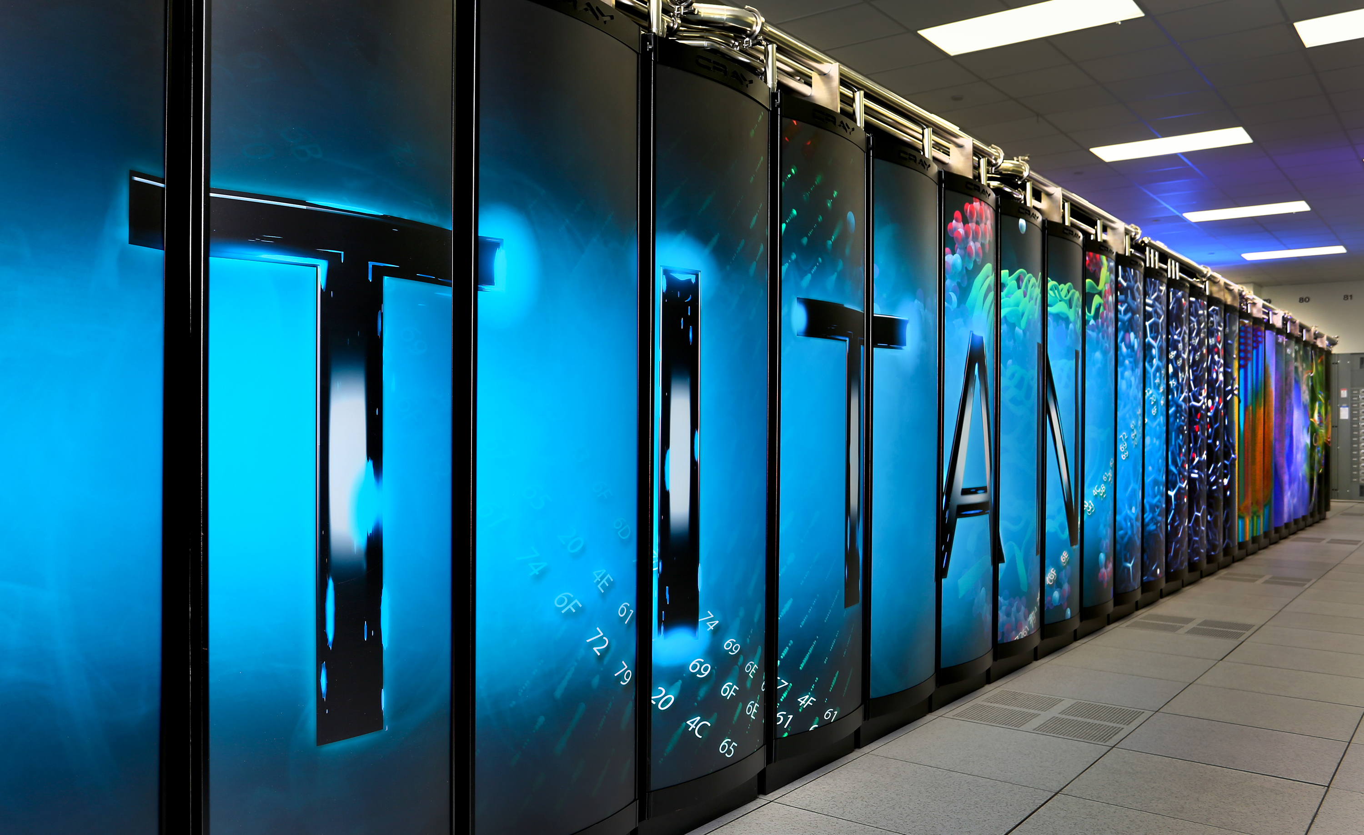
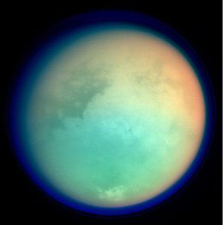

POP for GPUs/Titan, Moonlight
GPU needs
  Expose parallelism at lower levels
  Provide enough work for vectors
  Data transfer expensive
Refactoring
  Focus on momentum
  Push k-loops down
  OpenACC not up to task
  CUDA Fortran (esp. data txfr)
Results
Next up (before INCITE)
  Tracers
  Index/loop reordering
  Tavg
  abstractions
  Titan

Slide 18
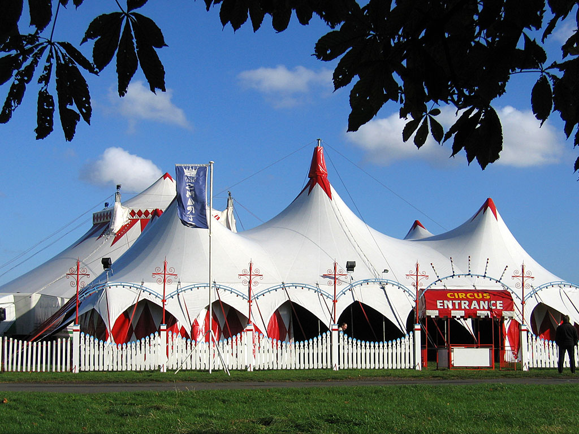
Climate and X-Stack
All of the above, big tent
  Already: Performance evaluation
  Abstractions, programming/execution models, auto-tuning, testing and correctness
  Languages? (PGAS, DSL)
We need to:
  Create compact apps

Slide 19



These are not the Apps you’re looking for:
Climate most important app
  Nuclear is dead
  Combustion is the problem
  Materials? Meh
  Astro/cosmology, particles, accelerators: seriously?
You want to work with us, don’t be evil, make a difference

Slide 20
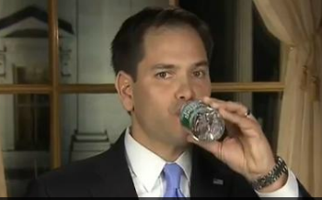
Rebuttals?

