Slide 1
Cholesky SWARM overview
Rishi Khan
Mark Glines
ET International, Inc.
12/5/2012

Slide 2
Cholesky factorization
“Blocked LU for Hermitian positive definite matrix”
Comprised of:
POTRF ([small-scale] Cholesky)
TRSM (triangular solve)
GEMM (matrix multiply)
SYRK (symmetric matrix multiply)
Expressible as a DAG
2

Slide 3
Cholesky DAG
POTRF → TRSM
TRSM → GEMM, SYRK
SYRK → POTRF
Implementations:
MKL/ACML (trivial)
OpenMP
SWARM
POTRF
TRSM
SYRK
GEMM
1:
2:
3:

Slide 4
OpenMP Implementations
Naïve OpenMP:
Perform POTRF
Spawn team for TRSMs
SYRKs in parallel
Spawn sub-team for GEMMs
Tuned OpenMP:
Perform POTRF
Spawn team for TRSMs
“Flatten” all enabled GEMM/SYRK tasks
POTRF
TRSM
SYRK
GEMM
1:
2:
3:

Slide 5
Naïve OpenMP Implementation
for (k = 0; k < AMatrix.mTile; ++k) {
float *adata = (float *) tile_getblockaddr(AMatrix, k, k);
spotrf(&uplo, &NrowTile, adata, &LDA, &info);
#pragma omp parallel
{
#pragma omp for schedule(dynamic, 1) private(i)
for (i = k + 1; i < AMatrix.nTile; ++i) {
float *bbdata = (float *) tile_getblockaddr(AMatrix, i, k);
cblas_strsm(CblasColMajor, CblasRight, CblasLower,
CblasTrans, CblasNonUnit, NrowTile, NrowTile, 1.0f,
adata, LDA, bbdata, LDA);
}
/* There is a implicit barrier here. */
#pragma omp for schedule(dynamic, 1) private(i)
for (i = k + 1; i < AMatrix.nTile; ++i) {
float *aadata = (float *) tile_getblockaddr(AMatrix, i, i);
float *bbdata = (float *) tile_getblockaddr(AMatrix, i, k);
cblas_ssyrk(CblasColMajor, CblasLower, CblasNoTrans,
NrowTile, NrowTile, -1.0f, bbdata, LDA, 1.0f,
aadata, LDA);
for (int jj = k + 1; jj < i; ++jj) {
float *cdata = (float *) tile_getblockaddr(AMatrix, i, jj);
float *acdata = (float *) tile_getblockaddr( AMatrix, jj, k);
float *bcdata = (float *) tile_getblockaddr( AMatrix, i, k);
cblas_sgemm(CblasColMajor, CblasNoTrans,
CblasTrans, NrowTile, NrowTile, NrowTile,
-1.0f, bcdata, LDA, acdata, LDA, 1.0f,
cdata, LDA);
} // for jj
} //for i
} // omp parallel
} // for k

Slide 6
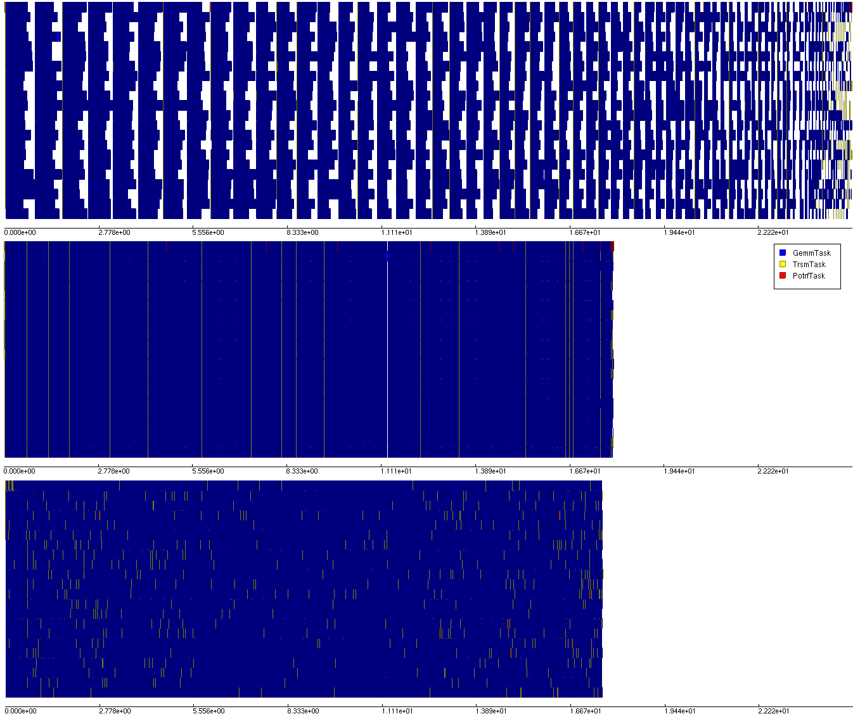
Profiles
Naïve OpenMP
Tuned OpenMP
SWARM

Slide 7
Tuned OpenMP Implementation
for (k = 0; k < AMatrix.mTile; ++k) {
float *adata = (float *) tile_getblockaddr(AMatrix, k, k);
spotrf(&uplo, &NrowTile, adata, &LDA, &info);
#pragma omp parallel
{
#pragma omp for schedule(dynamic, 1) private(i)
for (i = k + 1; i < AMatrix.nTile; ++i) {
float *bbdata = (float *) tile_getblockaddr(AMatrix, i, k);
cblas_strsm(CblasColMajor, CblasRight, CblasLower,
CblasTrans, CblasNonUnit, NrowTile, NrowTile, 1.0f,
adata, LDA, bbdata, LDA);
}
/* There is a implicit barrier here. */
#pragma omp for schedule(dynamic, 1) private(x)
for (int x = 0; x < numDGEMMS; x++)
{
int ii,jj;
GET_I_J(x, k+1, AMatrix.nTile, &ii, &jj);
if (jj=ii) {
float *aadata = (float *) tile_getblockaddr(AMatrix, ii, ii);
float *bbdata = (float *) tile_getblockaddr(AMatrix, ii, k);
cblas_ssyrk(CblasColMajor, CblasLower, CblasNoTrans,
NrowTile, NrowTile, -1.0f, bbdata, LDA, 1.0f,
aadata, LDA);
} else {
float *cdata = (float *) tile_getblockaddr(AMatrix, ii, jj);
float *acdata = (float *) tile_getblockaddr( AMatrix, jj, k);
float *bcdata = (float *) tile_getblockaddr( AMatrix, ii, k);
cblas_sgemm(CblasColMajor, CblasNoTrans,
CblasTrans, NrowTile, NrowTile, NrowTile,
-1.0f, bcdata, LDA, acdata, LDA, 1.0f,
cdata, LDA);
} // if/else
} //for x
} // omp parallel
} // for k

Slide 8
Profiles
Naïve OpenMP
Tuned OpenMP
SWARM

Slide 9
SWARM Implementation (1/2)
POTRF/TRSM/GEMM tasks are represented as codelets
GEMM pulls double duty – it does SYRK instead if it is running on the diagonal
Straight-forward dependencies are scheduled directly
POTRF -> TRSM on cells below
TRSM -> GEMM/SYRK on cells to the right
SYRK -> POTRF on the same cell
Indirect dependencies use TagTable
GEMM also depends on TRSM from a higher row
TRSM depends on the local GEMM from the previous round
GEMM depends on the local GEMM from the previous round
9

Slide 10
SWARM Implementation (2/2)
Those codelets get scheduled by one of their dependencies, and then call themselves back through TagTable “get” to gather the rest of the needed data
Then it calls the relevant BLAS function
The result of computation is “put” into the TagTable, to kick off the indirect dependers
Direct dependers are scheduled directly
This code is available in examples/src/cholesky/
10

Slide 11
Cholesky – SWARM implementation (1/2)
swarm_TagTable_t tt;
/* POTRF(phase,phase,phase) scheduled by SYRK(phase,phase,phase-1) */
CODELET_IMPL_BEGIN_NOCANCEL(POTRF)
int row = UNPACK_Y(THIS), col = UNPACK_X(THIS), phase = UNPACK_P(THIS), arg = UNPACK_A(THIS);
TILE_POTRF(row, col, ...);
if(row + 1 == T)
return swarm_dispatch(&CODELET(done), NULL, NULL, NULL, NULL);
for(i = row + 1; i < T; i++)
swarm_schedule(&CODELET(TRSM), PACK(i, col, phase, 0), NULL, NULL, NULL);
swarm_TagTable_put(&tt, PACKTAG(row, col, phase), NULL, 0, NULL, NULL);
CODELET_IMPL_END;
/* TRSM(row,phase,phase) scheduled by POTRF(phase,phase,phase),*/
/* uses TagTable to fetch GEMM(row,phase,phase-1) */
CODELET_IMPL_BEGIN_NOCANCEL(TRSM)
int row = UNPACK_Y(THIS), col = UNPACK_X(THIS), phase = UNPACK_P(THIS), arg = UNPACK_A(THIS);
if(phase && !arg)
return swarm_TagTable_get(&tt, PACKTAG(row,col,phase-1), &CODELET(TRSM),
PACK(row,col,phase,1));
TILE_TRSM(row, col, ...);
swarm_dispatch(&CODELET(SYRK), PACK(row, row, phase, 0), NULL, NULL, NULL);
for(i = col + 1; i < (row-1); i++)
swarm_schedule(&CODELET(GEMM), PACK(row, i, phase, 0), NULL, NULL, NULL);
swarm_TagTable_put(&tt, PACKTAG(row, col, phase), NULL, 0, NULL, NULL);
CODELET_IMPL_END;
Code
11

Slide 12
Cholesky – SWARM implementation (2/2)
Code
/* GEMM(row,column,phase) scheduled by TRSM(row,phase,phase), */
/* uses TagTable to fetch TRSM(column,phase,phase) and GEMM(row,column,phase-1) */
CODELET_IMPL_BEGIN_NOCANCEL(GEMM)
int row = UNPACK_Y(THIS), col = UNPACK_X(THIS), phase = UNPACK_P(THIS), arg = UNPACK_A(THIS);
if(phase && !arg)
return swarm_TagTable_get(&tt, PACKTAG(col,phase,phase), &CODELET(GEMM), PACK(row,col,phase,1));
if(phase && arg == 1)
return swarm_TagTable_get(&tt, PACKTAG(row,col,phase-1), &CODELET(GEMM), PACK(row,col,phase,2));
TILE_GEMM(row, col, ...);
swarm_TagTable_put(&tt, PACKTAG(row, col, phase), NULL, 0, NULL, NULL);
CODELET_IMPL_END;
/* SYRK(row,row,phase) scheduled by TRSM(row,phase,phase), */
/* uses TagTable to fetch SYRK(row,row,phase-1) */
CODELET_IMPL_BEGIN_NOCANCEL(SYRK)
int row = UNPACK_Y(THIS), col = UNPACK_X(THIS), phase = UNPACK_P(THIS), arg = UNPACK_A(THIS);
if(phase && !arg)
return swarm_TagTable_get(&tt, PACKTAG(row,col,phase-1), &CODELET(SYRK), PACK(row,col,phase,1));
TILE_SYRK(row, col, ...);
if(phase + 1 == row)
swarm_dispatch(&CODELET(POTRF), PACK_ARGS(row, col, phase+1), NULL, NULL, NULL);
swarm_TagTable_put(&tt, PACKTAG(row, col, phase), NULL, 0, NULL, NULL);
CODELET_IMPL_END;
. . .
swarm_schedule(&CODELET(POTRF), PACK(1,1,1,0), NULL, NULL, NULL);
12

Slide 13
Profiles
Naïve OpenMP
Tuned OpenMP
SWARM

Slide 14
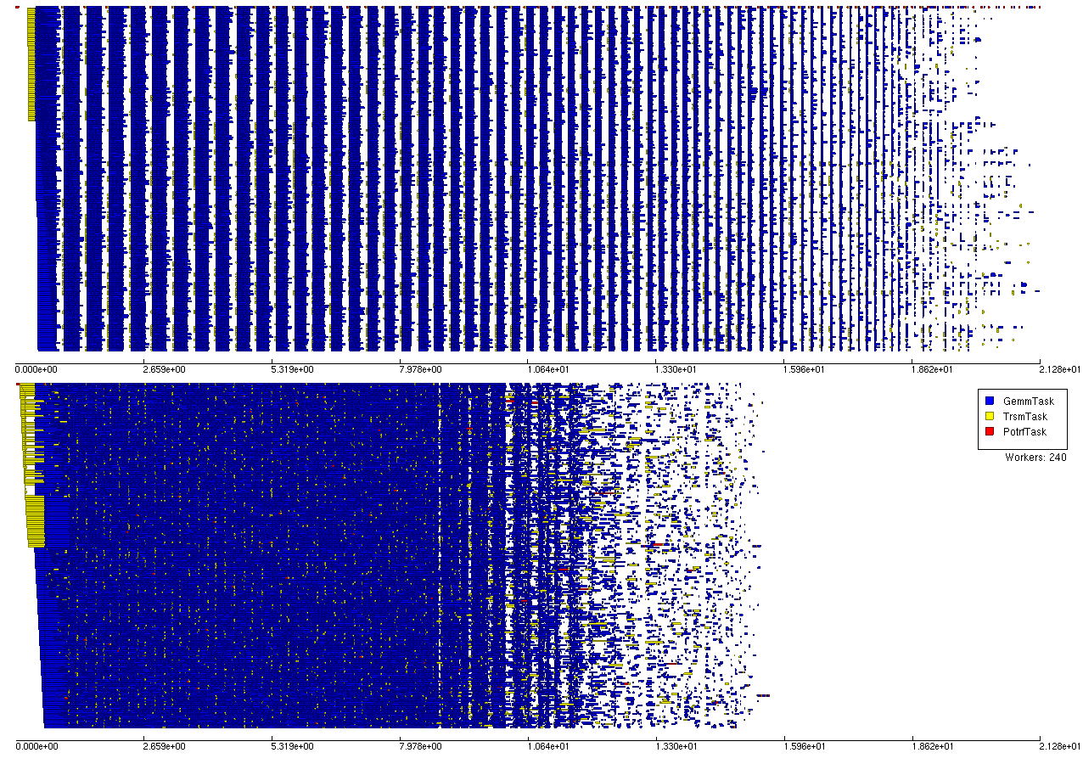
Xeon Phi Profiles
Tuned OpenMP
SWARM

Slide 15
Scheduling Priorities
SWARM natively supports 4 priorities (0-3)
POTRF/SYRK -> 3, TRSM -> 2, GEMM -> 1
POTRF can be called DIRECTLY from SYRK, so we don’t even need that priority
However, this approach causes problems on manycore and distributed systems
GEMM 2 rows down from phase top is very important to next phase critical path
What is needed is to assign priority based on location rather than task type.
Sort order by <row,col,phase> or <col,row,phase> produces equally good results and much better than task type

Slide 16
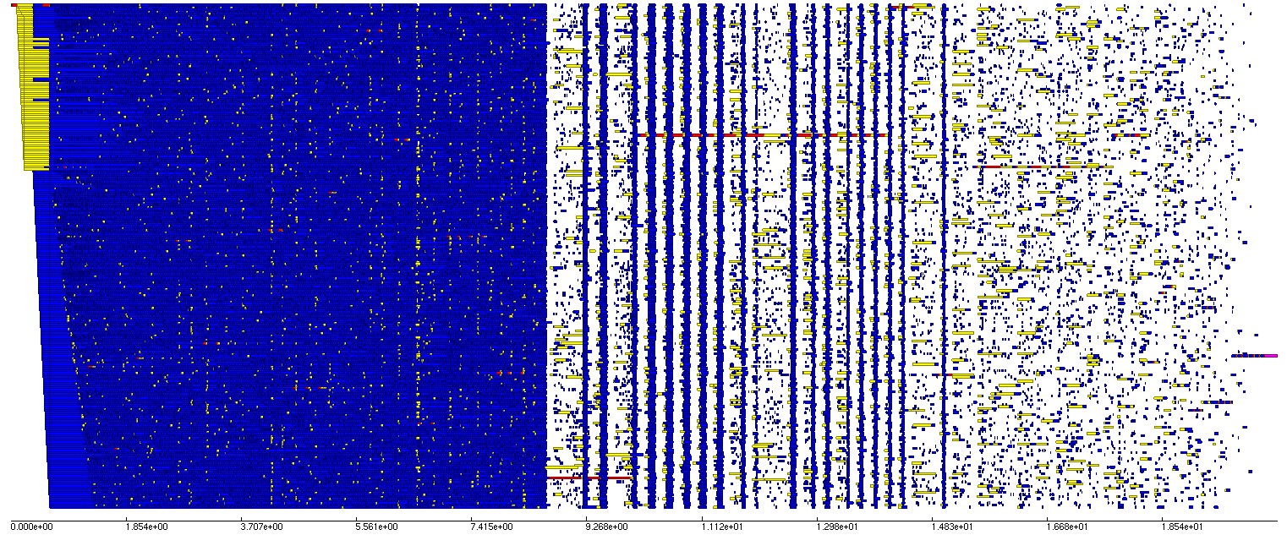
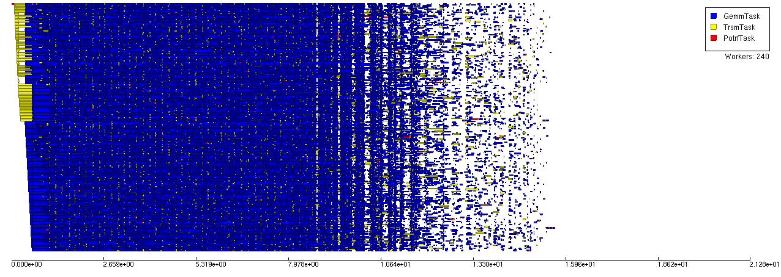
Priority on MIC
SWARM
with 4 task-level priorities
SWARM
With Priority queue

Slide 17
Multi-node Cholesky (intro)
The goals:
Go fast
Solve bigger matrices
Scale to huge node counts
The challenges:
How do we use multiple machines?
How do we keep everyone busy?
How do we not run out of memory?
Notes:
17

Slide 18
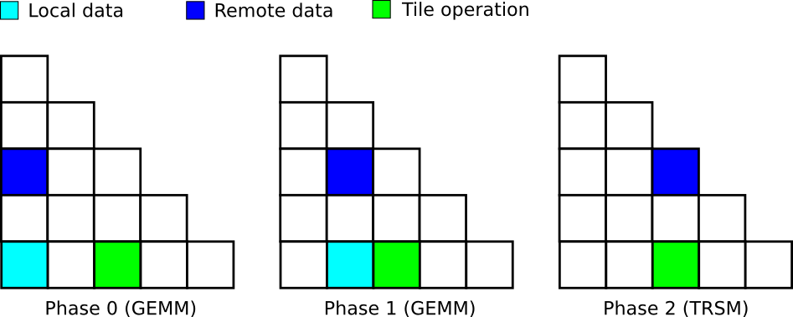
Multi-node Cholesky (details 1)
Divide rows of data up between nodes
Row R lives on node R modulo $NUM_NODES (for example)
Data in the same row as a local operation is local
Data in another row is (usually) remote
Remote data gets copied across the network
Once the local consumers have finished, the local copy can be freed
Notes:
18

Slide 19
19
Multi-node Cholesky (details 2)
Running efficiently on clusters is much more challenging than running locally
In the single-node case, it doesn’t matter what order the tasks run in, as long as enough parallelism is exposed to keep the local cores busy
In multi-node, your cores can be busy, but another node may be waiting for the results of something that you won’t get around to sending for a long time
It helps to bias toward tasks that will be needed soon
Notes:
19

Slide 20
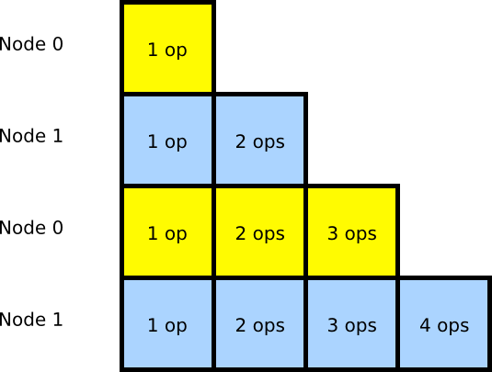
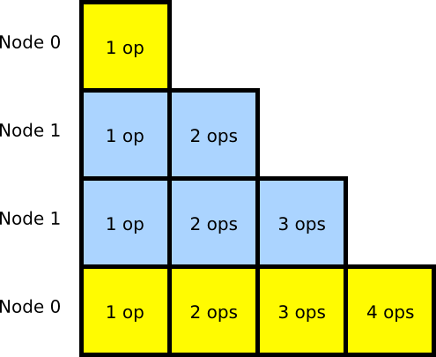
Workload imbalance (1)
It is important to make sure that nodes have an equal amount of work
Without this, idle nodes waste time waiting for busy nodes
A simple round-robin row assignment does not assure this
More complex row assignments can help
Notes:
20

Slide 21
Workload imbalance (2)
That solves global workload imbalance
Local workload imbalance is an issue, too
If nodes do not progress through the matrix at the same rate, slower nodes will not be sending data to faster nodes before it is needed
In extreme cases, this can run the faster nodes out of work and cause stalls
Let's look at some ways of handling this
Notes:
21

Slide 22
Workload imbalance (3)
Some solutions:
Assign in forward order for a while, then flip to reverse order for the remainder of the matrix
Has good global workload balance, if the flipping point is well placed
Has poor local workload balance
Flip it by rounds, assigning in forward, reverse, reverse, forward order
Has good global workload balance, assuming the total number of rounds is a multiple of 4
Has decent local workload balance too
Pick suitable nodes, one tile at a time
Has very good local and global workload balance
At the cost of negating the row-locality optimizations
Let's see how they look
Notes:
22

Slide 23
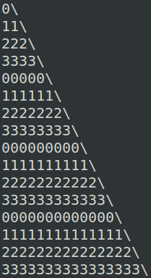
Simple round-robin row assignment
(128 nodes, 4 rows per node)
Storage imbalance of 42.9%
Global work imbalance of 71.1%
Local work imbalance rises geometrically

Slide 24
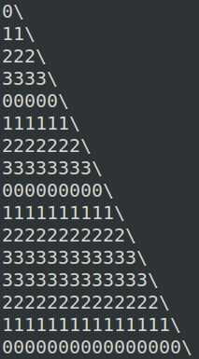
Flipped round-robin row assignment
(128 nodes, 4 rows per node, round 3 flipped)
Storage imbalance of 19.4%
Global work imbalance of 9.1%
Local work imbalance rises, then falls

Slide 25
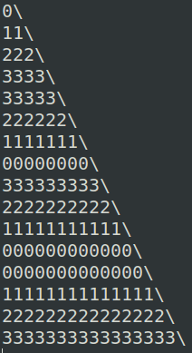
Flipped-by-rounds row assignment
(128 nodes, 4 rows per node)
Storage imbalance of 0.0%
Global work imbalance of 2.0%
Local work imbalance rises and falls in waves

Slide 26
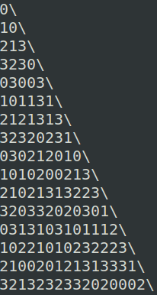
Row-independent tile assignment
(128 nodes, 4 rows per node)
This controls all forms of workload imbalance pretty well
Negates the row-locality optimizations (2x network load)

Slide 27
Memory management (1)
The problem:
The global matrix gets bigger and bigger as the node count increases
At some point (32 nodes?), the global matrix no longer fits into a single node's memory
All of the remote data is required to do local computations, but not all at once
It's better to only have the data that will be needed soon
The receiver is the right node to make that decision
We need to make sure we spend memory on the right things at the right times
How do we do that?
Notes:
27

Slide 28
Memory and Scheduling: no prefetch
Net – # outstanding buffers that are needed for computation but not yet consumed
Sched – # outstanding tasks that are ready to execute but have not yet been executed
Miss - # times a scheduler went to the task queue and found no work (since last timepoint)
Notice that at 500s, one node runs out of memory and starves everyone else.

Slide 29
Memory management (2)
Solution:
Have a way to pre-fetch remote data
Pre-fetch the necessary tile data before it is needed
Choose a priority scheme that lets you free things up quickly
There are two schemes which satisfy this criteria
Phase-first ordering + column prefetch
Do each phase of the calculation before proceeding to the next phase
A phase requires (and completely consumes) 1 column of TRSM data
Column-first ordering + row prefetch
Do all phases of a column before proceeding to the next column
A column requires (and completely consumes) 1 row of TRSM data
Notes:
29

Slide 30
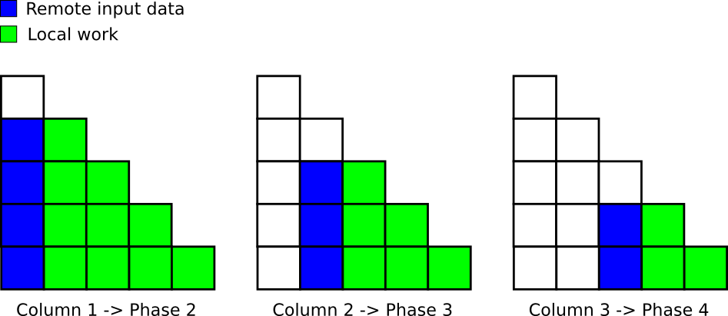
Column-to-phase prefetch
A column's worth of TRSM output is enough to calculate a phase
The TRSM output is never needed outside the phase, so completing the phase frees the network buffers

Slide 31
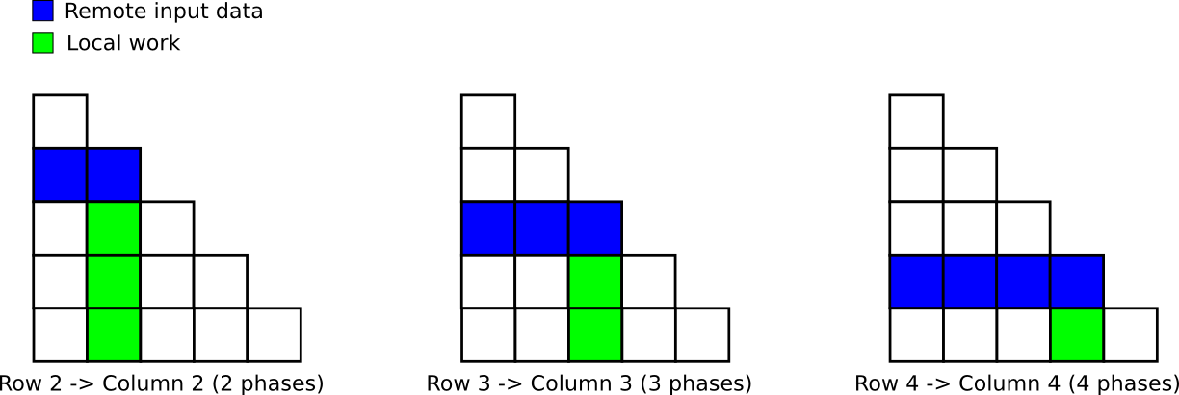
Row-to-column prefetch
A row's worth of remote data is enough to calculate a column (across all phases)
Each phase of a column consumes one tile of remote data

Slide 32
Memory and Scheduling: static prefetch
Because the receiver prefetches, he can obtain work as it is needed.
However, there is a tradeoff between prefetching too early and risking out of memory and prefetching too late and starving.
It turns out that at the beginning of the program we need to prefetch aggressively to keep the system busy, but prefectch less when memory is scarce.
A prefetch scheme that is not aware of memory usage cannot balance this tradeoff.

Slide 33
Memory management (3)
How do we manage the prefetch?
Two things we tried:
Determine somehow where the “current” execution point is, then always fetch N rows ahead of that
This didn't use memory evenly, and required careful tuning. (The size of the rows increase over time.)
Specify a target tile count (fixed amount of memory), keep track of how many tiles have already been requested, and issue new requests as needed to keep that memory full
This requires no tuning, and is much more reliable.

Slide 34
Memory and Scheduling: static prefetch
Because the receiver prefetches, he can obtain work as it is needed.
The receiver determines the most buffers it can handle (i.e. 40,000)
It immediately requests the max and whenever a buffer is consumed, it requests more.
Note the much higher rate of schedulable events at the beginning (5000 vs 1500) and no memory overcommital

Slide 35
Future Work
It is still the case that the nodes become starved in the last phases of computation
99.5% of the work was done in 550 seconds
The remaining 0.5% took 25 seconds
The scheduling and memory management techniques determined here should be abstracted and incorporated into the runtime

