Slide 1

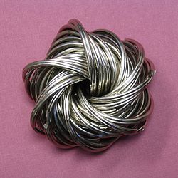

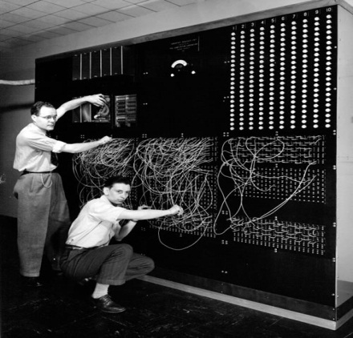
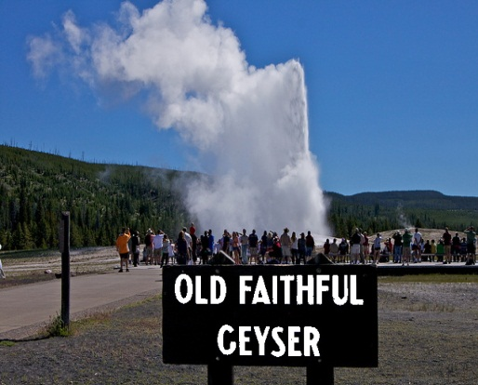
X-Stack PI and Coordination Meeting
Parallelism
Data Movement
Programmability
Resiliency
Sonia R. Sachs
May 28, 2014

Slide 2


Parallelism
Data Movement
Programmability
Resiliency
Meeting Organization
  Saman Amarasinghe
Panels/Technology Marketplace Organizers
  Andrew Chien and Mattan Erez
  Armando Solar-Lezama
  Marc Snir and Barney Maccabe
  Martin Schulz
  Mary Hall
  Saman Amarasinghe and Daniel Quinlan
  Shekhar Borkar and Wilfred Pinfold
  Vivek Sarkar

Slide 3
Acknowledgements
Parallelism
Data Movement
Programmability
Resiliency
MIT for hosting our meeting
  Special thanks to Saman Amarasinghe
MIT D-TEC support staff for meeting logistics
  Special thanks to Mary McDavitt
Panels/Technology Marketplace Session organizers
X-Stack PIs for xstack wiki and meeting materials
Intel/MIT team of scribes
Notes:
The organizing committee was essential to this meeting. Organizing the parallel sessions and the technology marketplace sessions was brilliantly accomplished and in record time.

Slide 4
Parallelism
Data Movement
Programmability
Resiliency
Meeting Goals
Review X-Stack Portfolio
  Projects presentations
  Discussions on current progress and expected results : components of the software stack
Review X-Stack Coordination
  Simulation Modeling projects: DMD(SST), CoDEX, and Blackcomb (Hardware Architecture Nexus)
  Abstract Machine Model and Proxy Architectures: Computing Architecture Laboratory (CAL) project, Hardware Architecture Nexus
  Operating Systems and Runtime software projects: ARGO, HOBBES, X-ARCC
  Application use cases for DSLs and runtime systems approaches
  Runtime Systems projects funded by other agencies
Present the Modelado Foundation
  Open source model for the software stack community
  Collect community input on the model
Review Vision for the Software Stack
  Share Runtime Systems summit results , collect community input for a report
  Share Programming Models vision, collect community input for a report
Notes:
Review of the complete X-Stack portfolio of project
Partial review of the coordinating portfolio:
some of the projects awarded in the architecture and software stack funding opportunities (FOA 255, 257),
execution models projects,
adapting MPI to Exascale,
computing architecture laboratory,
beyond simulation and modeling, and
Fast Forward
We want to discuss the extended X-Stack puzzle going forward:
how do these elements connect,
how can we leverage investments going forward.
We also want to look at the big picture: what is our vision for X-Stack?
Can we come up with an architecture?
Can we detail interfaces?
We made some progress to date on mapping project goals to the vision and identifying gaps.
We want to revisit the mapping, and want to check on our perception of gaps

Slide 5

Coordinating Projects
D-TEC: LLNL and MIT
Co-Design Centers
Traleika Glacier:Intel
CoDEX
DEGAS: LBNL
DMD
Execution Models
XPRESS: Sandia
Blackcomb
DynAX:ETI
CAL
BSM
X-Tune: U. Utah
Fast Forward
GVR: U. Chicago
SLEEC: Purdue
Exascale MPI: ANL
CORVETTE: UCB
ARES: LANL, ORNL
ECRP Projects
PIPER: LLNL
Vancouver: ORNL
Notes:
I am showing here the coordinating projects that are represented at this meeting and that are under my management, with the exception of FOX, which is under Lucy’s management.
A number of other projects certainly coordinate with these, such as a few more in the original x-stack portfolio, the storage portfolio, and the data management and visualization projects, but we didn’t have time or space to organize their participation at this meeting.
Today we will hear about CoDEX and Data Movement Dominates, Execution Models, BSM, and ZettaBricks
We will close with a presentation on What is Next for Programming Environments

Slide 6

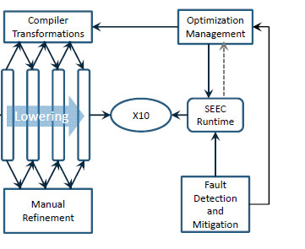



Software Stack: Vision in March 2013
Energy Efficiency, Resilience, Programmability, Scalability, Performance Portability, Interoperability
Feedback to
Apps
Existing MPI + X code
HPC Programmer
Parallel Language
Existing MPI + X code
Migration Process
High Level IR
Low Level IR
Runtimes
Runtime
Program in DSL Xi
DSL X1…Xn compilers
Domain Expert
Performance Programmer
X-Stack Front end
DSLs Generator
Compiler-optimized code
X-Stack Back end
Runtime optimized code
DSL Designers
Architecture Feedback

Slide 7
Vision in Progress
Programming Models Summit
Runtime Systems Summit
Collect community Input -> refine vision
  Migration path
    how do we take care of apps developed using current programming models (e.g. MPI+OpenMP)
  Exascale Application Development
  Beyond Exascale Application Development
Map current research to the vision for these three paths
Generate a Programming Models Report and a Runtime Systems Report by October 2014

Slide 8
Exascale Application Development
e.g., Continuous equations, Monte Carlo models
domain scientists
Application models
e.g, Discrete equations
domain scientists and computational scientists
Specify discretizations of models
e.g., DSLs, diagrams/equations for data and control dependencies
computational scientists and computer scientists
Specify Parallel algorithms for evaluating discretizations
Develop machine-independent code, using libraries/frameworks
e.g., DSLs, HLLs
computer scientists and software engineers
software and systems engineers
Manual code tuning for specific platform
e.g., specifying data and computation mappings, data movement, resilience
Auto-tuning and optimization system
Automated code tuning/compiler/runtime optimizations
Refinement loops

