Slide 1
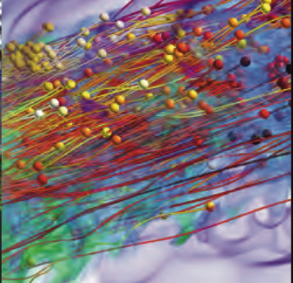
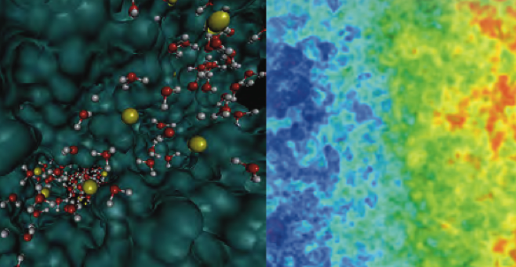
X-Stack Front-End Katherine Yelick, Organizer Tina Macaluso, Scribe Mary Hall, Presenter Participants: John Bell, Jim Belak, Milind Kulkarni, David Padua, Armando Solar-Lezama, Vijay Saraswat, John Daley, Andrew Lumsdaine, John Shalf, Dan Quinlan, Thuc Hoang, Richard Lethin and Benoit Meister

Slide 2
Exascale Challenges
Resilience | Programming model (all), OS/RT approach (DEGAS, GVR), Compiler (D-TEC), Compiler/RT (Traleika)
Undetected errors | Resilience Sensitivity (D-TEC, Corvette, SLEEC,GVR)
Spatial locality | Wide SIMD and how independent/configurable? Scatter/gather (MEMISA)? Language/DSL repr (DAX,DEGAS), Compiler (DAX,X-TUNE,D-TEC), Library interface selection (SLEEC), Library (HTA: Traleika & DAX)
Temporal locality | Scratchpad memories, communication avoidance, Non-Cache-Coherent, Language/DSL repr (DEGAS,D-TEC), Compiler (X-TUNE,D-TEC,Traleika/DAX:R-Stream), Library (Traleika/DAX:HTA)
Large # threads | Lightweight threads, synchronization mechanisms Language/Library (D-TEC,Xpress,DAX:Traleika:codelets,DEGAS), Compiler (X-TUNE,D-TEC)
Dynamic threads | Varying performance, Dynamic launch and migration, latency hiding Library (Traleika,DAX:HTA,R-Stream,DEGAS,XPRESS)
Heterogeneity | Explicit (DEGAS,Traleika,SLEEC,DAX,D-TEC,X-TUNE), Implicit (D-TEC,X-TUNE,Traleika)

Slide 3
Exascale Challenges
Mapping | Common High-level compiler/runtime IR? Common execution model? Common abstract machine model? [must capture above attributes]
Legacy Apps
Off-node Communication | Bandwidth tapering or topology, nesting collectives DEGAS, Xpress, D-TEC, Traleika, DAX
Control over performance
Feedback to user
Portability
SIMD vs. Spatial locality

Slide 4
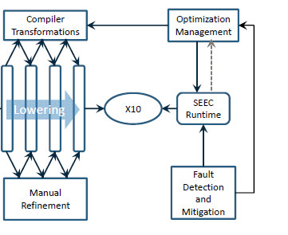
Agenda – Second Day
Energy Efficiency, Resilience, Programmability, Scalability, Performance Portability, Interoperability
Need Feedback to Apps (e.g., profiler performance)
Existing MPI + X code
LLIR: Representation of C/F/C++-level serial code, thread, and comm
E.g., (LLVM, or some other serial) plus comm+threads (XPI, Swarm, OCR, APGAS, UPCR
Also need an abstract machine model instance to generate code
HPC Programmer
Parallel Language
Existing MPI + X code
Migration Process
Runtimes
HLIR
LLIR
Runtime
HLIR: describes the structure of the program e.g., GDGs, PIL, AST (type-checked). May have domain-specific constructs
Some abstract machine model parameters may be needed here?
Program in DSL Xi
DSL X1…Xn compilers
Domain Expert
Performance Programmer
DSLs Generator
Compiler-optimized code
Runtime optimized code
Need Feedback from Architecture
DSL Designers
HLC: High Level Intermediate Representations
LLC: Low Level Intermediate Representations
X-Stack Front end
X-Stack Back end
Notes:
HLIR: describes the structure of the program e.g., GDGs, PIL, AST (type-checked). May have domain-specific constructs
Some abstract machine model parameters may be needed here?
LLIR: Representation of C/F/C++-level serial code, thread, and comm
E.g., (LLVM, or some other serial) plus comm+threads (XPI, Swarm, OCR, APGAS, UPCR
Also need an abstract machine model instance to generate code to

