Slide 1
Exploring Efficient Data Movement Strategies for Exascale Systems with
Deep Memory Hierarchies
Heterogeneous Memory
(or)
DMEM: Data Movement for hEterogeneous Memory
Pavan Balaji (PI), Computer Scientist
Antonio Pena, Postdoctoral Researcher
Argonne National Laboratory
Project Dates: Sep. 2012 to Aug. 2017

Slide 2
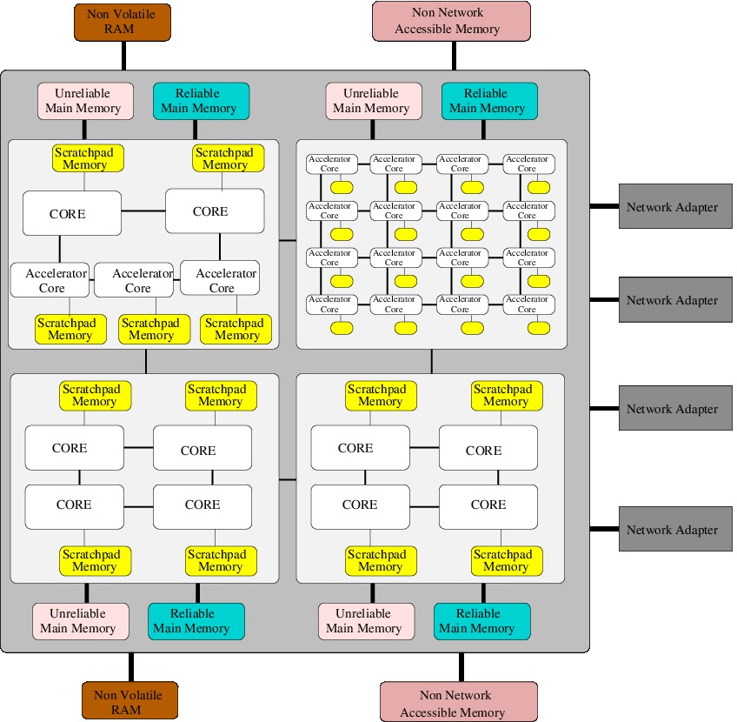
System Architecture Complexity
Processor heterogeneity is a well known issue
  Heavy weight general purpose cores
  Light weight accelerator cores
    No branch prediction
    In-order instructions
Memory heterogeneity: step-child of the heterogeneous computing era
  Main memory
  Scratchpad memory
  Nonvolatile memory
  Memory reliability and performance variation (because of power constraints)

Slide 3
Managing Heterogeneous Memory
Core problem being addressed:
  Heterogeneous memory is inevitable – all upcoming supercomputers use this in some way or another
  Applications need to make the leap from using legacy main memory to richer memory domains such as NVRAM, scratchpad memory, accelerator memory, etc.
Abstract architectural model:
  Our view of the system architecture focuses on utilizing different memory systems as directly accessible regions
Goals:
  Each memory has semantic differences that need to be addressed; we want to provide fundamental models for interacting with such memory
    Efficient end-to-end data motion from any memory to any memory (possibly across coherence domains)
    Moderated load/store accesses to memory (where applicable)
Core
Cache
Main Memory
NVRAM
Disk
Hierarchical Memory View
Scratchpad Memory
Main Memory
Core
Less Reliable Memory
NVRAM
Accelerator Memory
Compute-capable Memory
Heterogeneous Memory as First-class Citizens

Slide 4
Applications and Heterogeneous Memory: Case Studies
Several applications are already looking at utilizing different types of memory regions
Computational Chemistry
  Iterative convergence models allow most iterations to tolerate (infrequent) errors
  Same concept used in 32-bit/64-bit mixed precision computations
Nuclear Physics
  Green’s Function Monte Carlo simulations rely on large per-process memory footprints for their computations
  Current computations treat memory as uniform read/write performance units
  With NVRAM, scientists are considering modifying their algorithms to make them more read-intensive
A. E. DePrince, III and J. R. Hammond J. Chem. Theory Comput. 7, 1287 (2011) "Coupled Cluster Theory on Graphics Processing Units I. The Coupled Cluster Doubles Method."

Slide 5
Programming Environments in the Heterogeneous Memory Era
Memory fragmentation is inevitable
  Already seen with accelerator memory and scratchpad regions
  Applications are already embracing heterogeneous memory while taking advantage of the characteristics of each memory domain
Programming environments are, unfortunately, falling behind
  We tend to treat main memory as a “special” memory region, where the primary computation is performed
  Data movement and coordination is staged in main memory because of this view that main memory is superior in some way
  Computation relies on the characteristics of main memory for algorithmic choices
    Similar read/write performance
    Memory consistency semantics
    Reliability semantics

Slide 6
Challenges and Opportunities
Introspection Tools
Applications
Runtime Management
  End-to-End Data Movement
Programming Constructs
  Heterogeneous Memory Semantics
    Consistency
    Reliability
    Power/Energy Efficiency
Introspection Tools
Chemistry
Nuclear Physics
Biology
Programming Constructs
Data Residence Annotations
Memory Consistency Semantics
Data Motion Description
Runtime Performance/Power Management
Weak Memory Consistency
Integrated Data Movement
Memory Reliability Management
Hardware
Simulators
DOE Leadership Machines
Accelerators
CODEX

Slide 7
End-to-end Data Movement

Slide 8
Everyone is a First-Class Citizen
NVRAM
Less Reliable
Main Memory
Process
Process
Main Memory
Scratchpad
NVRAM
NVRAM
Less Reliable
Main Memory
Process
Process
Main Memory
Scratchpad
NVRAM
We envision an environment where all memory regions are first-class citizens, and a runtime system that provides for efficient data placement, and data movement capabilities

Slide 9
Example Heterogeneous Architecture: Accelerator Clusters
Graphics Processing Units (GPUs)
  Many-core architecture for high performance and efficiency (FLOPs, FLOPs/Watt, FLOPs/$)
  Programming Models: CUDA, OpenCL, OpenACC
  Explicitly managed global memory and separate address spaces
CPU clusters
  MPI based DRAM to DRAM communication
  Host memory only
Disjoint Memory Spaces!
GPU
CPU
Multiprocessor
MPI rank 0
MPI rank 1
MPI rank 2
MPI rank 3
Shared memory
Main memory
Global memory
PCIe
NIC

Slide 10
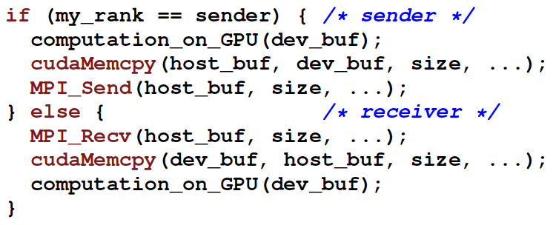
Programming Heterogeneous Memory Systems (e.g: MPI+CUDA)
GPU
device memory
GPU
device memory
Rank = 0
Rank = 1
PCIe
PCIe
CPU
main memory
Network
CPU
main memory
Programmability/Productivity: Manual data movement leading to complex, non-portable codes
Performance:
  Manual copy between host and GPU memory serializes PCIe, Interconnect
    Difficult for user to do optimal pipelining or utilize DMA engine efficiently
  Architecture-specific optimizations

Slide 11
DMEM: A Model for Unified Data Movement
Main Memory
Rank = 0
Rank = 1
Main Memory
GPU Memory
CPU
CPU
GPU Memory
Network
NVRAM
NVRAM
Unreliable Memory
Unreliable Memory
if(rank == 0)
{
MPI_Send(any_buf, .. ..);
}
if(rank == 1)
{
MPI_Recv(any_buf, .. ..);
}
“MPI-ACC: An Integrated and Extensible Approach to Data Movement in Accelerator-Based Systems”, Ashwin Aji, James S. Dinan, Darius T. Buntinas, Pavan Balaji, Wu-chun Feng, Keith R. Bisset and Rajeev S. Thakur. IEEE International Conference on High Performance Computing and Communications (HPCC), 2012

Slide 12
DMEM Runtime Optimizations
GPU Buffer
Topology-aware pipelining of data
Caching of meta-data (e.g., handles)
Multi-stream data transfer when possible (e.g., newer accelerators)
Architecture-specific optimizations: GPU Direct
GPU (Device)
Host side
Buffer pool
CPU (Host)
Without Pipelining
With Pipelining
29% better than manual blocking
14.6% better than manual non-blocking
CPU (Host)
Network
Time

Slide 13
Traditional Intranode Communication
Process 0
Process 1
Communication without heterogeneous memory support
  2 PCIe data copies + 2 main memory copies
  Transfers are serialized
GPU
Direct copy
Host
Shared Memory
Integration allows direct transfer into shared memory buffer
  Sender and receiver drive transfer concurrently
    Pipeline data transfer
    Full utilization of PCIe links
Direct Copy: DMA-driven peer GPU copy
Peer-to-peer data transfer between heterogeneous memory regions

Slide 14
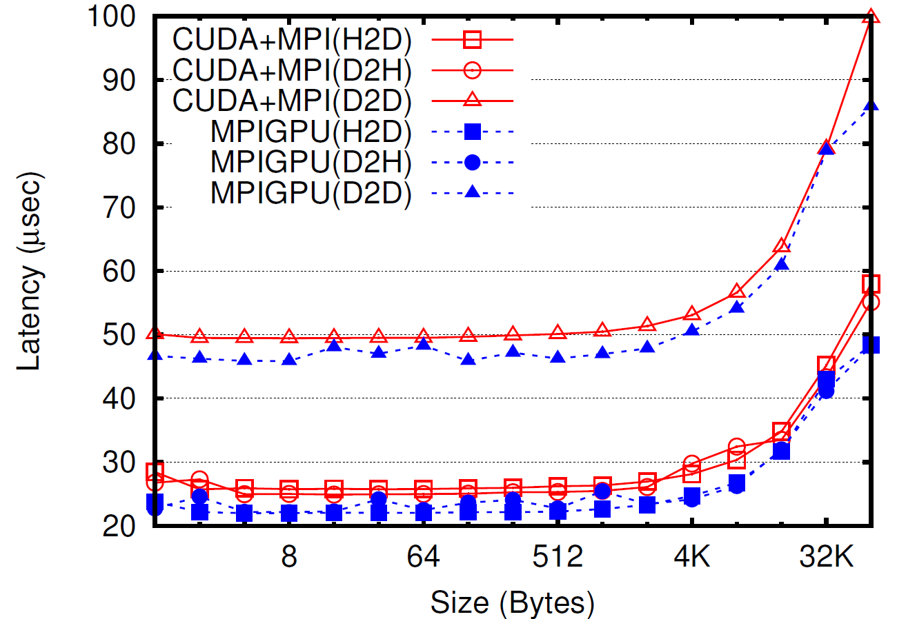
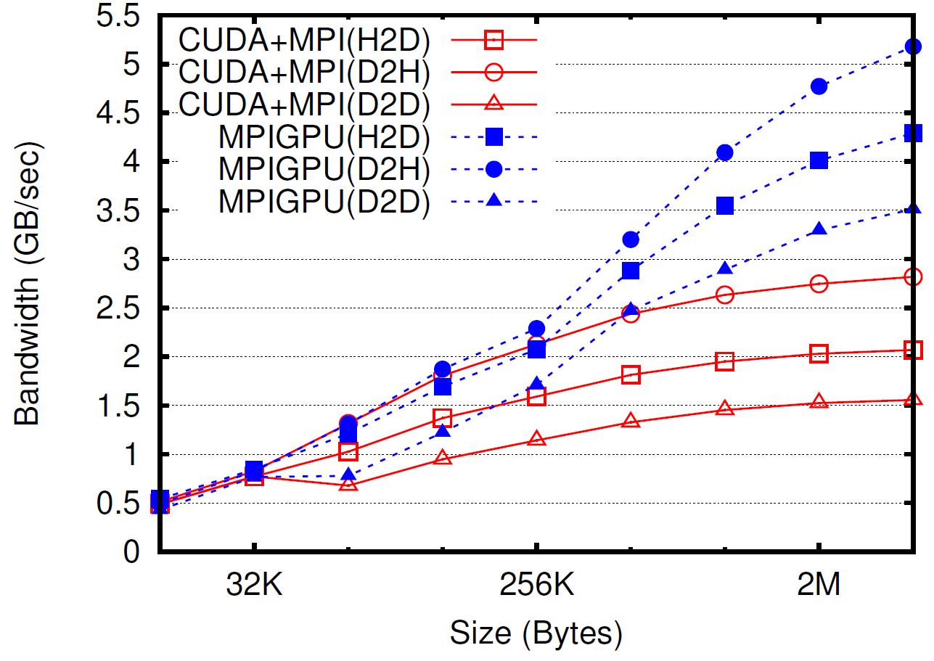
Shared Memory Performance
Less impact on D2D case
  PCIe latency dominant
Improvement: 6.7% (D2D), 15.7% (H2D), 10.9% (D2H)
Bandwidth discrepancy in different PCIe bus directions
Improvement: 56.5% (D2D), 48.7% (H2D), 27.9% (D2H)
Nearly saturates peak (6 GB/sec) in D2H case

Slide 15
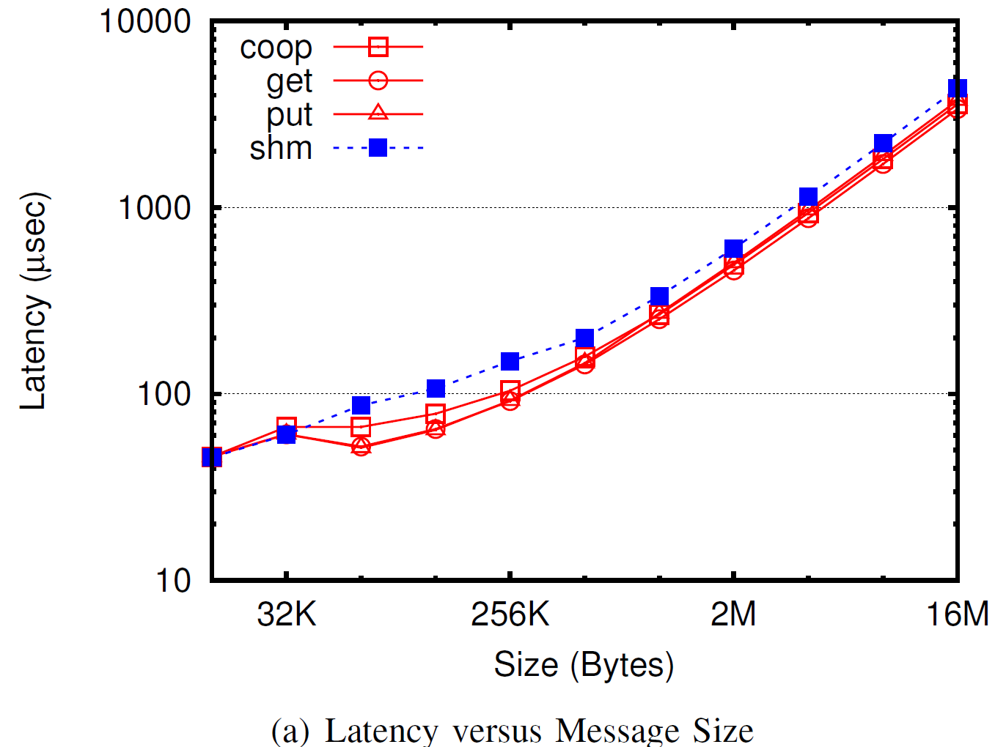
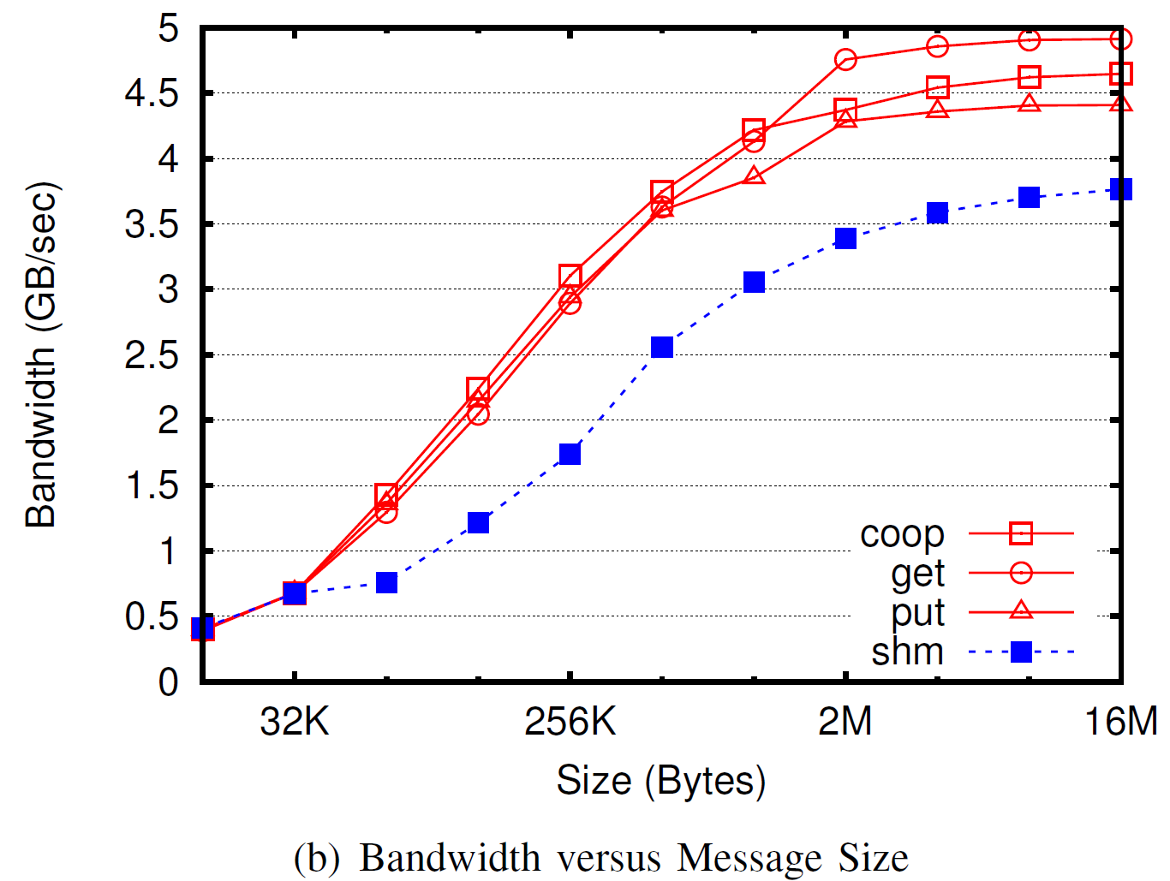
Direct DMA Performance
Bandwidth nearly reaches the peak bandwidth of the system
“DMA-Assisted, Intranode Communication in GPU Accelerated Systems”, Feng Ji, Ashwin Aji, James S. Dinan, Darius T. Buntinas, Pavan Balaji, Rajeev S. Thakur, Wu-chun Feng and Xiaosong Ma. IEEE International Conference on High Performance Computing and Communications (HPCC), 2012

Slide 16
Example – 2D Stencil Computation
non-contiguous!
GPU
GPU
CPU
CPU
cudaMemcpy
cudaMemcpy
high latency!
MPI_Isend/Irecv
CPU
CPU
cudaMemcpy
cudaMemcpy
16 MPI transfers + 16 GPU-CPU xfers
2x number of transfers!
GPU
GPU

Slide 17
“Compute-capable Memory” Optimizations
Element-wise traversal by different threads
Embarrassingly parallel problem, except for structs, where element sizes are not uniform
threads
B₀ |  |  | B₁ |  |  | B₂ |  |  | B₃
Pack
b_{1,0} |  | b_{1,1} |  | b_{1,2}
Recorded by
Dataloop
# elements
traverse by element #, read/write using extent/size

Slide 18
Evaluating Memory-attached Computational Capabilities
“Enabling Fast, Noncontiguous GPU Data Movement in Hybrid MPI+GPU Environments”, John Jenkins, James S. Dinan, Pavan Balaji, Nagiza F. Samatova and Rajeev S. Thakur. IEEE International Conference on Cluster Computing (Cluster), 2012

Slide 19
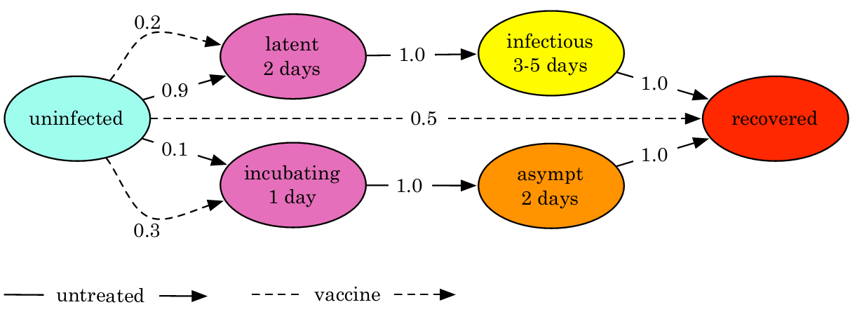
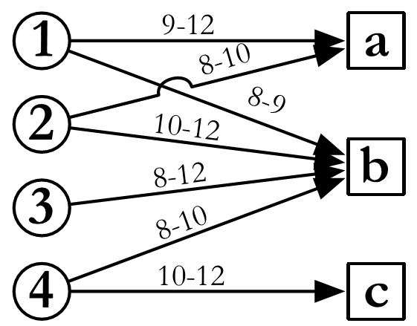
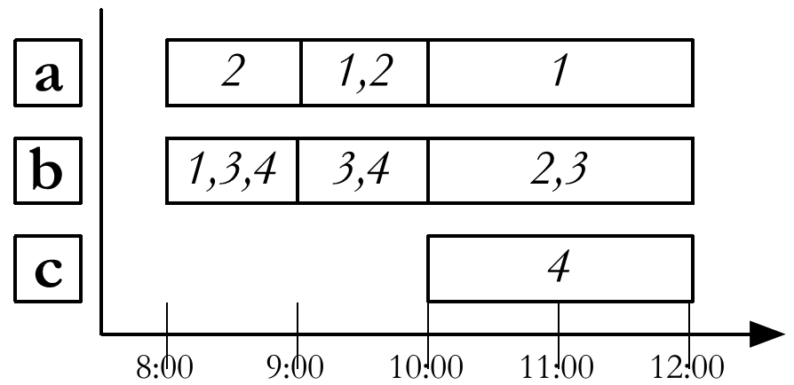
Epidemiology Simulation (EpiSimdemics)
Episimdemics models try to understand the spatio-temporal diffusion/spread of a contagious disease through social contact networks of populations
  Represents social networks by labeled bipartite graphs with two disjoint sets as People and Locations.
  Duration of interaction between people is modeled using the activities and overlap of stay of different people at different locations.
A variant of finite state machines, called probabilistic timed transition systems (PTTSs) is used to represent the within host disease propagation.
PI: Madhav Marathe, Virginia Tech

Slide 20
Case Study: Epidemiology
Network
Network
PE_{i} (Host CPU)
PE_{i} (Host CPU)
1a. Pipelined data transfers to GPU
1. Copy to GPU
1b. Overlapped processing with internode CPU-GPU communication
2. Process on GPU
GPU_{i} (Device)
GPU_{i} (Device)
Traditional Model
DMEM

Slide 21
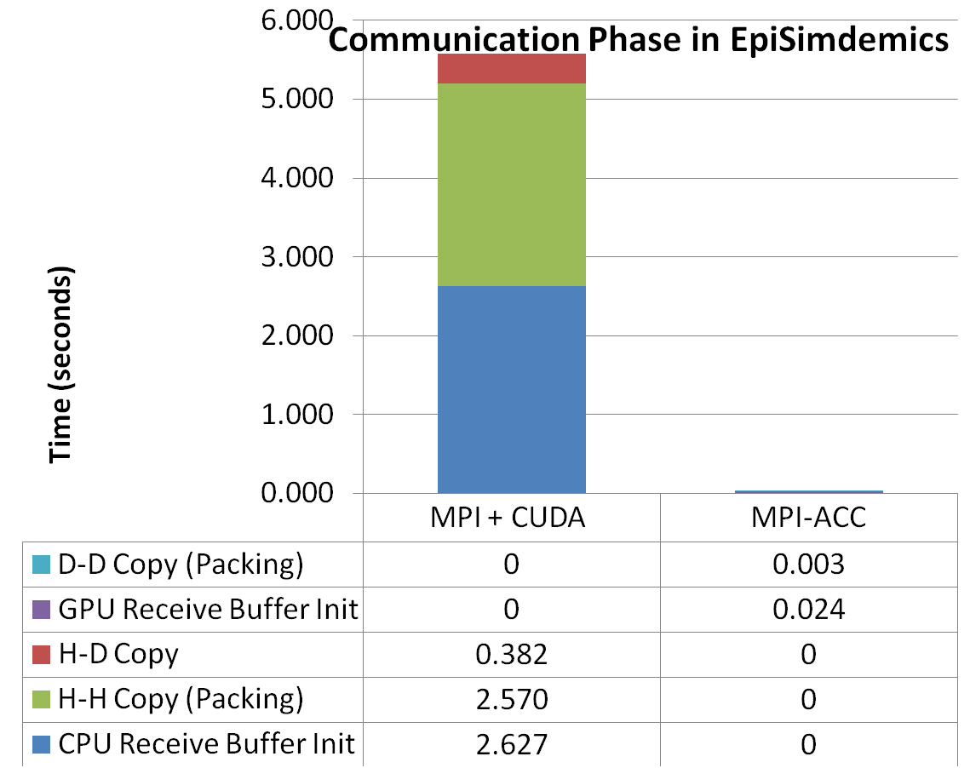
Evaluating the Epidemiology Simulation
GPU has two orders of magnitude faster memory
DMEM enables new application-level optimizations
DMEM

Slide 22
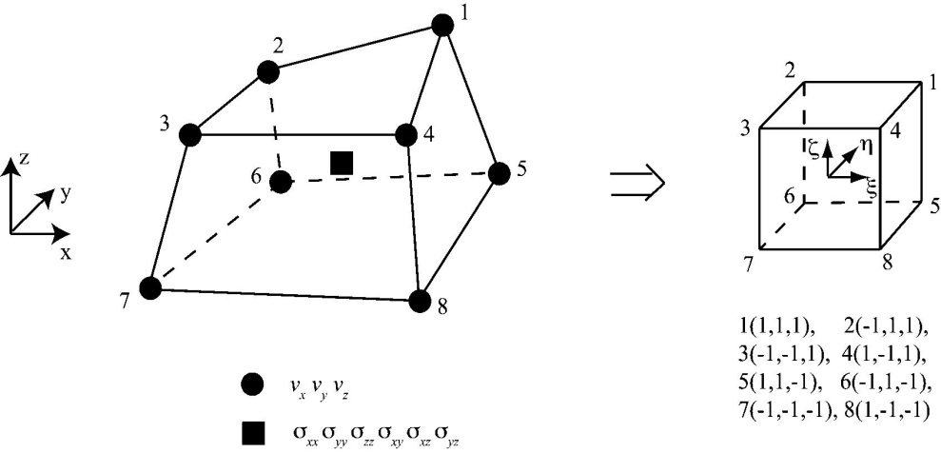
FDM-Seismological Modeling
Modeling Seismic waves using analytical methods is highly complex due to irregular heterogeneity of earth interior, friction laws, realistic attenuation etc.
Hence, approximate numerical methods such as Finite Difference Method (FDM) are used to solve differential wave equations.
This application realizes staggered-grid velocity-stress FDM method for modeling seismic waves.
Models the seismic waves by interpolating or triangulating the measured wave parameters at various seismic sensors.

Slide 23
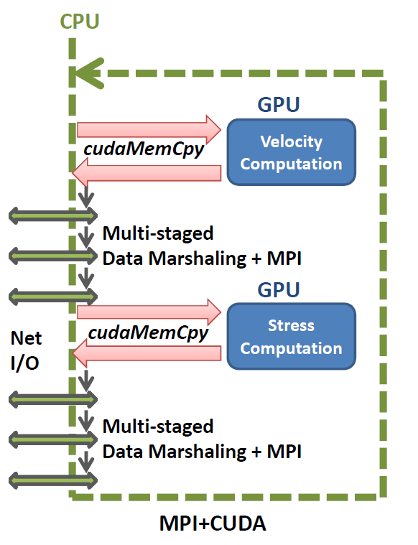
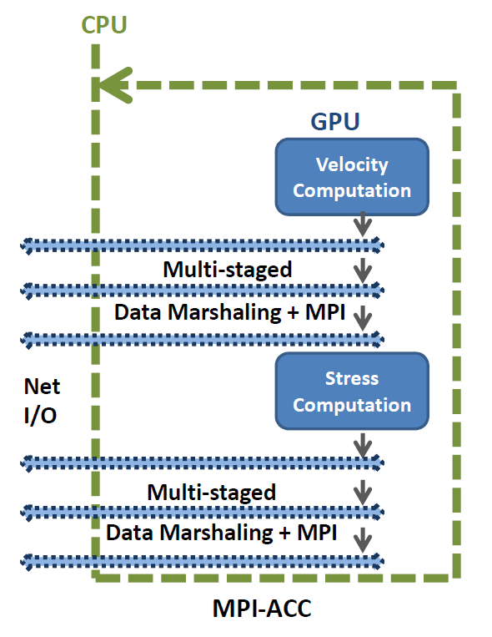
Case Study: Seismology

Slide 24
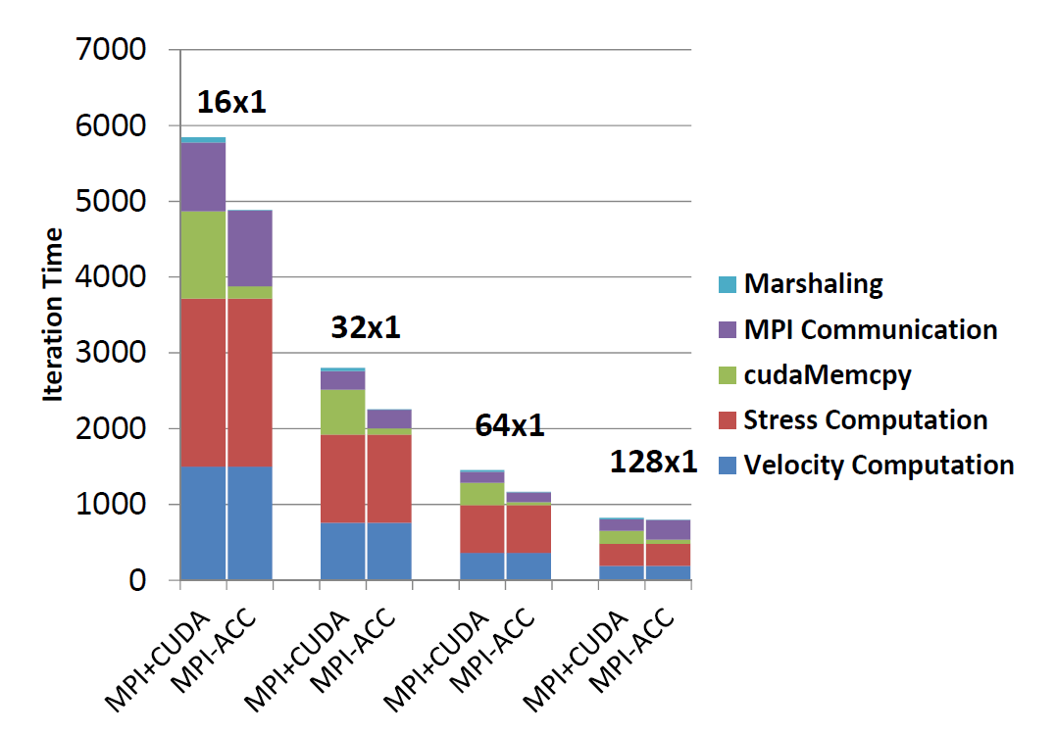
Case Study: Seismology
Up to 43% performance improvement
Trade-offs
  Data marshaling on CPU vs. GPU?
    GPU is better + cudaMemcpy is avoided
  Data communication from CPU vs. GPU?
    CPU is better because PCIe hop is avoided
“On the Efficacy of GPU-Integrated MPI for Scientific Applications”, Ashwin M. Aji, Lokendra S. Panwar, Feng Ji, Milind Chabbi, Karthik Murthy, Pavan Balaji, Keith R. Bisset, James Dinan, Wu-chun Feng, John Mellor-Crummey, Xiaosong Ma, and Rajeev Thakur. ACM International Symposium on High-Performance Parallel and Distributed Computing (HPDC), 2013

Slide 25
Programming Constructs for Matching Application and Memory Semantics

Slide 26
Data Placement and Semantics in Heterogeneous Memory Architectures
The memory usage characteristics of applications give the runtime system opportunities to place (and manage) data in different memory regions
  Read-intensive workloads that can get away with slightly slower memory bandwidth can use nonvolatile memory
  Workloads that have inherent errors in them might be able to get away with less-than-perfect memory reliability

Slide 27
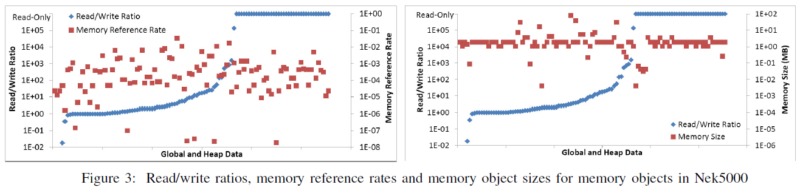
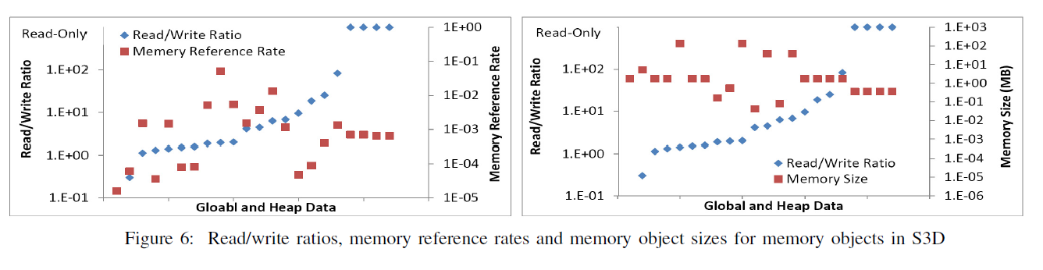
Measurement Results
D. Li, J.S. Vetter, G. Marin, C. McCurdy, C. Cira, Z. Liu, and W. Yu, “Identifying Opportunities for Byte-Addressable Non-Volatile Memory in Extreme-Scale Scientific Applications,” in IEEE International Parallel & Distributed Processing Symposium (IPDPS). Shanghai: IEEEE, 2012
Courtesy Jeff Vetter, Oak Ridge National Laboratory

Slide 28
Programming Model/Constructs Support for Memory Management
Example: Static memory allocation
Data movement constructs and annotations
  PGAS-like model to trap load/store accesses to predefined memory locations
  Read-intensive workloads with nonconflicting writes can be placed on NVRAM with store buffering
  Reordering and main memory caching can be internally employed by the runtime system
__nvram__ int X[100];
int foo(void) {
int x = X[15];
return 0;
}
int foo(void) {
int x = __nvram_bar(X + 15);
return 0;
}
Example: Dynamic Memory Migration
int X[100];
int foo(void) {
#pragma dmem read noconflict for
for (i = 0; i < 100; i++) {
Y[i] = X[i];
}
return 0;
}

Slide 29
Relaxed Memory Consistency
Inter-process/thread memory consistency can be expensive
  Full memory barriers can take up several hundreds of cycles today for DRAM
  With NVRAM or slower memory models, this can be much more expensive
Compiler/hardware provide eventuality semantics (data written by another process will “eventually” be visible to me); what “eventually” means can be different for different architectures
Are strict consistency semantics always critical?
In what cases can we relax these semantics?
Thread 0:
X = 1;
flag = 1;
Thread 1:
while (flag);
Y = X;
Need memory barriers

Slide 30
Summary
Memory heterogeneity is becoming increasingly common
  Different memories have different characteristics
Applications have already started investigating approaches to utilize these different memory regions
Programming environments, however, have traditionally treated main memory as a special entity for data placement and data movement
This can no longer be true – each memory architecture comes with its own set of capabilities and constraints – allowing applications to utilize each one of them as first-class citizens is critical

Slide 31
Relevant Publications
Ashwin M. Aji, Lokendra S. Panwar, Wu-chun Feng, Pavan Balaji, James S. Dinan, Rajeev S. Thakur, Feng Ji, Xiaosong Ma, Milind Chabbi, Karthik Murthy, John Mellor-Crummey and Keith R. Bisset. “MPI-ACC: GPU-Integrated MPI for Scientific Applications.” (under preparation for IEEE Transactions on Parallel and Distributed Systems (TPDS))
John Jenkins, Pavan Balaji, James S. Dinan, Nagiza F. Samatova, and Rajeev S. Thakur. “MPI Derived Datatypes Processing on Noncontiguous GPU-resident Data.” (under preparation for IEEE Transactions on Parallel and Distributed Systems (TPDS))
Ashwin M. Aji, Lokendra S. Panwar, Wu-chun Feng, Pavan Balaji, James S. Dinan, Rajeev S. Thakur, Feng Ji, Xiaosong Ma, Milind Chabbi, Karthik Murthy, John Mellor-Crummey and Keith R. Bisset. “On the Efficacy of GPU-Integrated MPI for Scientific Applications.” ACM International Symposium on High-Performance Parallel and Distributed Computing (HPDC). June 17-21, 2013, New York, New York
Ashwin M. Aji, Pavan Balaji, James S. Dinan, Wu-chun Feng and Rajeev S. Thakur. “Synchronization and Ordering Semantics in Hybrid MPI+GPU Programming.” Workshop on Accelerators and Hybrid Exascale Systems (AsHES); held in conjunction with the IEEE International Parallel and Distributed Processing Symposium (IPDPS). May 20th, 2013, Boston, Massachusetts
John Jenkins, James S. Dinan, Pavan Balaji, Nagiza F. Samatova and Rajeev S. Thakur. “Enabling Fast, Noncontiguous GPU Data Movement in Hybrid MPI+GPU Environments.” IEEE International Conference on Cluster Computing (Cluster). Sep. 28-30, 2012, Beijing, China
Feng Ji, Ashwin M. Aji, James S. Dinan, Darius T. Buntinas, Pavan Balaji, Rajeev S. Thakur, Wu-chun Feng and Xiaosong Ma. “DMA-Assisted, Intranode Communication in GPU Accelerated Systems.” IEEE International Conference on High Performance Computing and Communications (HPCC). June 25-27, 2012, Liverpool, UK
Ashwin M. Aji, James S. Dinan, Darius T. Buntinas, Pavan Balaji, Wu-chun Feng, Keith R. Bisset and Rajeev S. Thakur. “MPI-ACC: An Integrated and Extensible Approach to Data Movement in Accelerator-Based Systems.” IEEE International Conference on High Performance Computing and Communications (HPCC). June 25-27, 2012, Liverpool, UK
Feng Ji, James S. Dinan, Darius T. Buntinas, Pavan Balaji, Xiaosong Ma and Wu-chun Feng. “Optimizing GPU-to-GPU intra-node communication in MPI.” Workshop on Accelerators and Hybrid Exascale Systems (AsHES); held in conjunction with the IEEE International Parallel and Distributed Processing Symposium (IPDPS). May 25th, 2012, Shanghai, China

