Slide 1
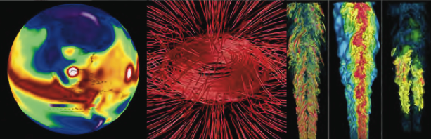
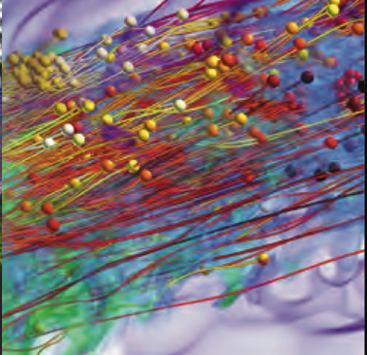
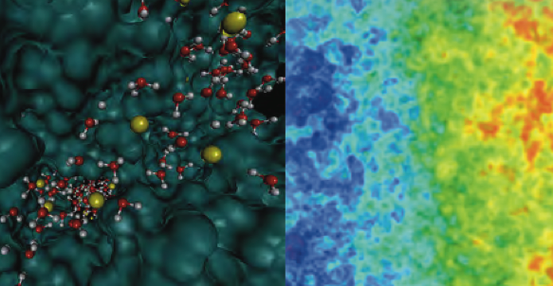
DEGAS:
Dynamic Exascale Global Address Space
Katherine Yelick, LBNL PI
Vivek Sarkar & John Mellor-Crummey, Rice
James Demmel & Krste Asanoviç UC Berkeley
Mattan Erez, UT Austin
Dan Quinlan, LLNL
Surendra Byna, Paul Hargrove, Steven Hofmeyr, Costin Iancu, Khaled Ibrahim, Leonid Oliker, Eric Roman, John Shalf, Erich Strohmaier, Samuel Williams, Yili Zheng, LBNL

Slide 2
DEGAS: Dynamic Exascale Global Address Space
Hierarchical Programming Models
Communication-Avoiding Compilers
Energy / Performance Feedback
Resilience
Adaptive Interoperable Runtimes
Lightweight One-Sided Communication
Integrated stack extends PGAS to be:
Hierarchical for machines and applications
Communication-avoiding for performance and energy

Slide 3
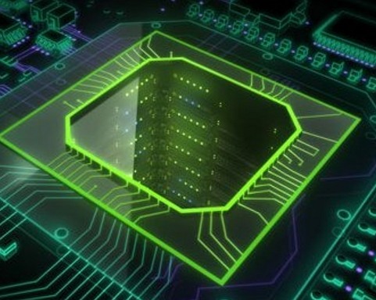
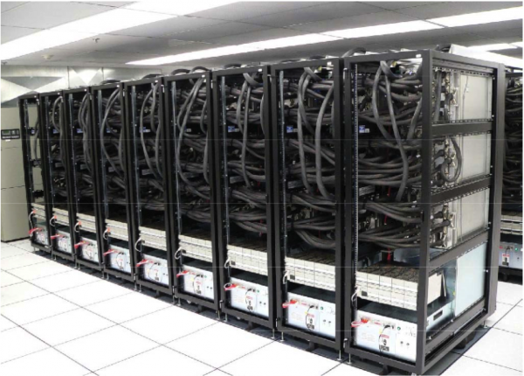
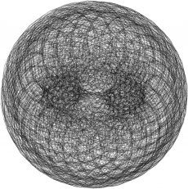
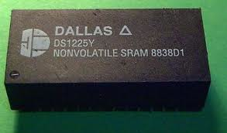
One-sided communication works everywhere
PGAS programming model
*p1 = *p2 + 1;
A[i] = B[i];
upc_memput(A,B,64);
It is implemented using one-sided communication: put/get
Support for one-sided communication (DMA) appears in:
Fast one-sided network communication (RDMA, Remote DMA)
Move data to/from accelerators
Move data to/from I/O system (Flash, disks,..)
Movement of data in/out of local-store (scratchpad) memory
Notes:
What is DMA? Use a title that is meaningful
Influenced MPI

Slide 4
Hierarchical PGAS (HPGAS) hierarchical memory & control
Single Program Multiple Data (SPMD) is too restrictive
Beyond (Single Program Multiple Data, SPMD)
Hierarchical locality model for network and node hierarchies
Hierarchical control model for applications (e.g., multiphysics)
0
2
4
6
1
0
3
5
7
1
2
3
Option 1: Dynamic parallelism creation
  Recursively divide until… you run out of work (or hardware)
Option 2: Hierarchical SPMD with “Mix-ins”
  Hardware threads can be grouped into units hierarchically
  Add dynamic parallelism with voluntary tasking on a group
  Add data parallelism with collectives on a group
Two approaches: collecting vs spreading threads

Slide 5
Scalability of UPC with Dynamism of Habanero-C
Combined UPC and Habanero-C demonstrated
Two possible approaches going forward: single compiler or library with overloading
Habanero-C offers asynchronous tasks scheduled dynamically
  Extended to work with MPI (Asynchronous Partitioned Global Name Space, has core/node for communication) [Chatterjee et al, IPDPS 2013]
UPC has static (SPMD) threading
Phalanx (based on C++) uses PGAS ideas globally with GPU support
  Provides a UPC++ like library using overloading and UPC runtime

Slide 6
PyGAS: Combine two popular ideas
Python
  No. 6 Popular on http://langpop.com and extensive libraries, e.g., Numpy, Scipy, Matplotlib, NetworkX
  10% of NERSC projects use Python
PGAS
  Convenient data and object sharing
PyGAS : Objects can be shared via Proxies with operations intercepted and dispatched over the network:
Leveraging duck typing:
  Proxies behave like original objects.
  Many libraries will automatically work.
num = 1+2*j
= share(num, from=0)
print pxy.real # shared read
pxy.imag = 3 # shared write
print pxy.conjugate() # invoke
Notes:
Large user base and active community

Slide 7
DEGAS: Dynamic Exascale Global Address Space
Hierarchical Programming Models
Communication-Avoiding Compilers
Energy / Performance Feedback
Resilience
Adaptive Interoperable Runtimes
Lightweight One-Sided Communication
Integrated stack extends PGAS to be:
Hierarchical for machines and applications
Communication-avoiding for performance and energy

Slide 8
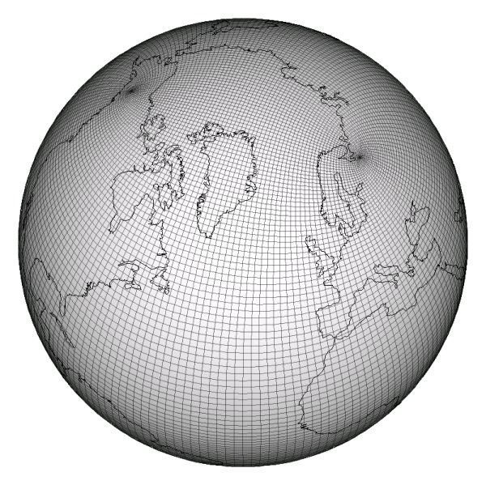
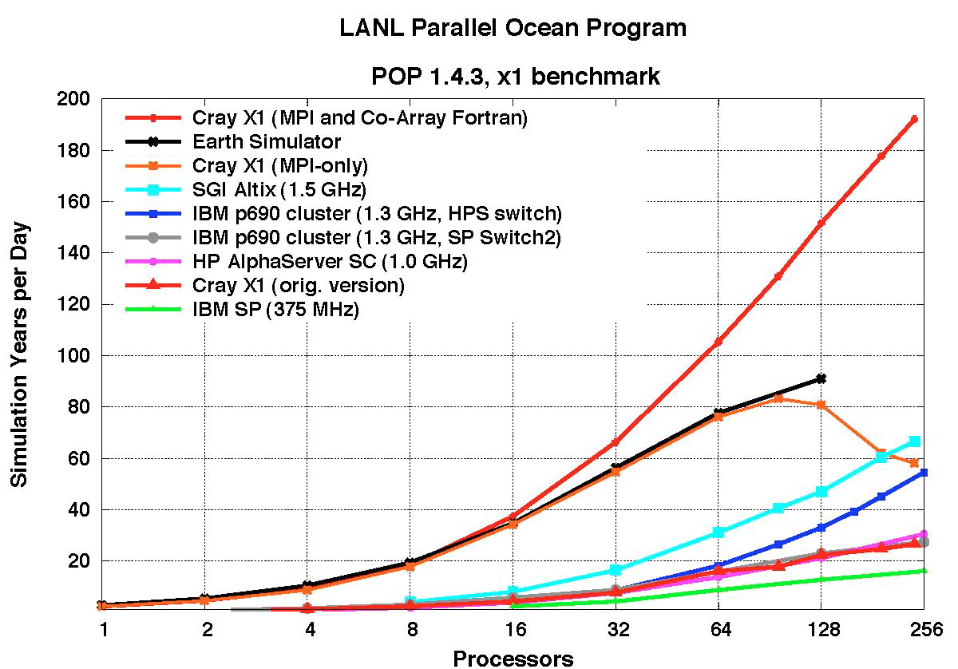
Co-Array Fortran (CAF) Demonstrates Efficiency of Overlap from One-Sided Communication
POP Ocean model has Co-Array version
  Communication-intensive (reductions and halo ghost exchanges)
  Historical: CAF faster than MPI on Cray X1
CAF 2.0 provides more programming
flexibility than original CAF
CGPOP mini-App in CAF 2.0
  Using HPCToolkit for tuning
  Limited by serial code (multi- dimensional array pointers) and parallel I/O (netCDF)
Worley et al results shown for historical context
See also Lumsdaine et al for Graph500, SC12

Slide 9
Towards Communication-Avoiding Compilers: Deconstructing 2.5D Matrix Multiply
x
k
y
z
y
z
j
x
i
Matrix Multiplication code has a 3D iteration space
Each point in the space is a constant computation (*/+)
for i, for j, for k
C[i,j] …
A[i,k] …
B[k,j] …
These are not just “avoiding,” they are “communication-optimal”

Slide 10
Generalizing Communication Optimal Transformations to Arbitrary Loop Nests
1.5D N-Body: Replicate and Reduce
The same idea (replicate and reduce) can be used on (direct) N-Body code:
1D decomposition → “1.5D”
Speedup of 1.5D N-Body over 1D
Does this work in general?
Yes, for certain loops and array expressions
Relies on basic result in group theory
Compiler work TBD
A Communication-Optimal N-Body Algorithm for Direct Interactions, Driscoll et al, IPDPS’13

Slide 11
Generalizing Communication Lower Bounds and Optimal Algorithms
For serial matmul, we know #words_moved = Ω (n³/M^{1/2}), attained by tile sizes M^{1/2} x M^{1/2}
  Where do all the ½’s come from?
Thm (Christ,Demmel,Knight,Scanlon,Yelick): For any program that “smells like” nested loops, accessing arrays with subscripts that are linear functions of the loop indices, #words_moved = Ω (#iterations/Me), for some e we can determine
Thm (C/D/K/S/Y): Under some assumptions, we can determine the optimal tiles sizes
Long term goal: All compilers should generate communication optimal code from nested loops
Notes:
Linear functions of the loop indices means subscripts can be j, j+3*k, 7*i-2*j+4*k, etc.
“Smells like” nested loops means sparse accesses, pointer references, etc are ok.
For example, this includes not just linear algebra, but direct n-body, database join, etc.
The theory to determine e requires some recent deep mathematical results using functional analysis
and group theory, due to a team of pure mathematicians including Mike Christ @ Berkeley, Terry Tao @UCLA, others.
The original characterization of e was not necessarily even decidable (Hilbert’s 10th problem over rationals), but
We think it is now decidable (still writing it up).
The assumptions in the second theorem are that
Dependencies permit us to reorder loop iterations as needed (matmul being an example)
Array subscripts are just subset of the loop indices (again like matmul, where loop indices are i,j,k, and
Subscripts are A(i,k), B(k,j), C(i,j)
We are still working on generalizing these assumptions.

Slide 12
Communication Overlap Complements Avoidance
Even with communication-optimal algorithms (minimized bandwidth) there are still benefits to overlap and other things that speed up networks
Communication Avoiding and Overlapping for Numerical Linear Algebra, Georganas et al, SC12

Slide 13
DEGAS: Dynamic Exascale Global Address Space
Hierarchical Programming Models
Communication-Avoiding Compilers
Energy / Performance Feedback
Resilience
Adaptive Interoperable Runtimes
Lightweight One-Sided Communication
Integrated stack extends PGAS to be:
Hierarchical for machines and applications
Communication-avoiding for performance and energy

Slide 14
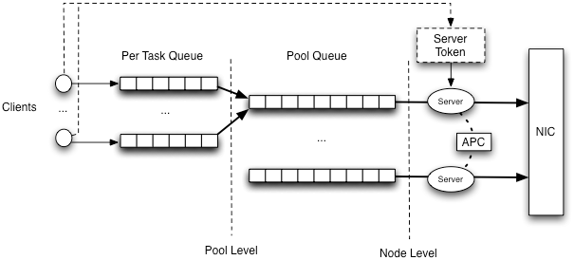
Resource management will require adaptive runtime systems
The value of throttling:
the number of messages in flight per core provides up to 4X performance improvements
the number of active cores per node can provide additional 40% performance improvement for
Developing adaptation based on history and (user-supplied) intent
Notes:
Too much stuff
Split into two slides

Slide 15
THOR: Throughput Oriented Runtime to Manage Resources
Juggle: Management of critical resources is increasingly important:
Memory and network bandwidth limited by cost and energy
Capacity limited at many levels: network buffers at interfaces, internal network congestion are real and growing problems
Having more than 4 submitting processes can negatively impact performance by up to 4x
Using overlap eliminates this problems
Notes:
Too much stuff
Split into two slides

Slide 16
Lithe Scheduling Abstraction: “Harts”: Hardware Threads
POSIX Threads
Harts
Hardware Partitions
App 2
App 1
App1
App2
Virtualized
Threads
Harts
(HW Thread Contexts)
OS
OS
0
1
2
3
0
1
2
3
Hardware
Hardware
• Merged resource and
computation abstraction.
• More accurate
resource abstraction.
Release planned for this spring with substantial rewrite
Separation of Lithe's API from OS functionality
Restructuring to support future preemption work.
Updated OpenMP and TBB ports.
Documentation: lithe.eecs.berkeley.edu

Slide 17
DEGAS: Dynamic Exascale Global Address Space
Hierarchical Programming Models
Communication-Avoiding Compilers
Energy / Performance Feedback
Resilience
Adaptive Interoperable Runtimes
Lightweight One-Sided Communication
Integrated stack extends PGAS to be:
Hierarchical for machines and applications
Communication-avoiding for performance and energy

Slide 18
DEGAS: Lightweight Communication (GASNet-EX)
GASNet-EX plans:
Congestion management: for 1-sided communication with ARTS
Hierarchical: communication management for H-PGAS
Resilience: globally consist states and fine-grained fault recovery
Progress: new models for scalability and
interoperatbility
Leverage GASNet (redesigned)
Major changes for on-chip interconnects
Each network has unique opportunities
Interface under design: “Speak now or….”
  https://sites.google.com/a/lbl.gov/gasnet-ex-collaboration/.
Berkeley UPC
GCC UPC
Chapel
Cray UPC/CAF
for Seastar
Titanium
Coarray
Fortran 2.0
Phalanx
GASNet
IBM
Cray
SGI
Infiniband
Ethernet
Intel
AMD
SUN
GPU
Shared
memory
Others

Slide 19


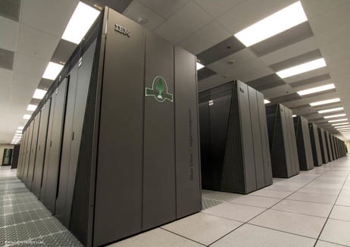
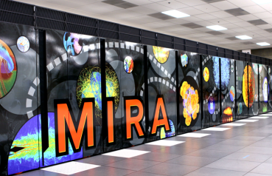
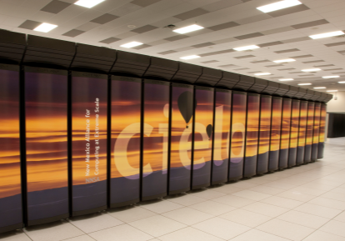
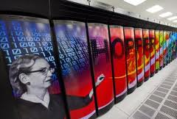
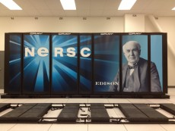
DOE is a world leader in HPC
Upgrades in the DOE computing landscape
  BG/Q (IBM custom interconnect, PAMI interfact)
  XK7 (Gemini interconnect)
  Cascade (Cray Aries interconnect)
November 2012
Titan at ORNL (#1, 17+ PF)
Sequoia at LLNL (#2, 16+ PF)
Mira at ANL
(#4, 8+ PF)
Cielo at LANL/SNL
( #18, 1+PF)
Hopper at LBNL (#19, 1+PF)
Performance increase on Gemini: 20% for CG, 40% for GUPPIE

Slide 20
DEGAS: Dynamic Exascale Global Address Space
Hierarchical Programming Models
Communication-Avoiding Compilers
Energy / Performance Feedback
Resilience
Adaptive Interoperable Runtimes
Lightweight One-Sided Communication
Integrated stack extends PGAS to be:
Hierarchical for machines and applications
Communication-avoiding for performance and energy

Slide 21
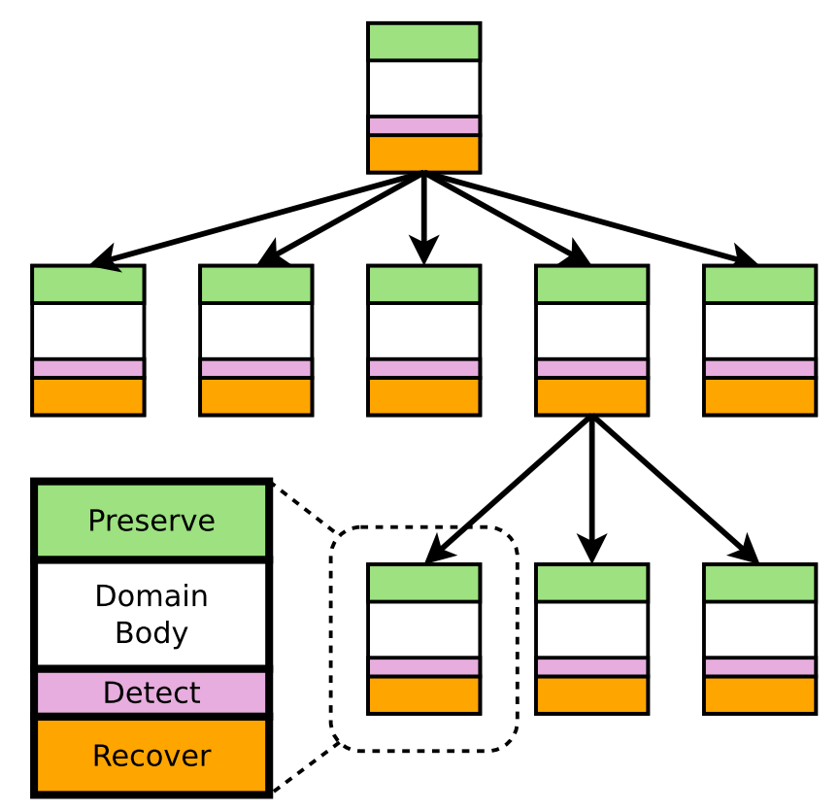
CDs Embed Resilience within Application
Components of a CD
Preserve data on domain start
Compute (domain body)
Detect faults before domain commits
Recover from detected errors
Single consistent abstraction
  Encapsulates resilience techniques
  Spans levels: programming, system, and analysis
Express resilience as a tree of CDs
  Match CD, task, and machine hierarchies
  Escalation for differentiated error handling
Recent work:
  Initial version of a CD-based resilience model for PGAS
  Identified required system support
  Reviewed prototype code from Cray that implements a subset of CD runtime
  Developed initial plans for “least common denominator” CD runtime implementation
Root CD
Child CD
Notes:
##Single Consistent abstraction##
1. One of the key aspects of containment domains are that they are single consistent abstraction.
2. Abstractions enable us to capture existing resilience techniques.
3. You can have a consistent way of expressing resilience concerns from application through analysis down to system implementation.
##Components##
4. To achieve that we express a program with a hierarchy of containment domains. Each containment domains has four components.
##Semantics##
5. In addition to four components, we require each containment domain to obey two simple semantics.
6. Errorneous data is never communicated out side of a containment domain.
7. Each containment domain provides some mechanism for recovery. It could be reexecution, re-generation of the data, or potentially because we have hierarchy of containment domains, some errors may not be efficiently tolerated in a certain containment domain level and instead the error can be escalated. If everything escalates all the way to the root it essentially matches global check point restart.
-------------------------------
Containment domain is a single consistent abstraction that encapsulates resilience concerns.
In addition to four components, we require each containment domain to obey two simple semantics.
No erroneous data is consumed by other domains.
Second, is that each cd provides
Recovery could be escalation.
If the overhead of handling the error at this level is too high, it gets escalated.
During the mapping, which error is handled at a level is decided.
Hierarchy and containment is key enabling mechanisms for handling errors efficiently. Also for simplifying the analysis.
--------------------------------------------------
Main points: Containment Domains encapsulates existing techniques + Erroneous data never communicated + Hierarchy
-> This makes analysis easy
-> Also makes error handled hierarchical -> thus efficient
If the overhead of handling the error at this level is too high, it gets escalated.
During the mapping -> which error is handled is decided -> if overhead is too high make them escalate.

Slide 22
DEGAS Resilience: Design Questions
DEGAS
Resilience
Research
Areas
How to define consistent (i.e. allowable) states in the PGAS model?
Theory well understood for fail-stop message-passing, but not PGAS.
2. How do we discover consistent states once we've defined them?
Containment domains offer a new approach, beyond conventional sync-and-stop algorithms.
3. How do we reconstruct consistent states after a failure?
Explore low overhead techniques that minimize effort required by applications programmers.
Leverage BLCR, GASnet, Berkeley UPC for development, and use Containment Domains as prototype API for requirements discovery
Application
implemented
recovery
Resilient UPC
Applications
Containment
Domains
Resilient PGAS Model
Resilient Runtime
Hybrid
Checkpoints
Durable State
Management
External Components
Legacy MPI
applications
System implemented
recovery
(e.g. BLCR)

Slide 23
DEGAS is combining efforts will produce a software stack
Resilience Support - Containment Domains + BLCR
Energy / Performance Feedback - IPM,Roofline
Proxy Applications, Numerical Libraries
PyGAS
Habanero-UPC
H-CAF
Python
SEJITS
Berkeley UPC
ROSE
Not DEGAS funding
Dynamic
Control
System
ARTS - Adaptive Run-Time System
GASNet-EX
Communication
Lithe – Resource Mgmt.
Task Dispatch
Hardware Threads
Accelerator Cores
General Purpose Cores
Network Interface
& I/O

Slide 24

Mechanisms, not Policies
PGAS + Mixins

Slide 25
DEGAS: Hierarchical Programming Model
Goal: Programmability of exascale applications while providing scalability, locality, energy efficiency, resilience, and portability
Implicit constructs: parallel multidimensional loops, global distributed data structures, adaptation for performance heterogeneity
Explicit constructs: asynchronous tasks, phaser synchronization, locality
Built on scalability,
performance, and
asynchrony of PGAS models
Language experience
from UPC, Habanero-C,
Co-Array Fortran,
Titanium
Both intra and inter-node;
focus is on node model
0
2
4
6
1
3
5
7
0
1
2
3

Slide 26
DEGAS: Hierarchical Programming Models
Languages demonstrate DEGAS programming model
Habanero-UPC: Habanero’s intra-node model with UPC’s inter-node model
Hierarchical Co-Array Fortran (CAF): CAF for on-chip scaling and more
Exploration of high level languages: E.g., Python extended with H-PGAS
Language-independent H-PGAS Features:
Hierarchical distributed arrays, asynchronous tasks, and compiler specialization for hybrid (task/loop) parallelism and heterogeneity
Semantic guarantees for deadlock avoidance, determinism, etc.
Asynchronous collectives, function shipping, and hierarchical places
End-to-end support for asynchrony (messaging, tasking, bandwidth utilization through concurrency)
Early concept exploration for applications and benchmarks
Notes:
Merge concepts into 2nd half of the slide
Emphasize demonstration
Separate 3 at top half of slide

Slide 27
DEGAS: Communication-Avoiding Compilers
Goal: massive parallelism, deep memory and network hierarchies, plus functional and performance heterogeneity
Fine-grained task and data parallelism: enable performance portability
Heterogeneity: guided by functional, energy and performance characteristics
Energy efficiency: minimize data movement and hooks to runtime adaptation
Programmability: manage details of memory, heterogeneity, and containment
Scalability: communication and synchronization hiding through asynchrony
H-PGAS into the Node
Communication is all data movement
Build on code-generation infrastructure
ROSE for H-CAF and Communication-
Avoidance optimizations
BUPC and Habanero-C; Zoltan
Additional theory of CA code generation
Notes:
John uses Hilbert curves to walk through the iteration space
Space-filling curves

Slide 28
Exascale Programming: Support for Future Algorithms
“C shadow”
Perfect Strong Scaling
k
“B shadow”
i
j
Solomonik, Demmel
“A shadow”
Approach: “Rethink” algorithms to optimize for data movement
New class of communication-optimal algorithms
Most codes are not bandwidth limited, but many should be
Challenges: How general are these algorithms?
Can they be automated and for what types of loops?
How much benefit is there in practice?

Slide 29
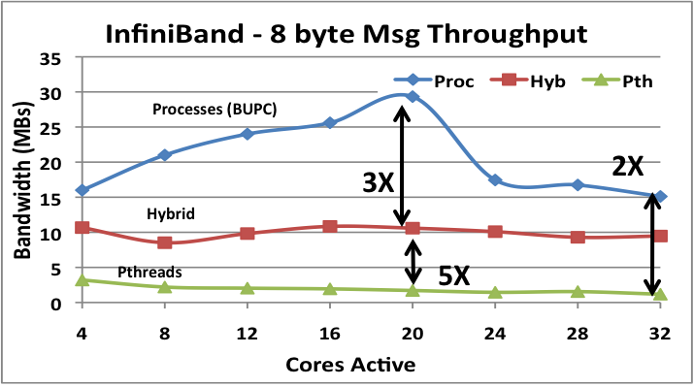
DEGAS: Adaptive Runtime Systems (ARTS)
Goal: Adaptive runtime for manycore systems that are hierarchical, heterogeneous and provide asymmetric performance
Reactive and proactive control for utilization and energy efficiency
Integrated tasking and communication: for hybrid programming
Sharing of hardware threads: required for library interoperability
Novelty: scalable control; integrated tasking with communication
Adaptation: Runtime annotated with performance history/intentions
Performance models: guide runtime optimizations, specialization
Hierarchical: resource / energy
Tunable control: Locality / load balance
Leverages: existing runtimes
Lithe scheduler composition; Juggle
BUPC and Habanero-C runtimes

Slide 30
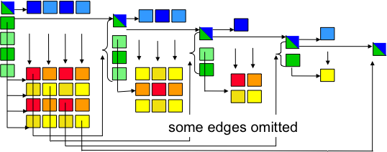
Synchronization Avoidance vs Resource Management
Management of critical resources will be more important:
Memory and network bandwidth limited by cost and energy
Capacity limited at many levels: network buffers at interfaces, internal network congestion are real and growing problems
Can runtimes manage these or do users need to help?
Adaptation based on history and (user-supplied) intent?
Where will bottlenecks be for a given architecture and application?
Resource management is complicated. Progress, deadlock, etc. are much more complex (or expensive) in distributed memory

Slide 31
Lithe Scheduling Abstraction: “Harts”: Hardware Threads
POSIX Threads
Harts
Hardware Partitions
App 2
App 1
App1
App2
Virtualized
Threads
Harts
(HW Thread Contexts)
OS
OS
0
1
2
3
0
1
2
3
Hardware
Hardware
• More accurate
resource abstraction.
• Let apps provide own computation abstractions
• Merged resource and
computation abstraction.

Slide 32
DEGAS: Lightweight Communication (GASNet-EX)
Goal: Maximize bandwidth use with lightweight communication
One-sided communication: to avoid over-synchronization
Active-Messages: for productivity and portability
Interoperability: with MPI and threading layers
Novelty:
Congestion management: for 1-sided communication with ARTS
Hierarchical: communication management for H-PGAS
Resilience: globally consist states and fine-grained fault recovery
Progress: new models for scalability and
interoperatbility
Leverage GASNet (redesigned)
Major changes for on-chip interconnects
Each network has unique opportunities
Berkeley UPC
GCC UPC
Chapel
Cray UPC/CAF
for Seastar
Titanium
Coarray
Fortran 2.0
Phalanx
GASNet
IBM
Cray
SGI
Infiniband
Ethernet
Intel
AMD
SUN
GPU
Shared
memory
Others

Slide 33
DEGAS: Resilience through Containment Domains
Goal: Provide a resilient runtime for PGAS applications
Applications should be able to customize resilience to their needs,
Resilient runtime that provides easy-to-use mechanisms
Novelty: Single analyzable abstraction for resilience
PGAS Resilience consistency model
Directed and hierarchical preservation
Global or localized recovery
Algorithm and system-specific detection, elision, and recovery
Leverage: Combined superset of prior approaches
Fast checkpoints for large bulk updates
Journal for small frequent updates
Hierarchical checkpoint-restart
OS-level save and restore
Distributed recovery
0
X
2
4
6
1
3
5
7

Slide 34
DEGAS Resilience: Research Questions
DEGAS
Resilience
Research
Areas
How to define consistent (i.e. allowable) states in the PGAS model?
Theory well understood for fail-stop message-passing, but not PGAS.
2. How do we discover consistent states once we've defined them?
Containment domains offer a new approach, beyond conventional sync-and-stop algorithms.
3. How do we reconstruct consistent states after a failure?
Explore low overhead techniques that minimize effort required by applications programmers.
Leverage BLCR, GASnet, Berkeley UPC for development, and use Containment Domains as prototype API for requirements discovery
Application
implemented
recovery
Resilient UPC
Applications
Containment
Domains
Resilient PGAS Model
Resilient Runtime
Hybrid
Checkpoints
Durable State
Management
External Components
Legacy MPI
applications
System implemented
recovery
(e.g. BLCR)

Slide 35
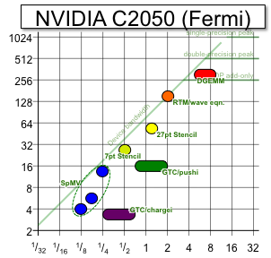
DEGAS: Energy and Performance Feedback
Goal: Monitoring and feedback of performance and energy for online and offline optimization
Collect and distill: performance/energy/timing data
Identify and report bottlenecks: through summarization/visualization
Provide mechanisms: for autonomous runtime adaptation
Novelty: Automated runtime introspection
Provide monitoring: power / network utilization
Machine Learning: identify common characteristics
Resource management: including dark silicon
Leverage: Performance / energy counters
Integrated Performance Monitoring (IPM)
Roofline formalism
Performance/energy counters
Notes:
By “dim” silicon I mean memory, NoC, or cores underclocked to hit a power contstraint

Slide 36

DEGAS Pieces of the Puzzle
Communication-Avoiding optimization in Rose
Containment Domains with state capture
GASNet-EX to avoid synchronization
Lithe for managing hardware threads
H-PGAS (C/F) for generating DSL code; intra node locality management

Slide 37
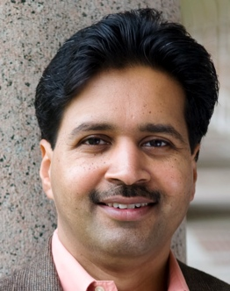
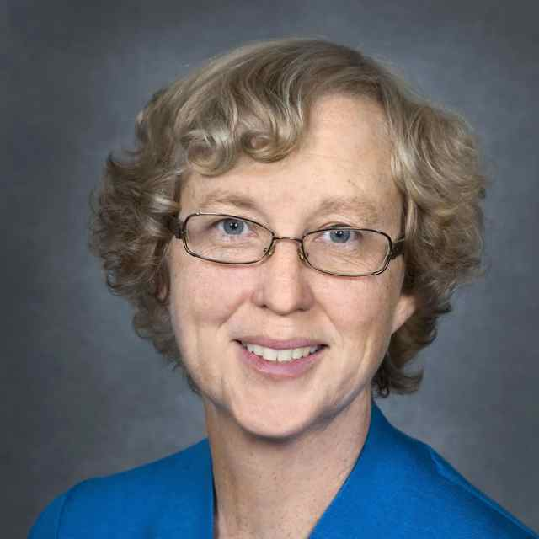




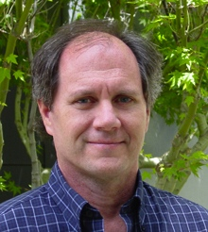





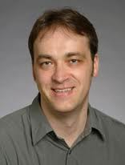

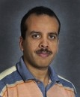






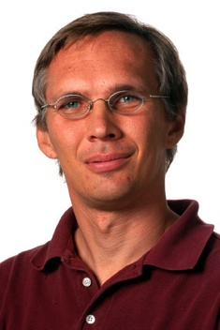

Team Members
Vivek Sarkar Kathy Yelick John MC Costin Iancu Paul Hargrove John Shalf Dan Quinlan
Brian VS Yili Zheng Mattan Erez Lenny Oliker Jim Demmel Krste Asanovic Eric Roman Khaled I.
Tony Erich Armando Steve Surendra David Frank Sam
Drummond Strohmaier Fox Hofmeyer Bayna Skinner Mueller Williams

Slide 38
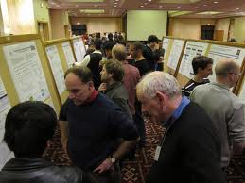
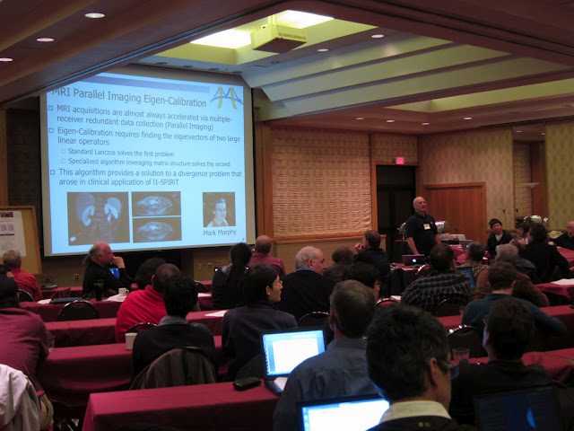
DEGAS Retreats Highlight and Encourage Integration
Semi-annual 2-day meeting of entire team, stakeholders
  Application and Vendor Advisory groups
Updates on progress, open problems, plans
Demos showing integration of tools and driving applications
Enforces teamwork, demos for milestones and progress metrics
Feedback from team and stakeholders to refine goals and effort
Long tradition of retreats at UC Berkeley
  Many successful large projects (from RAID to ParLab)

