Slide 1
Exploiting Global View for Resilience (GVR)
An Outside-In Approach to Resilience
Andrew A. Chien
X-stack PI Meeting @ LBNL
March 20-22, 2013

Slide 2



Project Team
University of Chicago: Chien (PI), Dr. Hajime Fujita, Zachary Rubenstein, Prof. Guoming Lu
Argonne: Pavan Balaji (co-PI), James Dinan, Pete Beckman, Kamil Iskra
HP Labs: Robert Schreiber
Application Partnerships
  Future Nuclear Reactor Simulation (Andrew Siegel, CESAR)
  Computational Chemistry (Jeff Hammond, ALCF)
  Rich Computational Frameworks (Mike Heroux, Sandia)
  ... and more!...

Slide 3
Outline
Global View Resilience (GVR)
Progress
Next Steps

Slide 4
Global View Resilience
Global-view Data
Data-oriented Resilience
Applications
System
“Just add Resilience” Incremental application resilience
  “Outside in”, as needed, incremental, ... “end to end”
  Rising resilience challenges; manage in flexible application-driven context
Global view Data-oriented resilience
  Express globally consistent snapshots
  Express error handling and recovery with global view
Application-System x-layer Partnership
  Applications: Exposes algorithm and application domain knowledge
  System: reifies and exposes hardware and system error
Portable, efficient interface for resilience

Slide 5
Data-oriented Resilience based on Multi-versions
Phases create new
logical versions
Checking,
Efficient coverage
App-semantics
based recovery
Parallel applications and Global-view data
Frames invariant checks, more complex checks based on high-level semantics
Frames system, HW, OS, runtime errors
Can be implemented efficiently with hardware support
Enables rollback and forward (sophisticated) recovery on per global-view data item basis

Slide 6
x-Layer App-System Error Checking and Handling
Open Reliability
Applications
Runtime
OS
Architecture
GVR
Interface
Effective Resilience,
Efficient Implementation
Exploit semantics from many layers (app, rt, os arch)
Manage redundancy, storage, checks efficiently
  Temporal redundancy -- Multi-version memory, integrated memory and NVRAM management
  Push checks to most efficient level (find early, contain, reduce ovhd)
  Recover based on semantics from any level (repair more, larger feasible computation, reduce ovhd)
Recover effectively from many more errors

Slide 7
Outline
Global View Resilience (GVR)
Progress
  Design: GVR API and Architecture
  Implement: Initial Prototype
  Modeling: Latent Errors
Next Steps

Slide 8
GVR Application Interface
Global view creation
  New, federation interfaces
Global view data access
  Data access, consistency
Versioning
  Create persistent copies, restore
Error handling
  Capture and handle system errors, application errors
  Flags application errors
  Recover based on application semantics and versioned state

Slide 9
Application Lifecycle* – Error Handling
put(), get(),
version_inc()
resume()
Running
Error Recovery
put(), get()
general computation
raise_error()
recovery
Error Handling Dispatch
move_to_prev()
move_to_next()
descriptor_clone()
*Can be “partial application” life cycle.

Slide 10
Unified Signalling and Recovery
application_check()
Mapping
runtime_check()
OS_signal ()
raise_error(gds, error_desc)
Hardware_error ()
other()
Unified Signalling (HW, OS, runtime, application)
Application-defined error checking
Application-defined handling

Slide 11
Dispatch and Recovery
Correct
Recompute
raise_error(gds,
e_desc)
Dispatch
resume(gds)
Reload
Rollback
Error description and Dispatch
Error recovery
Resume Application
Customized error handling
  Simple - paired notification and recovery routines
  Enhanced as resilience challenges and recovery capabilities increase
Exploit x-layer information and semantics
Approximate
Restart
Fail

Slide 12

GVR System Architecture
Applications
Global View Service
Provides API
…
Distributed Metadata Service
Provides global-view, distributed metadata, versions, and consistency
Client side
Distributed Storage Service
Manages the latest array
…
Distributed Recovery Management Service
Manages old versions, resilience, data transformations
Target side
Block Storage
Local Resilient Data Store
Local data store, data transformation
Data
DRAM
Flash

Slide 13
GVR Prototype
It works! Basic implementation
But...
  Simple versioning
  Simple error handling
  Not high performance
  Not highly scalable
However...
  Good enough to enable app and application experiments
  Good enough to enable GVR system implementation research
Demo in Resilience Technology Marketplace

Slide 14
GVR applied to miniFE
miniFE: mini-application for unstructured implicit Finite Element codes
1. Calculate matrix A and vector b
2. Solve the linear system with CG
  Generate a better approximation of x with each iteration
  Additional state preserved in direction vector p and residual vector r
  Each iteration involves parallel DAXPY, matrix vector product, and dot product
  Computation has parallel for loops and reductions
Simple demonstration of Global view, Error checking & signaling, Error recovery

Slide 15
GVR-enhanced miniFE Skeleton
GDS_status_t handle_error(gds, local_buffer{
GDS_get(local_buffer, gds);
GDS_resume();
}
void cg_solve() {
for each iteration {
if ((old_residual - new_residual) / old_residual > TOL){
GDS_raise_error(gds_r, r);
recalculate_residual();
}
if (iteration % CP_INTERVAL == 0) {
GDS_put(r, gds_r); }
do_calculation(); }
}
Error
Handler
Error
Check
Save
Soln state

Slide 16
MiniFE Execution (fault injection)

Slide 17
Discussion
Simple example
  Captures critical state vector
  Restores when residual is incorrect
More ambitious use
  Coverage of other structures (A matrix, check, restore)
  Versioning to recover from latent errors
  Selective recovery and rollback
  GVR as primary data store
Next Steps: Larger application studies, programming system experiments, etc.

Slide 18
Latent Errors and Multi-version Snapshots
Guoming Lu, Ziming Zheng, and Andrew A. Chien, ”When are Multiple Checkpoints needed?”, to appear in Fault Tolerance at Extreme Scale, (FTXS), June 2013.

Slide 19
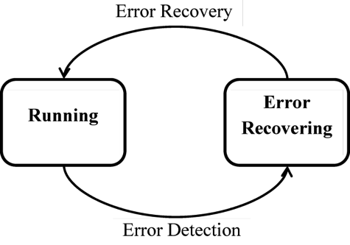
Fail-stop vs. Latent Errors
Error Recovery
Running
Error Latent
Error Detected
Error
Detected
Error Generation
Error Detection
Fig. 1.a Fail-stop Model
Fig. 1.b Latent Error Model
Existing resilience systems mostly assume “Fail-stop”
“Silent”, delayed errors are likely to be a growing problem.
Why? Increasing variety of errors, cost of checking.
  More subtle hardware and software errors (small data perturbation, small data structure perturbation, minor divergence)
  More expensive checks (scrubbing, x-structure, x-node, symmetry data structure, energy conserve, ....)

Slide 20

Versions Needed for Error Coverage
  where
As detection latency increases, at expected error rates, many versions are needed to cover errors.

Slide 21
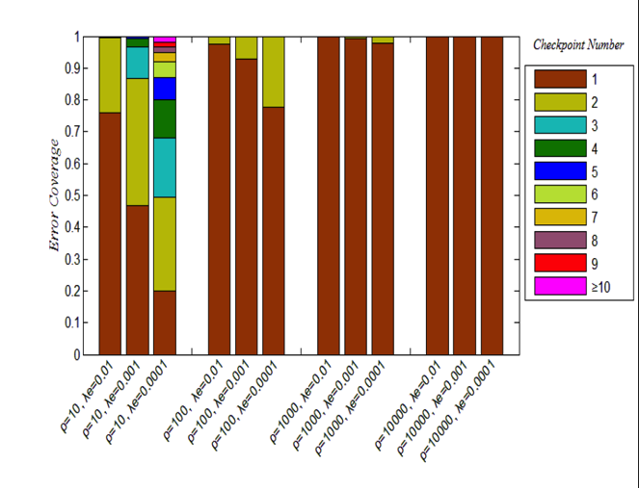
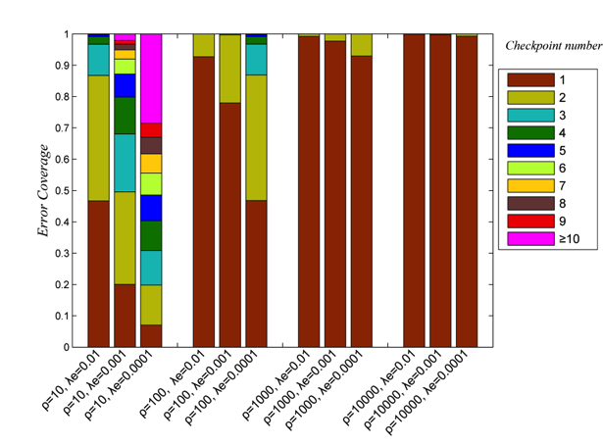
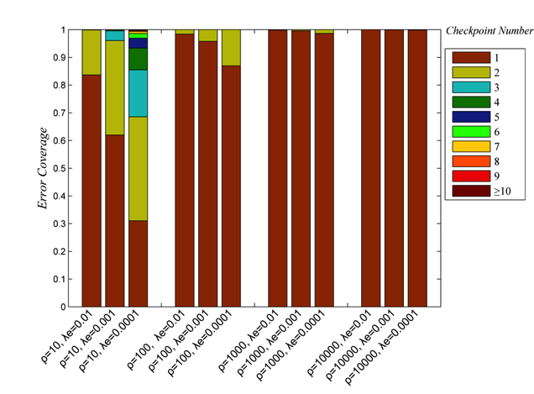
Versions and Error Coverage
δ=1
δ=10
If error detection latency is low (large ρ, fail stop”), 1-2 versions are sufficient.
Higher latency, the number of versions increase significantly.
Reduced checkpoint overhead increases need for more versions.
δ=30

Slide 22
Exascale Scenarios (Latent Errors)
Table 2: Exascale scenarios: Achievable effciency and least version requirements compared with single version scheme( the checkpoint interval is set to K times of optimal interval). δ= 5, R = 5 for traditional checkpoint system. δ= 1, R = 1 for optimized. ρ= 10 for both.
 | Traditional |  |  | Optimized(SCR)
λe(per minute) | versions(K) | Ef of K-Version | Ef of 1-Version | versions(K) | Ef of K-Version | Ef of 1-Version)
0.3 | 2 | 0.107 | NA | 3 | 0.370 | NA
0.1 | 3 | 0.298 | NA | 4 | 0.566 | NA
0.03 | 4 | 0.489 | NA | 5 | 0.692 | NA
0.01 | 4 | 0.656 | NA | 8 | 0.787 | NA
0.003 | 5 | 0.756 | 0.039 | 11 | 0.836 | NA
0.001 | 7 | 0.826 | 0.267 | 16 | 0.866 | 0.261
Maximum achievable efficiency for long running jobs (ρ=10)
Multi-version required for usable efficiency at high error rates, many versions required
Multi-version benefit increases with
  Lower error rates (rework)
  Lower checkpoint cost (coverage)

Slide 23
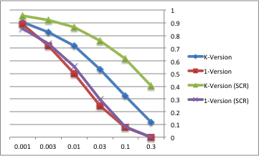
Exascale Efficiency (Latent Errors)
System
Efficiency
Error Rate
(errors/minute)
To increase resilience to latent errors, increase 1-version checkpoint beyond “optimal”, (ρ=500)
Multi-version enables much higher efficiency
Multi-version much better, particularly at high error rates

Slide 24
Bottom Line
Need to worry about latent errors (detection delay)
Multi-version can help, and serves as an insurance policy
Optimized checkpointing increases need for multi-version
Error detection latency reduction (containment) is a critical research area

Slide 25
GVR Next Steps
Refine API, based on co-design apps and other experiments (OpenMC, Trilinos, ...)
  Explore GVR capabilities match with common application structures – refine API and demonstrate potential
Continue implementation, towards a full API, and robust functionality
  Explore efficient implementation of redundant, distributed global-view data structures, snapshot consistency and capture
  Explore efficient multi-version storage techniques, redundancy, compression, and restoration
Work with OS/runtime community on cross-layer error handling classification and naming
More Multi-version analysis...

Slide 26
GVR X-stack Synergies
Applications
Applications
Applications
Petsc
Trilinos
...
PM
#1
PM
#2
PM
#3
...
...
GVR
...
...
GVR
...
...
GVR
GVR
GVR
Direct Application Programming Interface
  Co-existence, even targetted by other Runtimes
Rich Solver Library Building Block
Programming System Target

Slide 27
Publications
Guoming Lu, Ziming Zheng, and Andrew A. Chien, When are Multiple Checkpoints Needed?, to appear in Fault Tolerance at Extreme Scale, (FTXS), June 2013.
Hajime Fujita, Robert Schreiber, Andrew A. Chien, It's Time for New Programming Models for Unreliable Hardware, in ACM Conference on Architectural Support for Programming Languages and Operating Systems, March 18-20, 2013. (Provocative Ideas session).
The Global View Resilience Application Programming Interface, Version 0.71, February 2013.
Prior relevant work
Sean Hogan, Jeff Hammond, and Andrew A. Chien, An Evaluation of Difference and Threshold Techniques for Efficient Checkpointing, 2nd workshop on fault-tolerance for HPC at extreme scale FTXS 2012 at DSN 2012

