Slide 2
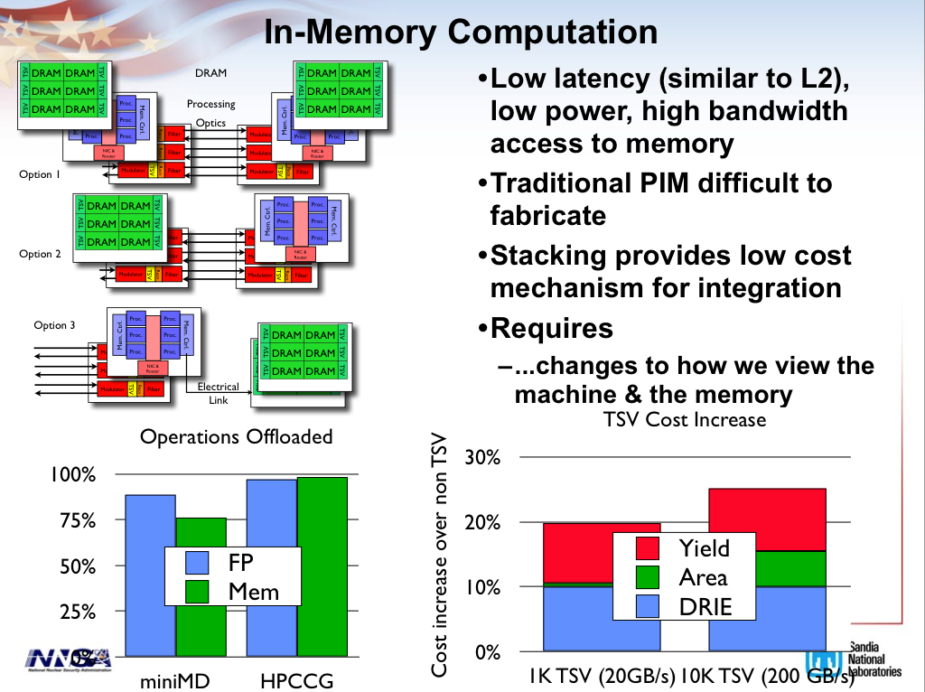

Slide 3
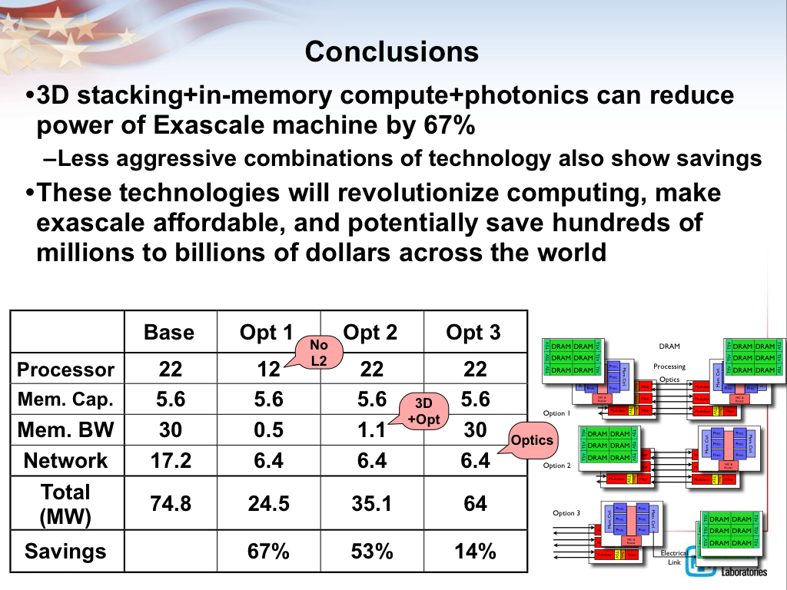

Slide 4
Recent Accomplishments/Use Cases

Slide 5
Static Compiler Analysis
Cy Chan and Didem Unat
(joint work with ExaCT)
Developed on top of the ROSE framework
For each module/subroutine in input code
  Collect function level information
    Local and non-local variables
    Data arrays: read-only, write-only, read-write
    Communications between processes
  Collect loop level information
    Iteration range and stride
    Arithmetic operation counts
    State variables: locals, parameters, arguments
    Data arrays: access types and patterns
Currently takes Fortran codes and outputs an XML

Slide 6
Proxy Applications
SMC is compressible Navier Stokes solver
  Uses the same discretization approach as the petascale application code S3D
  Simplified set of boundary conditions
  Uses eight-order finite difference approximation in space and a low-storage Runge-Kutta algorithm in time.
CNS is compressible Navier Stokes
  Does not include chemical species
  Uses constant coefficient transport properties

Slide 7
SMC code
with 53 species
Even though transcendentals and division ops might be low in count, they can dominate the CPU time

Slide 8
Register Requirements for SMC
Chemistry FP State Variables by Rank
x86 has 16 FP named registers!
Allocate to registers
Leave in L1 cache

Slide 9
Impact of Software Optimization on CNS Cache/Bandwidth Trade-Off
Up to 45% improvement for blocking and 90% for fusion

Slide 10
SMC Performance Projections
Neither software optimizations alone nor hardware optimizations alone will not get us to the exascale, we have to apply both.
Neither software optimizations alone nor hardware optimizations alone will not get us to the exascale, we have to apply both.

Slide 11
Ranking arrays by the read/write ratios and write access rates
NVRAM is not friendly to write references

Slide 12
ReadWrite Ratio > 5,
NVRAM percentage 35%
Write Access Rate <= 0.11%,
NVRAM percentage 75%
Using RW ratio might be misleading. RW ratio > 5 goes to NVRAM (only 35% of the data)
If a write access rate of <=0.11% is chosen, then 75% of memory footprint qualifies for NVRAM
  Roughly 75% idle power savings but the dynamic energy will go up by a factor of 4 to 40
  Need power simulations for more accurate results

Slide 13
Auto-Skeletonization
(LLNL and Sandia)
GOAL: Generate a reduced program that retains the performance characteristics of the original.
Reduced program ideal for use in simulation environment : remove computations that aren’t relevant with respect to performance aspect of interest (e.g., message passing performance).
Our approach uses static analysis and code transformation via ROSE with user guidance for fine tuning skeletonization process.

Slide 14
Analysis and Simulation Components

Slide 15
Static analysis
Static single assignment form provided by ROSE defines data dependency information for program.
Resolution of interprocedural data dependencies based on transitive closure of program call graph.
Data dependency graph is labeled based on role data plays with respect to an API (such as MPI).
  Roles include “payload”, “comm. topology”, etc.
  Allows dependencies to be treated differently depending on how they affect the API calls.
Annotation guidance to inject user-knowledge not available purely from static analysis.
  Many properties are data dependent. E.g.: expected iteration counts for iterative solvers.
  Annotations were important in applying skeletonizer to real programs.

Slide 16
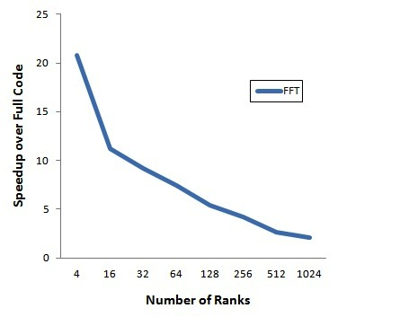
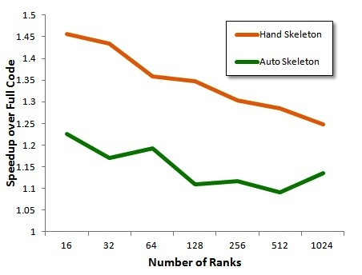
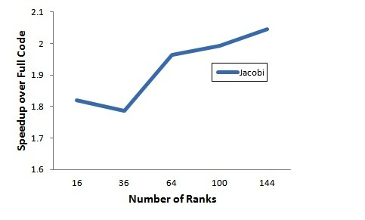
Preliminary results
Three case studies in paper: 2D FFT; 2D Jacobi; Sandia Mantevo HPCCG benchmark.
Summary:
  All generated skeletons were smaller and ran faster than original code under simulation with the SST/Macro simulator.
  Skeletons matched hand-coded skeletons for cases where these existed (HPCCG, FFT).
FFT
HPCCG
Jacobi

Slide 17
Current work
Whole-program dependency analysis for programs with many distinct compilation units.
Working with pre-processor and conditional compilation.
  NAS benchmarks is complicated by problem size selection occurring at compiler time. Would like to create one skeleton, not one per problem size.
Continuation of memory footprint skeleton generator initiated in 2012. Allows a second performance dimension to be studied in addition to message passing performance.

Slide 18
Mixed Model Simulation
(Sandia & LBNL)
Accomplishment: Create flexible, modular, interoperable simulation environment using SystemC Industry standard
  More agile environment to rapidly configure experiments to answer questions posed by vendors and CoDesign centers
  Enables accurate multiscale evaulation of energy costs for data movement

Slide 19
NVRAM Simulation
(LBNL and U. Penn)
Accomplishment: Created validated simulator for NVRAM components using Micron and Samsung data
  Enable study of in-situ I/O
  Motivated serve SDMA work in ExaCT Codesign Center

Slide 20
NVRAM Simulation for Advanced PRAM Architecture Studies
Architecture study of multi-layer cross-point RRAM architecture (In collaboration with HP Labs and Adesto)
  High-density (shared wordlines and bitlines reduce area cost)
  Parallel data access among multiple layers
  Bi-group operation scheme
Identified new memory organization for RRAM that overcomes traditional sources of failure and demonstrated its effectiveness with architectural simulation
Paper accepted for publication in Usenix FAST13 conference on Design of Large Scale Storage
Arch Study of Multi-layer Cross-point RRAM Architecture
High-density (shared wordlines & bitlines reduce area cost)
Parallel data access among multiple layers
Bi-group operation scheme
Simulation of conventional single slab RRAM
Limited cell read parallelism
Spends majority of time on cell reads
Simulation of multi-slab RRAM
Drastically improves internal bandwidth
Saturates bus channel and avoids common
Failure modes for memresistive technology
Proposed multi-slab RRAM Architecture

Slide 21
Fault Injection for Resilience Research
(LLNL and LBNL)
Accomplishment: Create flexible hardware simulation environment to support fault resilience research
  Helps ROSE Triple Modular Redundancy (TMR) Research
  Will support emerging Resilience research projects

Slide 22
Thank You!
Please visit
http://www.nersc.gov/projects/CoDEx
For more information!

