Slide 1
DynAX
Innovations in Programming Models, Compilers and Runtime Systems for Dynamic Adaptive Event-Driven Execution Models
X-Stack: Programming Challenges, Runtime Systems, and Tools
Brandywine Team
May2013

Slide 2
Objectives
Scalability | Expose, express, and exploit O(10¹⁰) concurrency
Locality | Locality aware data types, algorithms, and optimizations
Programmability | Easy expression of asynchrony, concurrency, locality
Portability | Stack portability across heterogeneous architectures
Energy Efficiency | Maximize static and dynamic energy savings while managing the tradeoff between energy efficiency, resilience, and performance
Resilience | Gradual degradation in the face of many faults
Interoperability | Leverage legacy code through a gradual transformation towards exascale performance
Applications | Support NWChem

Slide 3




Brandywine Xstack Software Stack
NWChem + Co-Design Applications
Rescinded Primitive Data Types .
HTA
(Library)
R-Stream
(Compiler)
SCALE
(Compiler)
E.T. International, Inc.
SWARM
(Runtime System)
E.T. International, Inc.

Slide 4
SWARM
MPI, OpenMP, OpenCL
SWARM
VS.
Time
Time
Active threads
Waiting
Communicating Sequential Processes
Bulk Synchronous
Message Passing
Asynchronous Event-Driven Tasks
Dependencies
Resources
Active Messages
Control Migration

Slide 5
SWARM
Principles of Operation
  Codelets
    Basic unit of parallelism
    Nonblocking tasks
    Scheduled upon satisfaction of precedent constraints
  Hierarchical Locale Tree: spatial position, data locality
  Lightweight Synchronization
  Active Global Address Space (planned)
Dynamics
  Asynchronous Split-phase Transactions: latency hiding
  Message Driven Computation
  Control-flow and Dataflow Futures
  Error Handling
  Fault Tolerance (planned)

Slide 6
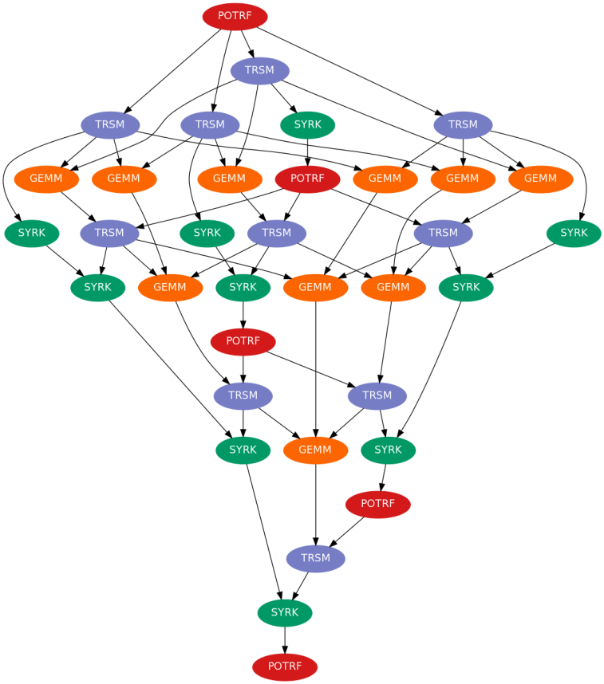
Cholesky DAG
POTRF → TRSM
TRSM → GEMM, SYRK
SYRK → POTRF
Implementations:
  OpenMP
  SWARM
POTRF
TRSM
SYRK
GEMM
1:
2:
3:

Slide 7
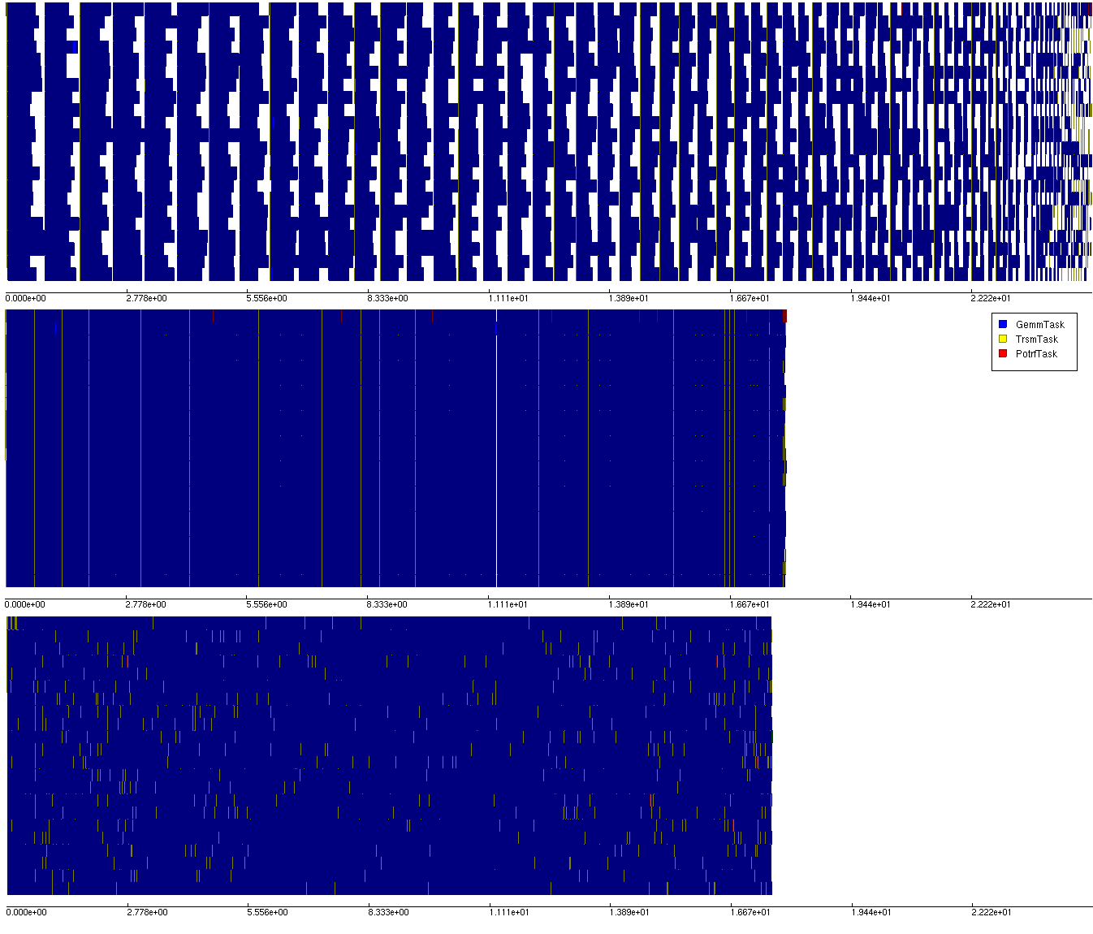
Cholesky Decomposition: Xeon
Naïve OpenMP
Tuned OpenMP
SWARM

Slide 8
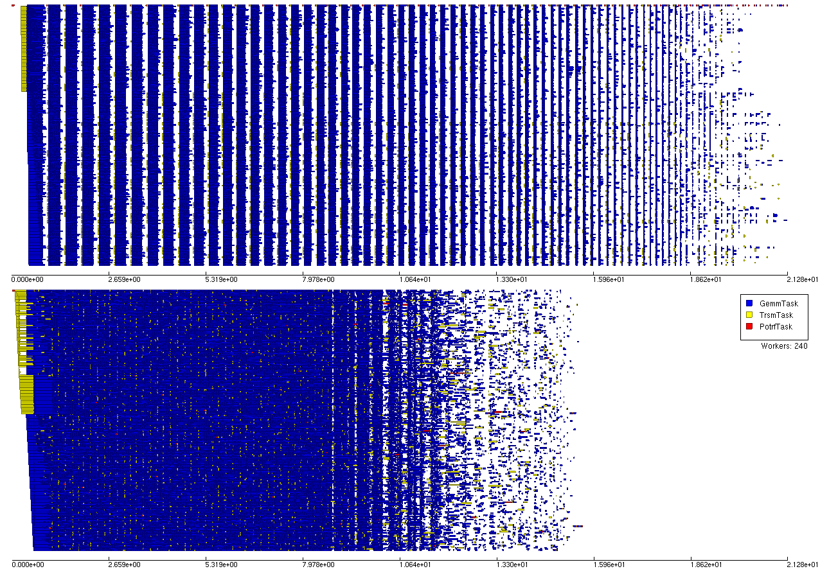
Cholesky Decomposition: Xeon Phi
OpenMP
SWARM
Xeon Phi: 240 Threads
OpenMP fork-join programming suffers on many-core chips (e.g. Xeon Phi).
SWARM removes these synchronizations.

Slide 9
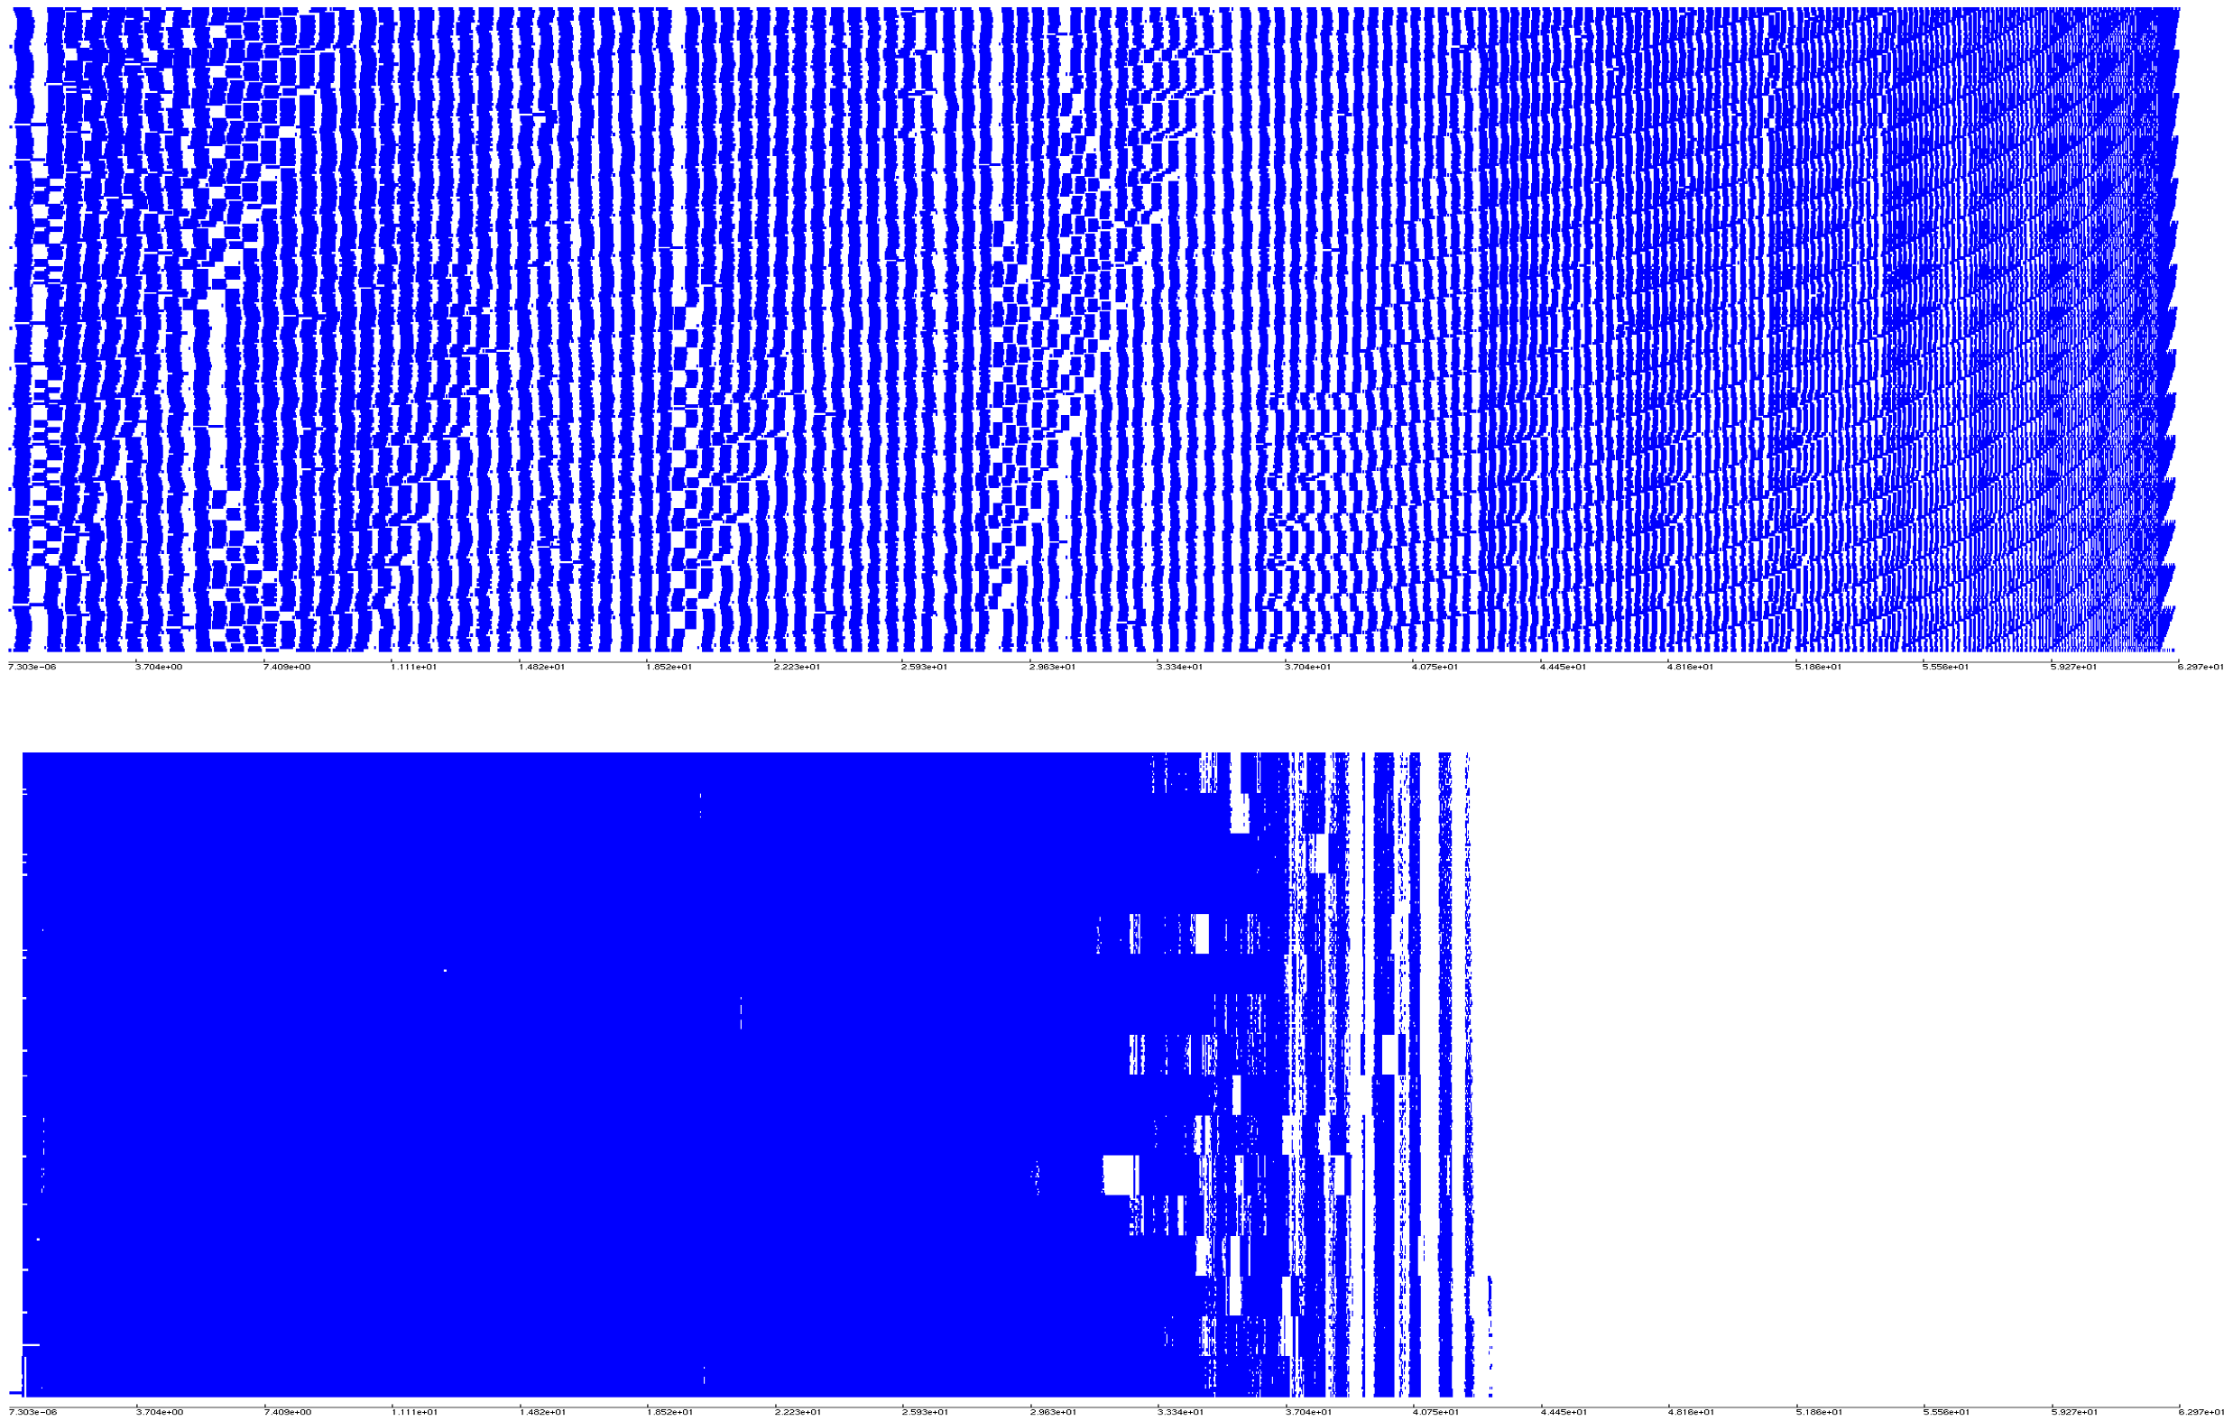
Cholesky: SWARM vs ScaLapack/MKL
ScaLapack
SWARM
16 node cluster: Intel Xeon E5-2670 16-core 2.6GHz
Asynchrony is key in large dense linear algebra

Slide 10
Code Transition to Exascale
Determine application execution, communication, and data access patterns
Find ways to accelerate application execution directly.
Consider data access pattern to better lay out data across distributed heterogeneous nodes.
Convert single-node synchronization to asynchronous control-flow/data-flow (OpenMP -> asynchronous scheduling)
Remove bulk-synchronous communications where possible (MPI -> asynchronous communication)
Synergize inter-node and intra-node code
Determine further optimizations afforded by asynchronous model.
Method successfully deployed for NWChem code transition

Slide 11
Self Consistent Field Module From NWChem
NWChem used by 1000’s of researchers
Code is designed to be highly scalable to petaflop scale
Thousands of man-hours expensed on tuning and performance
Self Consistent Field (SCF) module is a key component of NWChem
ETI has worked with PNNL to extract the algorithm from NWChem to study how to improve it.
  As part of the DOE XStack program

Slide 12
Serial Optimizations

Slide 13
Single Node Parallelization

Slide 14
Multi-Node Parallelization

Slide 15
Information Repository
All of this information is available in more detail at the Xstack wiki:
  http://www.xstackwiki.com

Slide 16
Questions?

Slide 17
Acknowledgements
Co-PIs:
  Benoit Meister (Reservoir)
  David Padua (Univ. Illinois)
  John Feo (PNNL)
Other team members:
  ETI: Mark Glines, Kelly Livingston, Adam Markey
  Reservoir: Rich Lethin
  Univ. Illinois: Adam Smith
  PNNL: Andres Marquez
DOE
  Sonia Sachs, Bill Harrod

