Slide 1
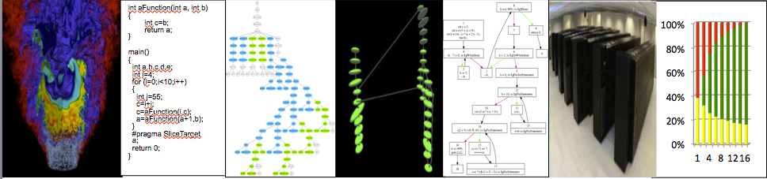



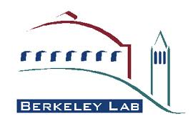



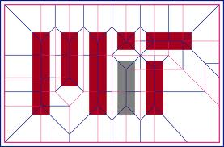
D-TEC
Techniques for Building
Domain Specific Languages (DSLs)
2012 X-Stack: Programming Challenges, Runtime Systems, and Tools - LAB 12-619
Daniel J. Quinlan
Lawrence Livermore National Laboratory
(Lead PI)
Co-PIs and Institutions: Massachusetts Institute of Technology: Saman Amarasinghe, Armando Solar-Lezama, Adam Chlipala, Srinivas Devadas, Una-May, O’Reilly, Nir Shavit, Youssef Marzouk; Rice University: John Mellor-Crummey & Vivek Sarkar; IBM Watson: Vijay Saraswat & David Grove; Ohio State University: P. Sadayappan & Atanas Rountev; University of California at Berkeley: Ras Bodik; University of Oregon: Craig Rasmussen; Lawrence Berkeley National Laboratory: Phil Colella; University of California at San Diego: Scott Baden.

Slide 2
DSLs are a Transformational Technology
D-TEC
Domain Specific Languages (DSLs)
Domain Specific Languages capture expert knowledge about application domains. For the domain scientist, the DSL provides a view of the high-level programming model. The DSL compiler captures expert knowledge about how to map high-level abstractions to different architectures. The DSL compiler’s analysis and transformations are complemented by the general compiler analysis and transformations shared by general purpose languages.
There are different types of DSLs:
  Embedded DSLs: Have custom compiler support for high level abstractions defined in a host language (abstractions defined via a library, for example)
  General DSLs (syntax extended): Have their own syntax and grammar; can be full languages, but defined to address a narrowly defined domain
DSL design is a responsibility shared between application domain and algorithm scientists
Extraction of abstractions requires significant application and algorithm expertise
We have an application team at 7.5% of the total funding
  provide expertise that will ground our DSL research
  ensure its relevance to DOE & enable impact by the end of three years
Saman and Dan merged efforts to provide the strongest possible proposal specific to DSLs; the merged effort will be led by Dan at LLNL
Notes:
Define DSL
1) DSL capture expert knowledge of the domain
2) relationship to the Programming Model
3) DSL compiler
4) DSL compiler analysis and transformations
Why DSLs are important for HPC/Exascale:
1) DSLs address how we will manage complexity; via domain-specific high-level abstractions. DSLs are then a mechanism for packaging the semantics of the high level abstractions. What makes this important in a Exascale program is that we expect Exascale architectures to be more complex.
2) DSLs are not new, some examples:
* Matlab and Mathematica
* Adding compiler support for MPI (embedded DSL)
* Matrix, Array, and Mesh abstractions (data distribution, parallel semantics)
* MAPLE (adding symbolic analysis and code generation support for higher-order stencils)
3) Expected impact:
* Performance Portability: Generation of lower level code tailored to architecture
* Programmability: A consequence of using high-level abstractions
* Resiliency: Many different types of errors (soft errors: addressed through TMR code generation)
* Correctness: Benefits from semantics of high-level abstractions
4) Emphasize the importance to Programmability and Performance
* Results only useful if we balance Programmability and Performance
There are different types of DSLs, broadly there are:
1) Embedded DSLs, where custom compiler support for high level abstractions is defined as a part of compiling the host language (C, C++, Fortran). The optimization of library abstractions to form DSLs is an example of this.
2) General DSL with added syntax of whole new syntax can be extended languages or full languages.
Finally, we have an application focus so that we can:
provide expertise that will ground our DSL research, and
ensure its relevance to DOE & enable impact by the end of three years
X Provide forward reference to “Scientific Impact” slide

Slide 3
D-TEC
Project Goal: Making DSLs Effective for Exascale (1 of 2)
We address all parts of the Exascale Stack:
  We will provide effective performance by addressing Exascale challenges:
  Our approach includes interoperability and a migration strategy:
Languages (DSLs) | define and build several DSLs economically
Compilers | define and demonstrate the analysis and optimizations required to build DSLs
Parameterized Abstract Machine | define how the hardware is evaluated to provide inputs to the compiler and runtime
Runtime system | define a runtime system and resource management support for DSLs
Tools | design and use tools to communicate to specific levels of abstraction in the DSLs
Scalability | deeply integrated with state-of-art X10 scaling framework
Programmability | build DSLs around high levels of abstraction for specific domains
Performance Portability | DSL compilers give greater flexibility to the code generation for diverse architectures
Resilience | define compiler and runtime technology to make code resilient
Energy Efficiency | machine learning and autotuning will drive energy efficiency
Correctness | formal methods technologies required to verify DSL transformations
Heterogeneity | demonstrate how to automatically generate lower level multi-ISA code
Interoperability with MPI + X | demonstrate embedding of DSLs into MPI + X applications
Migration for Existing Code | demonstrate source-to-source technology to migrate existing code
Notes:
We are addressing the full software stack
We define 5 stack components as …
Languages and libraries instantiate the programming models: our focus is on how to build DSLs economically
Compilers are essential to the translation of DSL to generate lower level code: our focus is on how the analysis and optimizations required for DLS
Parameterized Abstract Machines permit a simplification of the hardware: Our work uses these to drive the static optimizations in the compiler and dynamic optimizations in the runtime
Runtime system will be used to support the execution of applications using DSLs
Tools research will focus on how to map data between the levels of DSL abstraction and tools to support the migration process of existing codes to use DSL
There are specific challenges in this proposal; we have listed these with our response to each…
Interoperability will be addressed: We will demonstrate how to embed DSLs into MPI + X applications
Migration of existing codes will be addressed using source-to-source compiler translation. We will demonstrate source-to-source translation of existing code to use DSLs

Slide 4
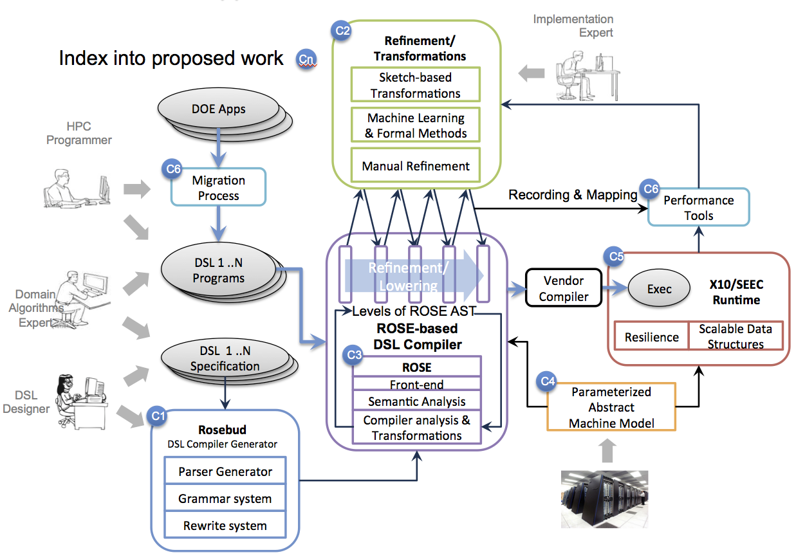
D-TEC
Project Goal: Making DSLs Effective for Exascale (2 of 2)
Focus of D-TEC for DSLs
  How to build them
  How they can work together (composability)
  What program analysis they require
  How to handle code generation from them
  How to scale the performance to Exascale
  How tools can work with DSLs
  What abstractions are essential to DOE HPC
  Examples of DLS demonstrating these ideas
Exceptions
Full-range of proposed Exascale Software Stack is addressed, except:
  Operating Systems (OS)
  Applications
  Tools

Slide 5
D-TEC
Canonical Exascale Node
To provide context, assume a canonical exascale node architecture:
Heterogeneous cores, including accelerator support
Vector hardware
Hierarchical memory
Separate memory spaces
NUMA
Multiple domains for cache coherence
Lots of hardware parallelism
Some off-node network connection topology.
Possible Canonical Exascale Node
Memory
Memory
Main Memory
Device Memory
Cache
Cache
SIMD
SIMD
Cache
Cache
SIMD
SIMD
Cache Coherent Domains
“thin” core
“fat”core
Accelerators (GPUs)

Slide 6
D-TEC
Team Members
Name | Expertise
Massachusetts Institute of Technology
Armando Solar-Lezama | DSLs, Compilers, Program Synthesis
Adam Chlipala | Formal methods
Fredrik Berg Kjolstad | DSLs
Hank Hoffman | Adaptive runtime systems
Jason Ansel | Autotuning, Machine learning
Michael Carbin | Resiliency, Compilers
Rohit Singh | Program Synthesis
Saman Amarasinghe | DSLs, Compilers, Autotuning, Machine Learning
Nir Shavit | Scalable runtime systems
Stelios Sidiroglou-Douskos | Resiliency, Compilers
Una-May O’Reilly | Machine learning, autotuning
Youssef Morzouk | Uncertainty quantification, Resiliency
Rice University
Zoran Budimlic | Compilers, Parallel Runtime systems
Michael Burke | Program Analysis, Compilers
Vincent Cave | Front-ends, Translators, Software Engineering
Philippe Charles | Parsers, Front-ends, Translators
Michael Fagan | Performance tools, languages, applied mathematics
John Mellor-Crummey | Performance tools, compilers
Zung Nguyen | Software engineering, Applied Mathematics
Vivek Sarkar | Parallel Languages, Compilers, Runtimes
Scott W. Warren | Languages, Compilers
Jisheng Zhao | Optimizing Compilers
Lai Wei | Machine Models
University of California, San Diego
Scott Baden | Tools, Runtime, Legacy Migration
Name | Expertise
Lawrence Livermore National Laboratory
Dan Quinlan | Compilers, Embedded DSLs, Computational Mathematics
Chunhua “Leo” Liao | Compilers, OpenMP, Program Analysis
Markus Schordan | Compilers, Program Analysis, Verification
Justin Too | Compiler Testing
Lawrence Berkeley National Laboratory
Brian van Straalen | Computational Mathematics
Emina Torlak | DSLs, Compilers, Program Synthesis
Phil Colella | Computational Mathematics
Ras Bodik | DSLs, Compilers, Program Synthesis
IBM Thomas J. Watson Research Center
Avraham E Shinnar | Type systems, Theorem proving
Benjamin Herta | System and network programming
David Grove | Compilers, Runtime systems
David Cunningham | Compilers, Runtime systems
Olivier Tardieu | Scalable Runtime Systems, Compilers
Vijay Saraswat | Language design, Type systems, DSLs
Ohio State University
Louis-Noel Pouchet | Polyhedral analysis
Atanas (Nasko) Rountev | Static and dynamic compiler analysis
P. (Saday) Sadayappan | Optimizing compilers, Polyhedral analysis
University of Oregon
Craig Rasmussen | Fortran Parsers, Compilers

Slide 7
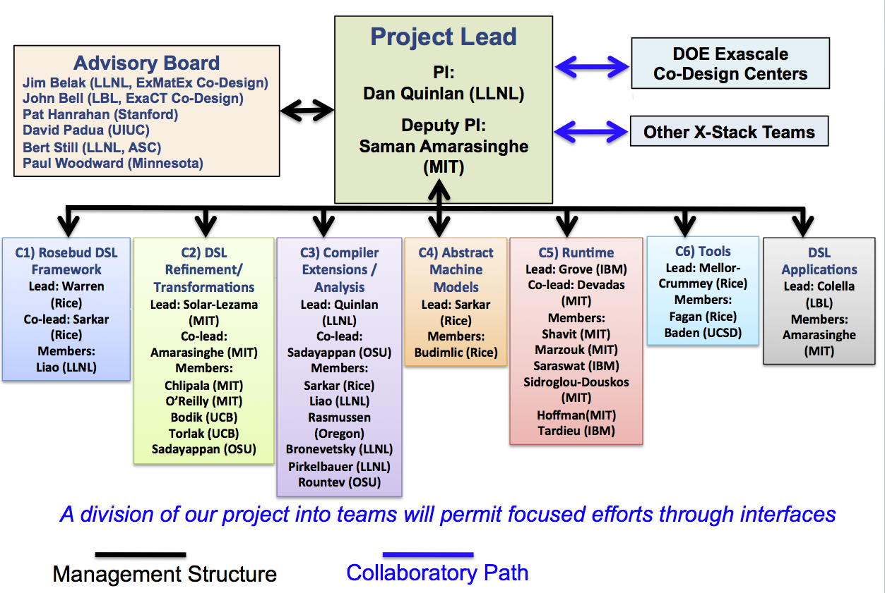
D-TEC
Management Plan & Collaboration Paths
(with Advisory Board and Outside Community)
Notes:
Slide 22: Management plan and project execution plan
Organizational view of the project:
- Team leads of the two merged proposals
- ties to DOE Exascale Co-design centers and other X-Stack teams
- The project will have an advisory board that has experience in HPC, DSL, DOE applications, …
advisory board members
- The project is divided into sub-teams, where each team is responsible for the development
of one component as defined on the previous slide
sub-team leads
One mechanism to achieve the coordination across teams is to work with specified APIs on sub-project boundaries.
Many (senior) team members are part of more then one sub-team, which also helps distribute relevant information
… thus the information is available for autonomous decision making.

Slide 8
D-TEC
Rosebud – Translator’s Plugin Architecture
Rosebud Generator reads RDL and produces a plugin
Application developer writes mixed-language source code
  using existing DSL plugins or newly created ones
Rosebud Translator translates mixed-language source code to pure host language
  loads specified set of plugins dynamically
Vendor toolchain compiles translated code to executable

Slide 9
D-TEC
Rosebud – Two-phase Parsing for Custom-Syntax DSLs
Code in host language + multiple DSLs
mixed in same source file
  DSLs ⇒ expressive custom notations
  host ⇒ standard general-purpose language
  mixed ⇒ expressive, readable, maintainable
Phase 1: parse & extract DSL code
  SGLR parser supports union of languages
  build & preserve DSL AST subtrees
  replace DSL constructs by markers
Phase 2: parse host language code
  existing ROSE front end (C++, Fortran, etc.)
  inserted markers are syntactically correct
  host-language semantic analysis
Merge DSL tree fragments into host AST
  replace marker nodes by DSL subtrees
  DSL semantic analysis
  detection of embedded-DSL constructs

Slide 10
D-TEC
DSL Refinement and Transformations – Overview
We want to satisfy some competing goals:
  Allow domain experts to code in high-level DSLs without sacrificing performance
  Allow performance experts to exert control over the code that is generated
    but without breaking the code
    and without having to reimplement everything by hand
    and without having to become compiler experts
    and without having to reinvent the wheel every time

Slide 11
D-TEC
DSL Refinement and Transformations –
Technologies: Sketch Based Synthesis
Programmer provides the structure of the solution
Synthesizer derives low level details
Motivation:
  Support manual refinement
    In many cases, expert has a good idea of how to implement a particular algorithm
    Synthesis can make this process more efficient and less error prone
Talk by Armando and Saman later this afternoon

Slide 12
D-TEC
Compiler Extensions and Analysis –
Compiler Research Approach
Front-end:
  Language capabilities
    Languages requirements: C, Fortran, C++, X10, OpenCL, CUDA
    DSLs: connection to Rosebud DSL framework
  Intermediate Representation (IR) extensibility
Mid-end:
  Program Analysis:
    Compositional Data-Flow Analysis
    Existing program analysis in ROSE is ongoing work
  Program Transformations:
    New AST Builder API and implementation
    Connection to Stratego formal rewrite system
Back-end (code generation):
    Connection to LLVM (recently updated to LLVM 3.2)
    GPU code generator
    Source-to-Source code generation

Slide 13
D-TEC
Compiler Extensions and Analysis –
Exascale Challenges
Resilience
  Resiliency research work (touching on the compiler)
    TMR generated as needed based on user directives
    Resiliency models of applications derived from binary analysis
Energy Efficiency
  Power optimizations for Exascale architectures
    API defined for controlling processor power usage
    Compiler analysis (mixed source code and binary analysis) to detect resource usage
    Compiler transformations to source code to implement power optimizations
Heterogeneity
  GPU code generation support
    MINT compiler for stencil codes in C (from UCSD)
    OpenMP Accelerator Interface support (more general GPU support) and part of open source OpenMP compiler released in ROSE
    OpenACC pragma handling as part of ongoing OpenACC research and a future open research implementation (OpenACC is typically proprietary, like OpenMP)
Compiler Challenges
  Compiler support across multiple languages
    Compiler construction: Front-end, IR
    Analysis & Transformations: language dependent and independent support
  DSLs add more issues (addressed jointly within Rosebud research)

Slide 14
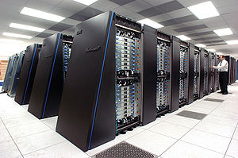
D-TEC
Abstract Machines –
Compiler Optimizations Driven by Parameterized Abstract Machine Models (C4)
  The parameterized abstract machine model is informed by an analysis of micro-benchmarks and then provides a set of cost models used to drive optimizations. This approach permits the compiler and runtime system to be tailored to different architectures to provide portable performance across a wide range of future architectures and cost analysis to be evaluated with levels of abstraction simpler than the final hardware.
We will leverage existing technologies:
  PACE project at Rice (former DARPA AACE project)
  Habanero Hierarchal Place Tree (HPT)
We will develop new technologies:
  Development of parameterized abstract machine to model nodes and networks
  Encapsulate the abstract machine to a library for use in DSL optimization
We will advance the state-of-the-art:
  Use of abstract machine by both DSL compiler and runtime system
Exascale challenges:
  Scalability: addressed by the network model, to be leveraged by the compiler and runtime
  Programmability: Isolates hardware details away from users
  Performance Portability: Exposes selected hardware details to the compiler and runtime
Interoperability and Migration Plans:
  Interoperability: The same abstract machine will be shared within the DSL infrastructure
C4
Parameterized
Abstract
Machine Model
Notes:
b. Outline for sub-team presentations:
1. What research is being done
2. What are the approaches and technologies
3. What are the challenges
4. What are the dependences (internal and external)
5. What are the deliverables
6. What will be the impact

Slide 15
D-TEC
Runtime – Overview
Runtime Team Objectives:
  Leverage X10 Runtime to develop APGAS Runtime
    Support Asynchronous Partitioned Global Address Space programming model at scale for multiple languages (X10, C++, C, Fortran, etc.)
    Support interoperability between APGAS and MPI based applications
    ROSE compiler, including Rosebud DSLs & Sketching, will target APGAS runtime
  Enhance X10/APGAS Runtime for Exascale
    Increased system scale (beyond current Petascale results)
    Introduce “areas” for increased intra-node concurrency and heterogeneity
  Develop Adaptive runtime system for resilience & power efficiency
    Builds on MIT SEEC runtime (adaptive resource usage)
    Explore Runtime System implications of Uncertainty Quantification and Algorithm-Based Fault Tolerance

Slide 16
D-TEC
Tools and Legacy Code Modernization –
Tools for Legacy Code Modernization
Incrementally add DSL constructs to legacy codes
  Replace performance-critical sections by DSLs
  Our “mixed-DSLs + host language” architecture supports this
Manual addition of DSL constructs is low risk
Semi-automatic addition of DSL constructs is promising
  Recognize opportunities for DSL constructs using same pattern-matching as in rewriting system
  Human could direct, assist, verify, or veto
Fully automatic rewriting of fragments to DSL constructs may be possible
Benefits
  Higher performance using aggressive DSL optimization
  Performance portability without a complete rewrite

Slide 17
D-TEC
Tools and Legacy Code Modernization –
Tools for Understanding DSL Performance
Challenges
  Huge semantic gap between embedded DSL and generated code
  Code generation for DSLs is opaque, debugging is hard,
  and fine-grain performance attribution is unavailable
Goal: Bridge semantic gap for debugging &
performance tuning
Approach
  Record information during program compilation
    two-way mappings between every token in source & generated code
    transformation options, domain knowledge, cost models, and choices
  Monitor and attribute execution characteristics with instrumentation and sampling
    e.g., parallelism, resource consumption, contention, failure, scalability
  Map performance back to source, transformations, and domain knowledge
  Compensate for approximate cost models with empirical autotuning
Technologies to be developed
  Strategies for maintaining mappings without overly burdening DSL implementers
  Strategies for tracking transformations, knowledge, and costs through compilation
  Techniques for exploring and explaining the roles of transformations and knowledge
  Algorithms for refining cost estimates with observed costs to support autotuning
T1
…
Tn

Slide 18
D-TEC
Applications –
Goals and Impacts
Goal:
  Assure that the infrastructure developed here will be broadly applicable across DOE modeling and simulation domains.
Approach:
  Use Exascale Co-Design Center applications as focus for evaluation.
  Integration of applications team into design process.
Evaluation Criteria:
  Performance on next-generation platforms.
  Expressiveness: support for domain specific-abstractions that enhance ease of implementation.
  Software scalability: ability to support the development of complex combinations of application-specific code and domain-specific cross-cutting libraries.

Slide 19
D-TEC
Applications –
Evaluation Process
Miniapps and other applications components are obtained from the Co-Design Centers, plus other sources (e.g. Mantevo) as well as additional applications as specified by the DOE program management.
Implementations are translated into high-level mathematical specifications (algorithm components). These components are used as a basis for design of DSLs.
Algorithm components are implemented in DSLs, with resulting implementations used to evaluate the DSL based on the criteria in the previous slide.
The overall process is iterative
  DSL infrastructure will change in response to the evaluation process, and the modified infrastructure will be subjected to the same process.
  The body of algorithmic components will change as part of the co-design process.
Notes:
Bullet 3: applications typically factor out algorithmic components that are heaviiy used across multiple problems, which are implemented as optimized libraries. The DSL needs to support the larger combination of libraries and problem-specific code.

Slide 20
D-TEC
Techniques for Building
Domain Specific Languages (DSLs)
2012 X-Stack: Programming Challenges, Runtime Systems, and Tools - LAB 12-619
Daniel J. Quinlan
Lawrence Livermore National Laboratory
(Lead PI)
Co-PIs and Institutions: Massachusetts Institute of Technology: Saman Amarasinghe, Armando Solar-Lezama, Adam Chlipala, Srinivas Devadas, Una-May, O’Reilly, Nir Shavit, Youssef Marzouk; Rice University: John Mellor-Crummey & Vivek Sarkar; IBM Watson: Vijay Saraswat & David Grove; Ohio State University: P. Sadayappan & Atanas Rountev; University of California at Berkeley: Ras Bodik; University of Oregon: Craig Rasmussen; Lawrence Berkeley National Laboratory: Phil Colella; University of California at San Diego: Scott Baden.

