Slide 1
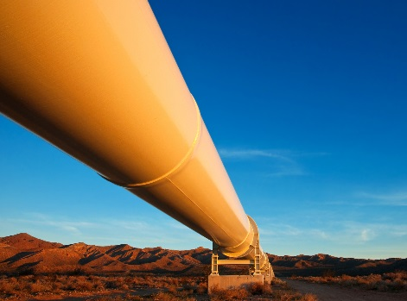
DEGAS Software Technologies Pipeline
Communication-Avoiding Algorithms
CA Compiler,
CD for PGAS,
End-to-End Resilience,
Snowflake
Theories and Designs
UPC++,
Habanero-UPC++,
AMR, Chemistry, Genomics, Machine Learning, Seismic
TRL 1-2
Research Prototypes
TRL 2-5
Application Demonstrations
UPC, GASNet, BLCR
TRL 5-6
Production Software
TRL 8-9

